Slide 1
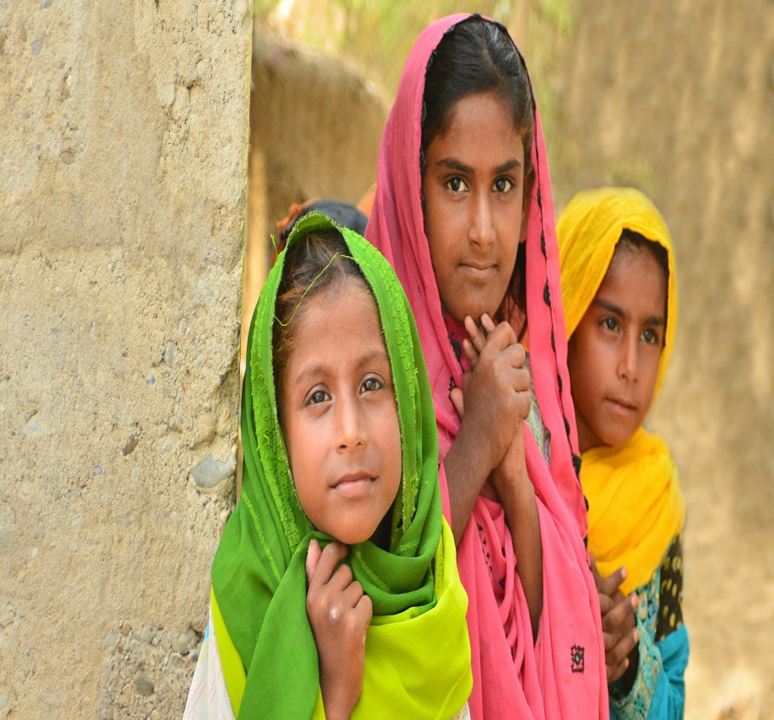
Expanding citizen voice in education systems accountability: Evidence from ASER Pakistan
‘This one will never read’: A decade of citizen led assessments in Asia and Africa ”
Baela Raza Jamil
March 10, 2016 - 3:00-4:45 p.m.
Venue: –Burrard - Sheraton Hotel – Vancouver
www.aserpakistan.org

Slide 2
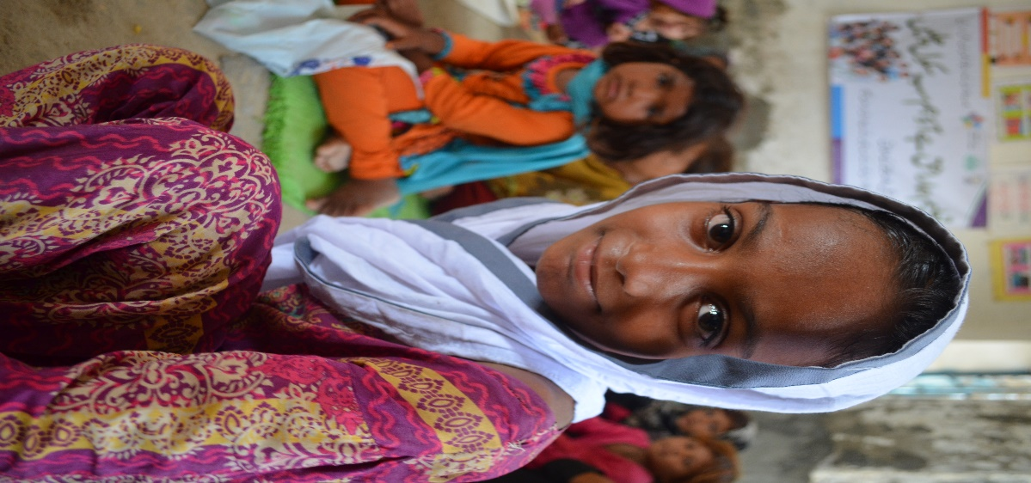
Introduction
Pakistan is at the centre of unmet global MDG/EFA targets & OOSC- takes second position after Nigeria
The 18th Amendment (Article 25-A) made in 2010 to the constitution of Pakistan declares education as a fundamental right guaranteed by the State
3 out of 4 provinces and federal areas have legislated to implement Article 25-A- rules just being framed.
Innovations are being tested to address challenges of learning

Slide 3
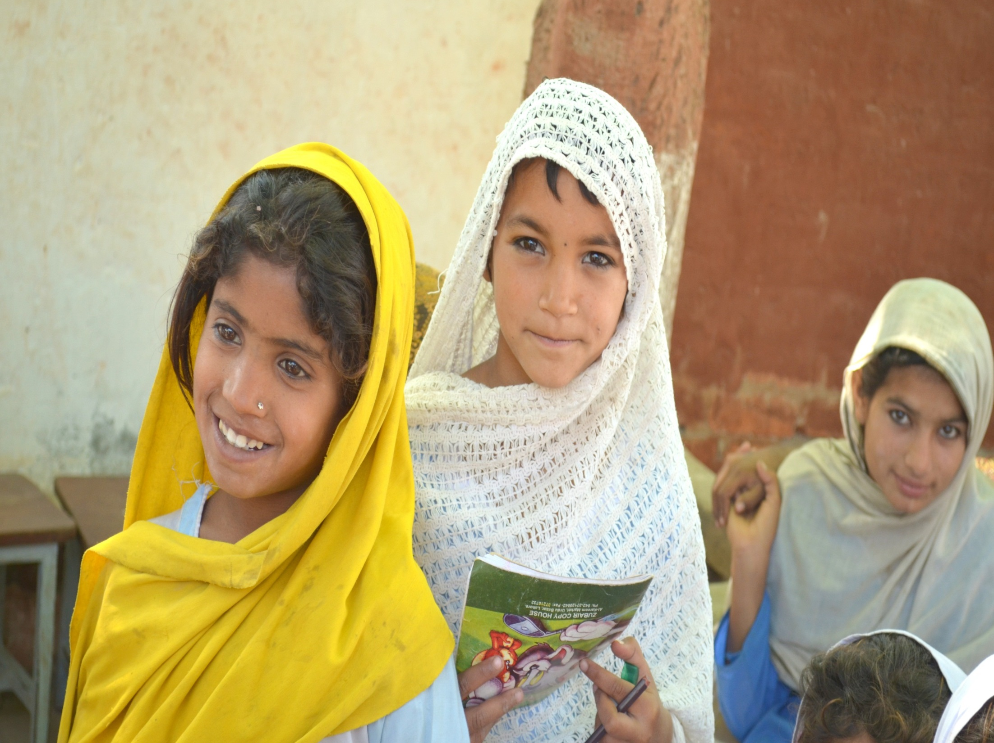
LEARNING CHALLENGES

Slide 4
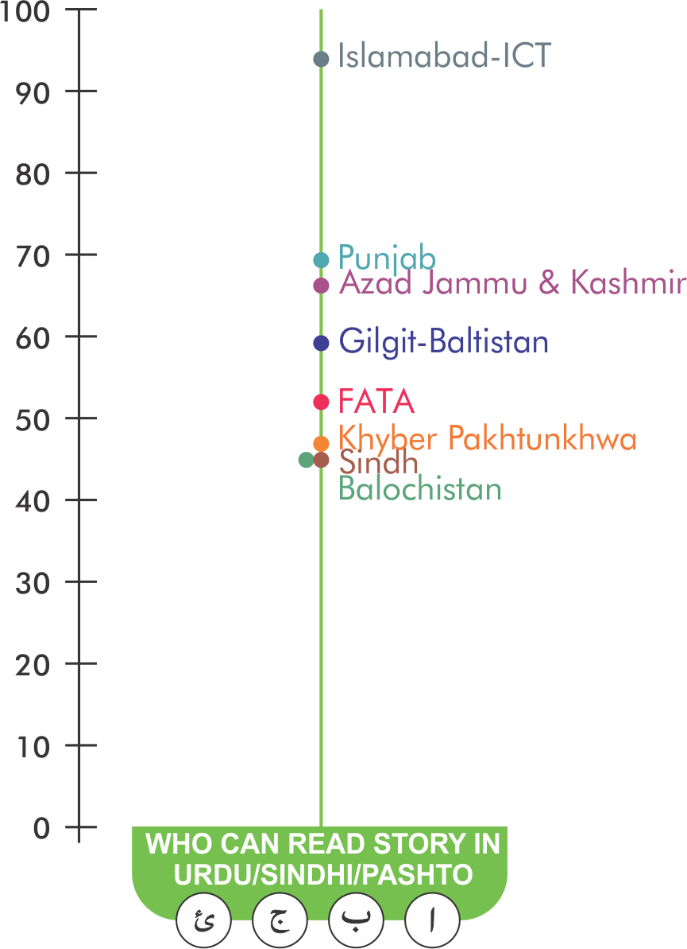
Urdu/Sindhi/Pashto (Class 5) Provincial Comparison
Balochistan still on the bottom- ASER Findings 2015
Balochistan has the lowest learning level (Urdu/Sindhi/Pashto) of children enrolled in class 5
Province/Territory-wise map showing 42% children who can read story of class 2 level.

Slide 5
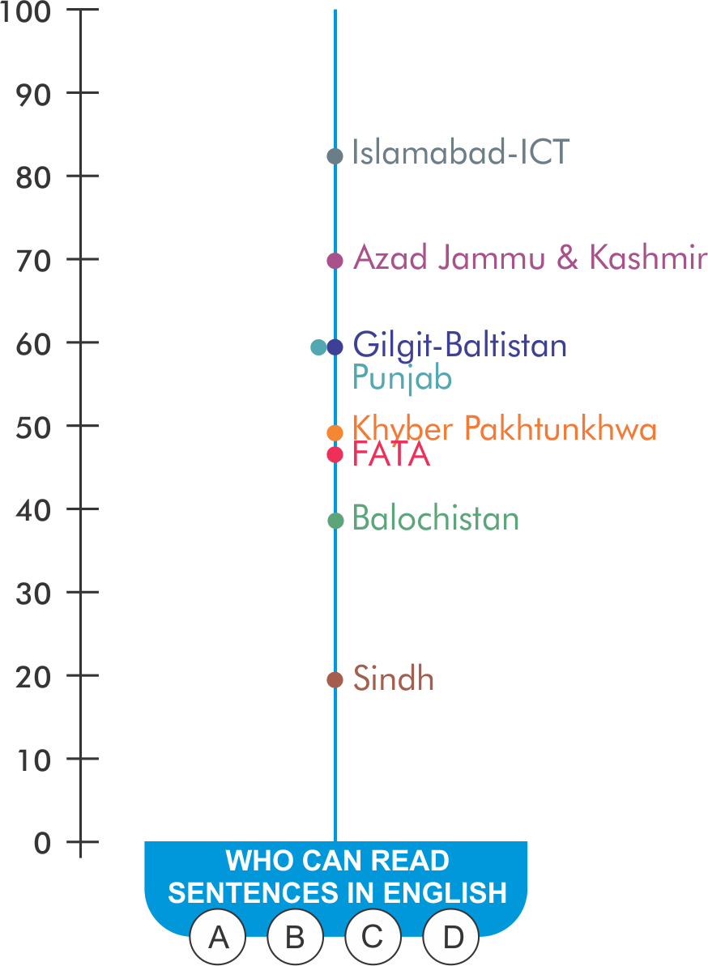
English (Class 5) Provincial Comparison
Sindh performing the worse
ASER Findings 2015
Sindh has the lowest learning level (English) of children, enrolled in class 5.
Province/Territory-wise map showing 19% children who can read sentences of class 2 level.

Slide 6
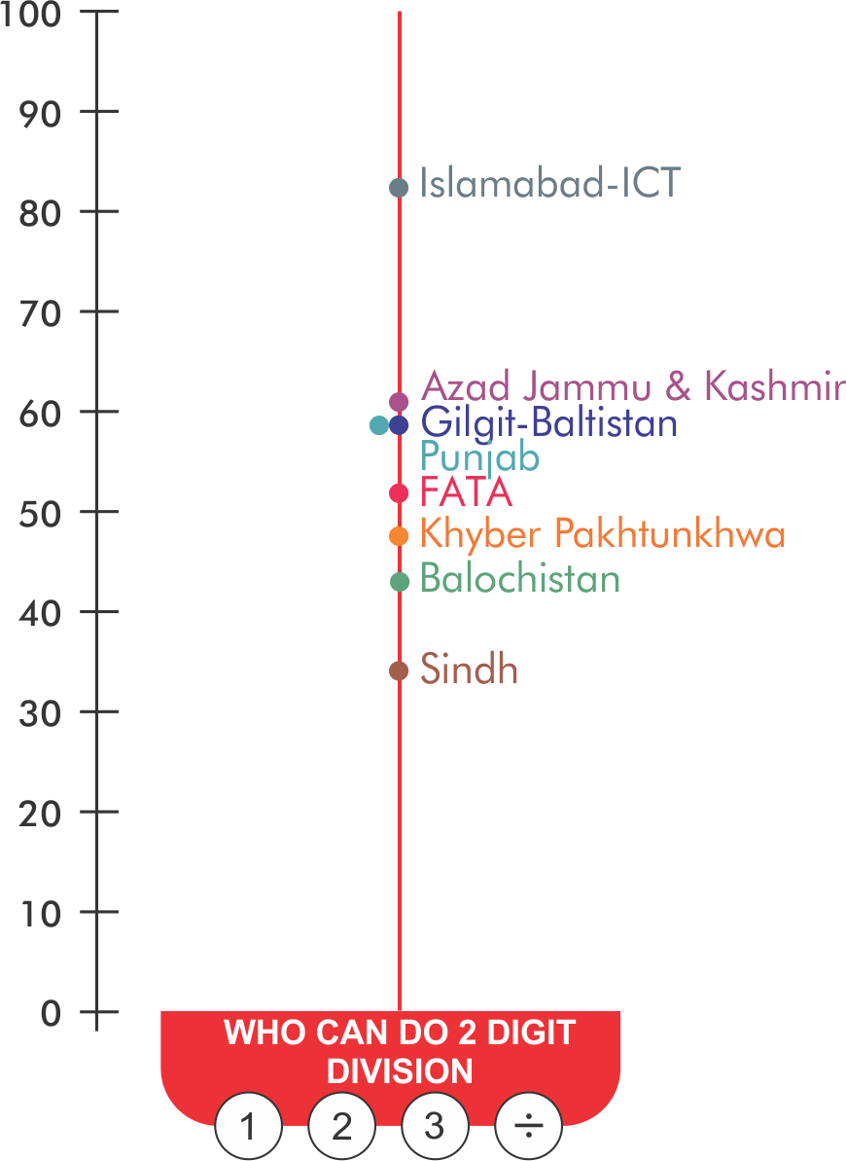
Arithmetic (Class 5) Provincial Comparison
Sindh still on the bottom
ASER Findings 2015
Sindh has the lowest learning level (Arithmetic) of children, enrolled in class 5.
Province/Territory-wise map showing 33% children who can solve 2 digit division of class 2 level.

Slide 7
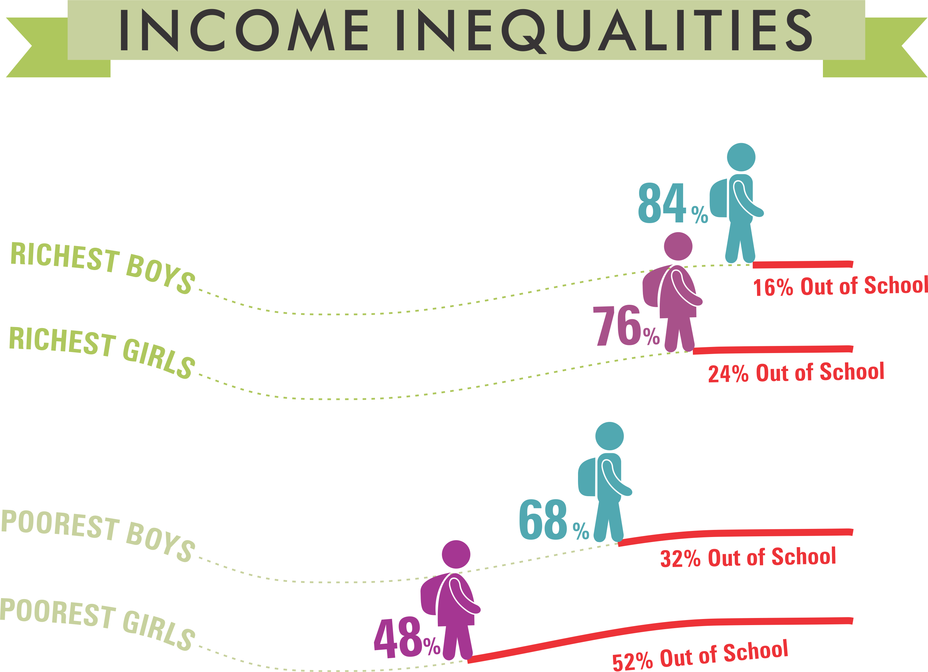
Disparities in enrollment exist as per ASER Findings

Slide 8
Richest continue to perform better in all three competencies

Slide 9
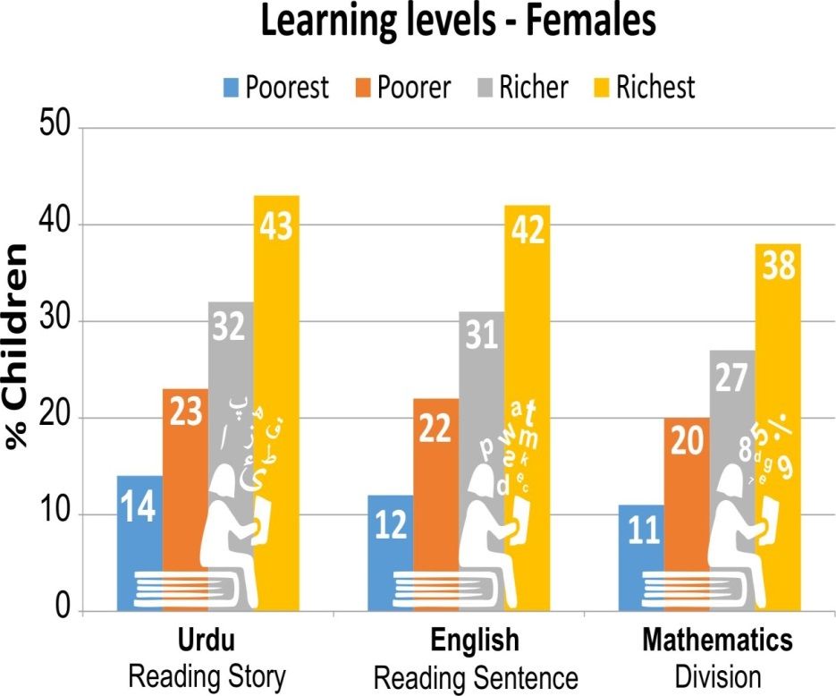
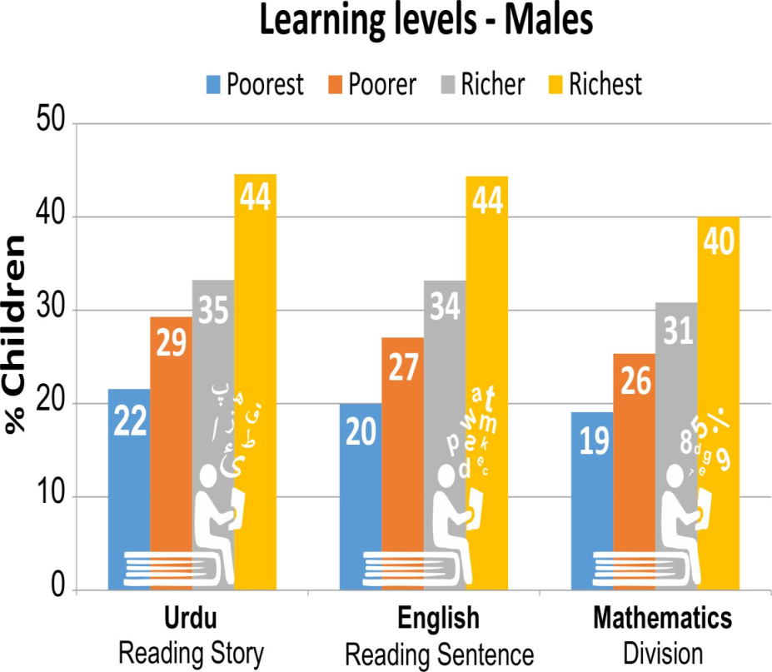
Persistence of Gender Gaps across Socio-economic lines – 2015
Only14% of the poorest females can read a story and 11% poorest females can do two-digit division sums
22% of the poorest males can read a story and 19% poorest males can do two-digit division sums

Slide 10
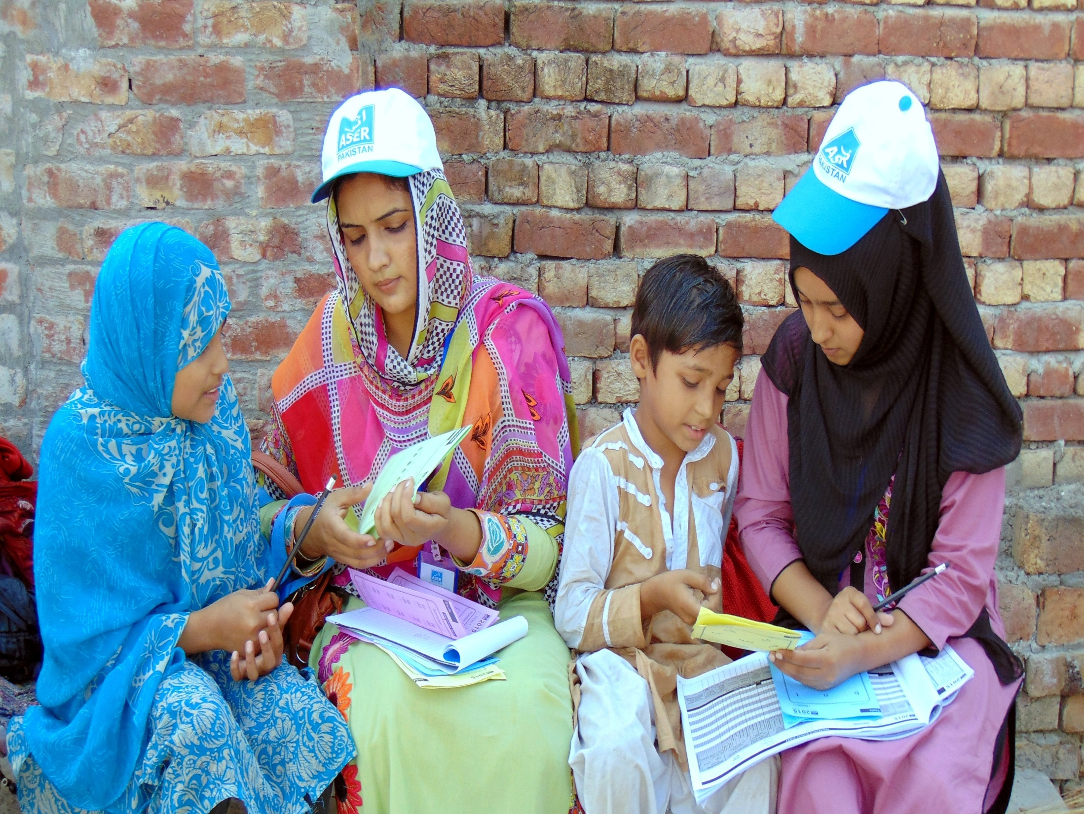
ASER PAKISTAN AS AN EXAMPLE

Slide 11
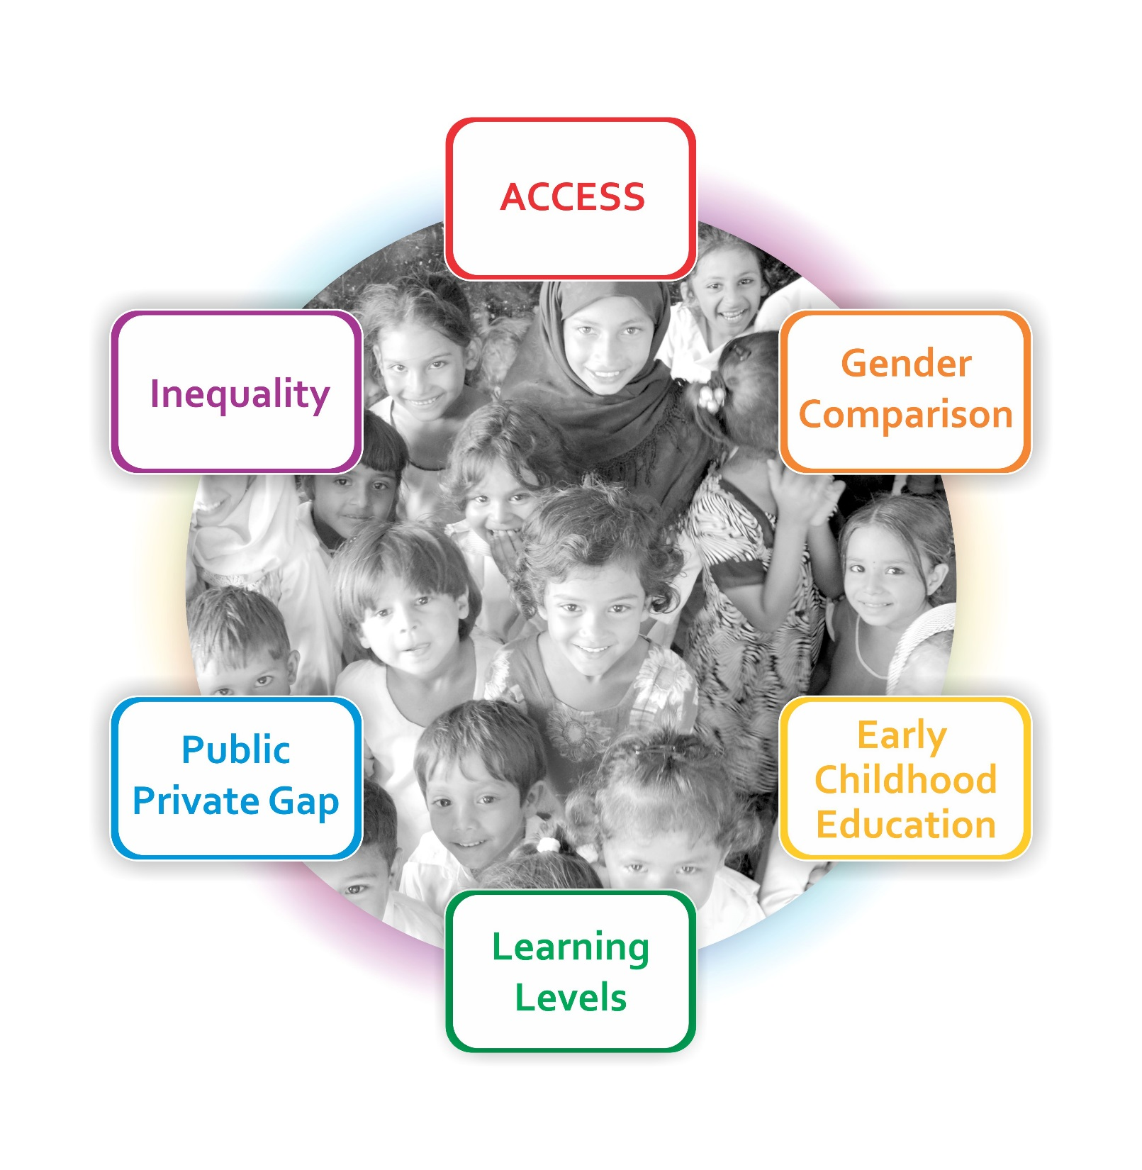
Themes of ASER

Slide 12
The Rigor & Stages of Mobilization
Objective
Provision of Dataset on:
Evidence
Finalizing Reports:
Policy Briefs
Impact
Informs RTE
Advocacy
Report Launches
Learning Outcomes
Trainings
Policy Dialogues
Village Gatherings
Media Training
Poster ( target/ actions based)
National, Provincial, District
Access
School Facilities
District Report Cards
National
Mass Dissemination
CSO Coalition Meetings
High Level Endorsements
Influenced political agenda/ campaigns
Media Campaigns for transforming education
Triggered Research
Demand from research institutions
Provided Baseline for provincial Sector Reforms/Plans
Data Collection
Field Survey
District
Provincial
Regional /Local
Civil Society and Social Capital Formation

Slide 13
Seeking Stakeholders Attention: Building Social Capital
Decision Makers I
Politicians
Decision Makers II
Parents / Community
Academia / Think tanks
Teachers/ Associations
Parliamentarians
Judiciary & Judicial Academies
Children
Media
Youth
Bureaucrats

Slide 14
Collecting evidence of learning levels of children
Seek evidence-based engagement to transform conditions of exclusion and learning challenges at the household, community, school, and college level.
Communicating findings
Communities across the country who commit to rethinking their conditions, values and structures for change.
Mobilizing resources for improved learning
Collaborating with partners across networks (national, regional & global) to influence progress through synergistic collaboration & actions
Community mobilization for social accountability
Engages inspiring leaders as communicators of ideas, learning solutions, change, practice and accountability.

Slide 15
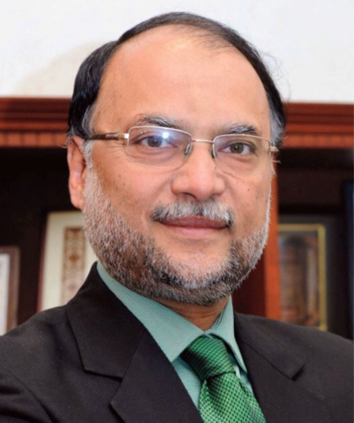
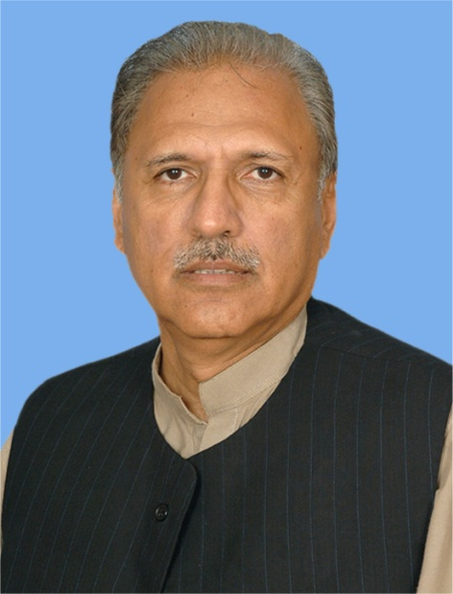
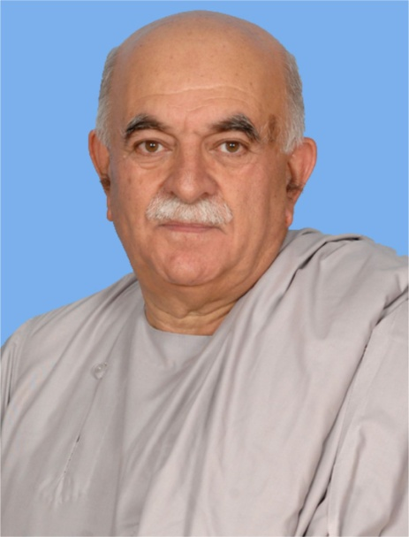
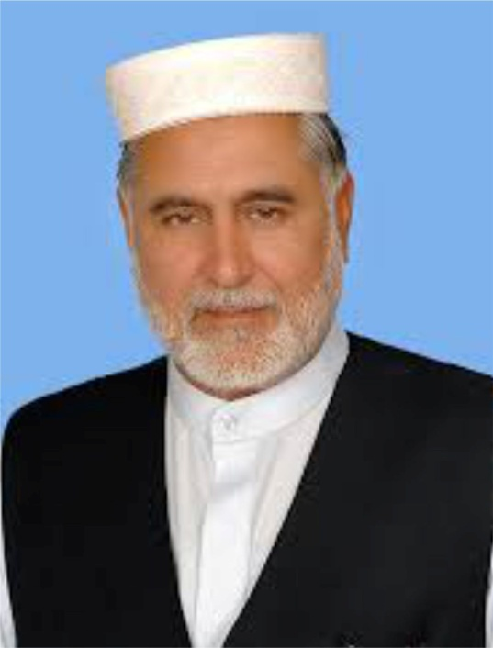
Informing Politicians & Providing results on constituencies- “what works and why?”

Slide 16
CASE OF NAROWAL- Gender Reversal!
A Politician who Walked the Talk on Gender! Ahsan Iqbal Fed. Minister

Slide 17
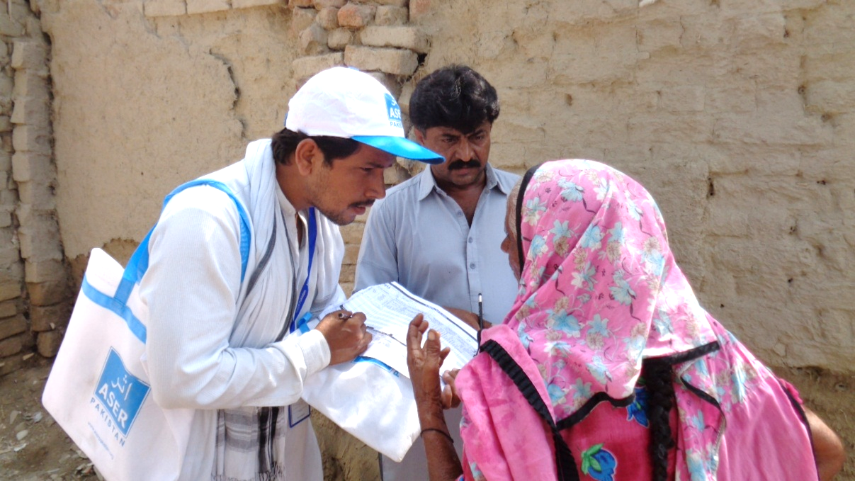
ASER ADVOCACY CAMPAIGN
A story of partnerships and Citizen Participation

Slide 18
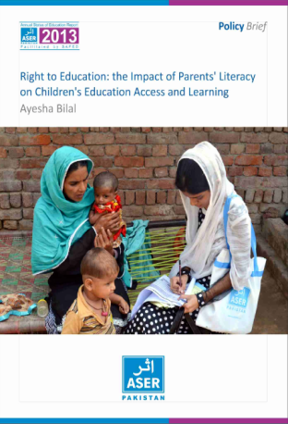
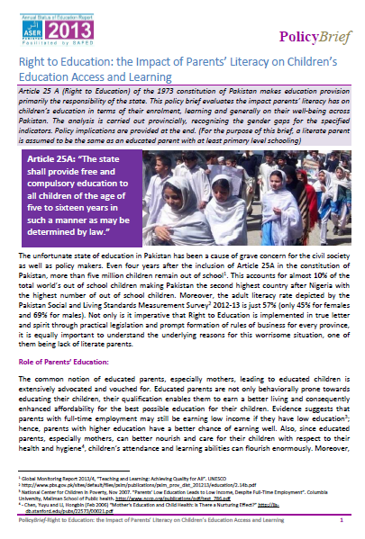
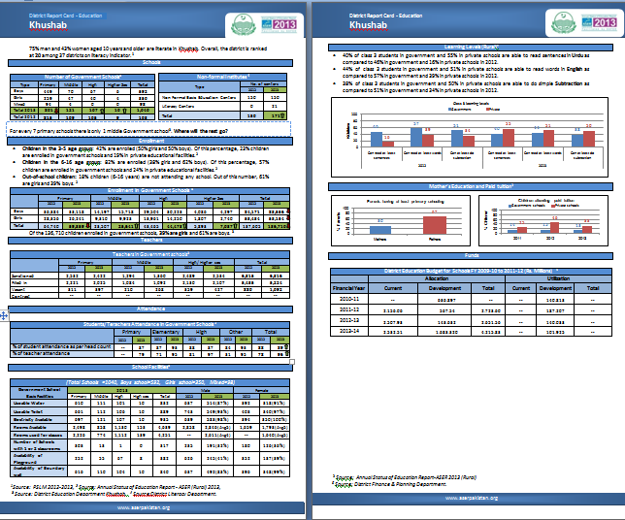
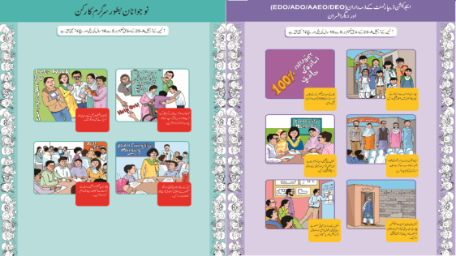
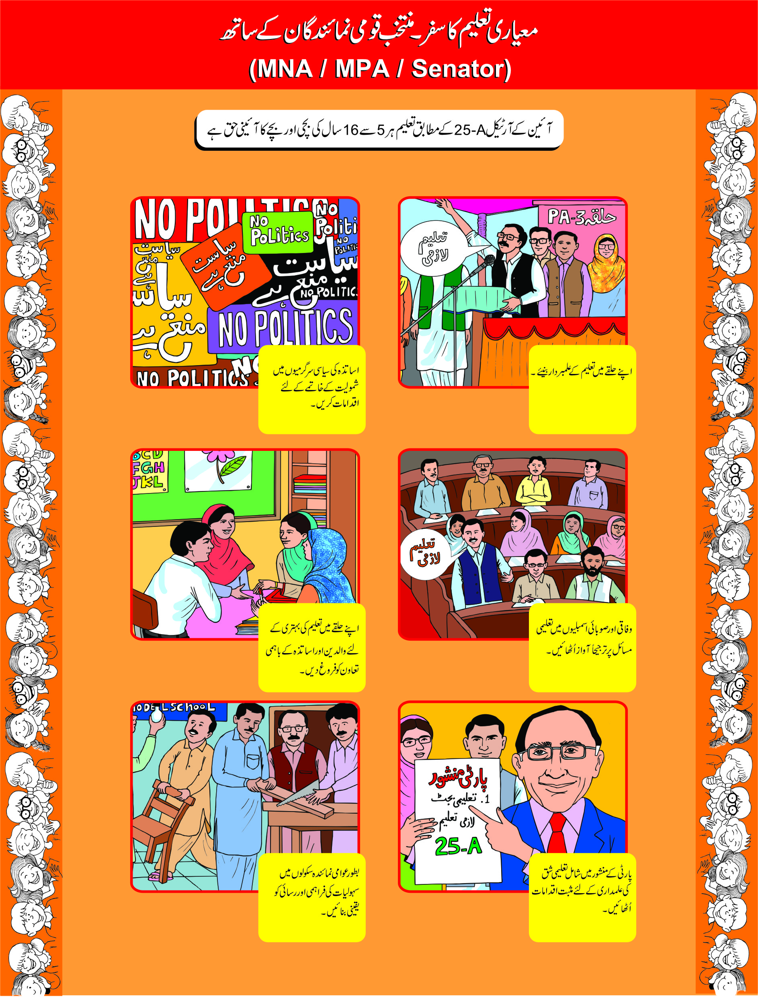
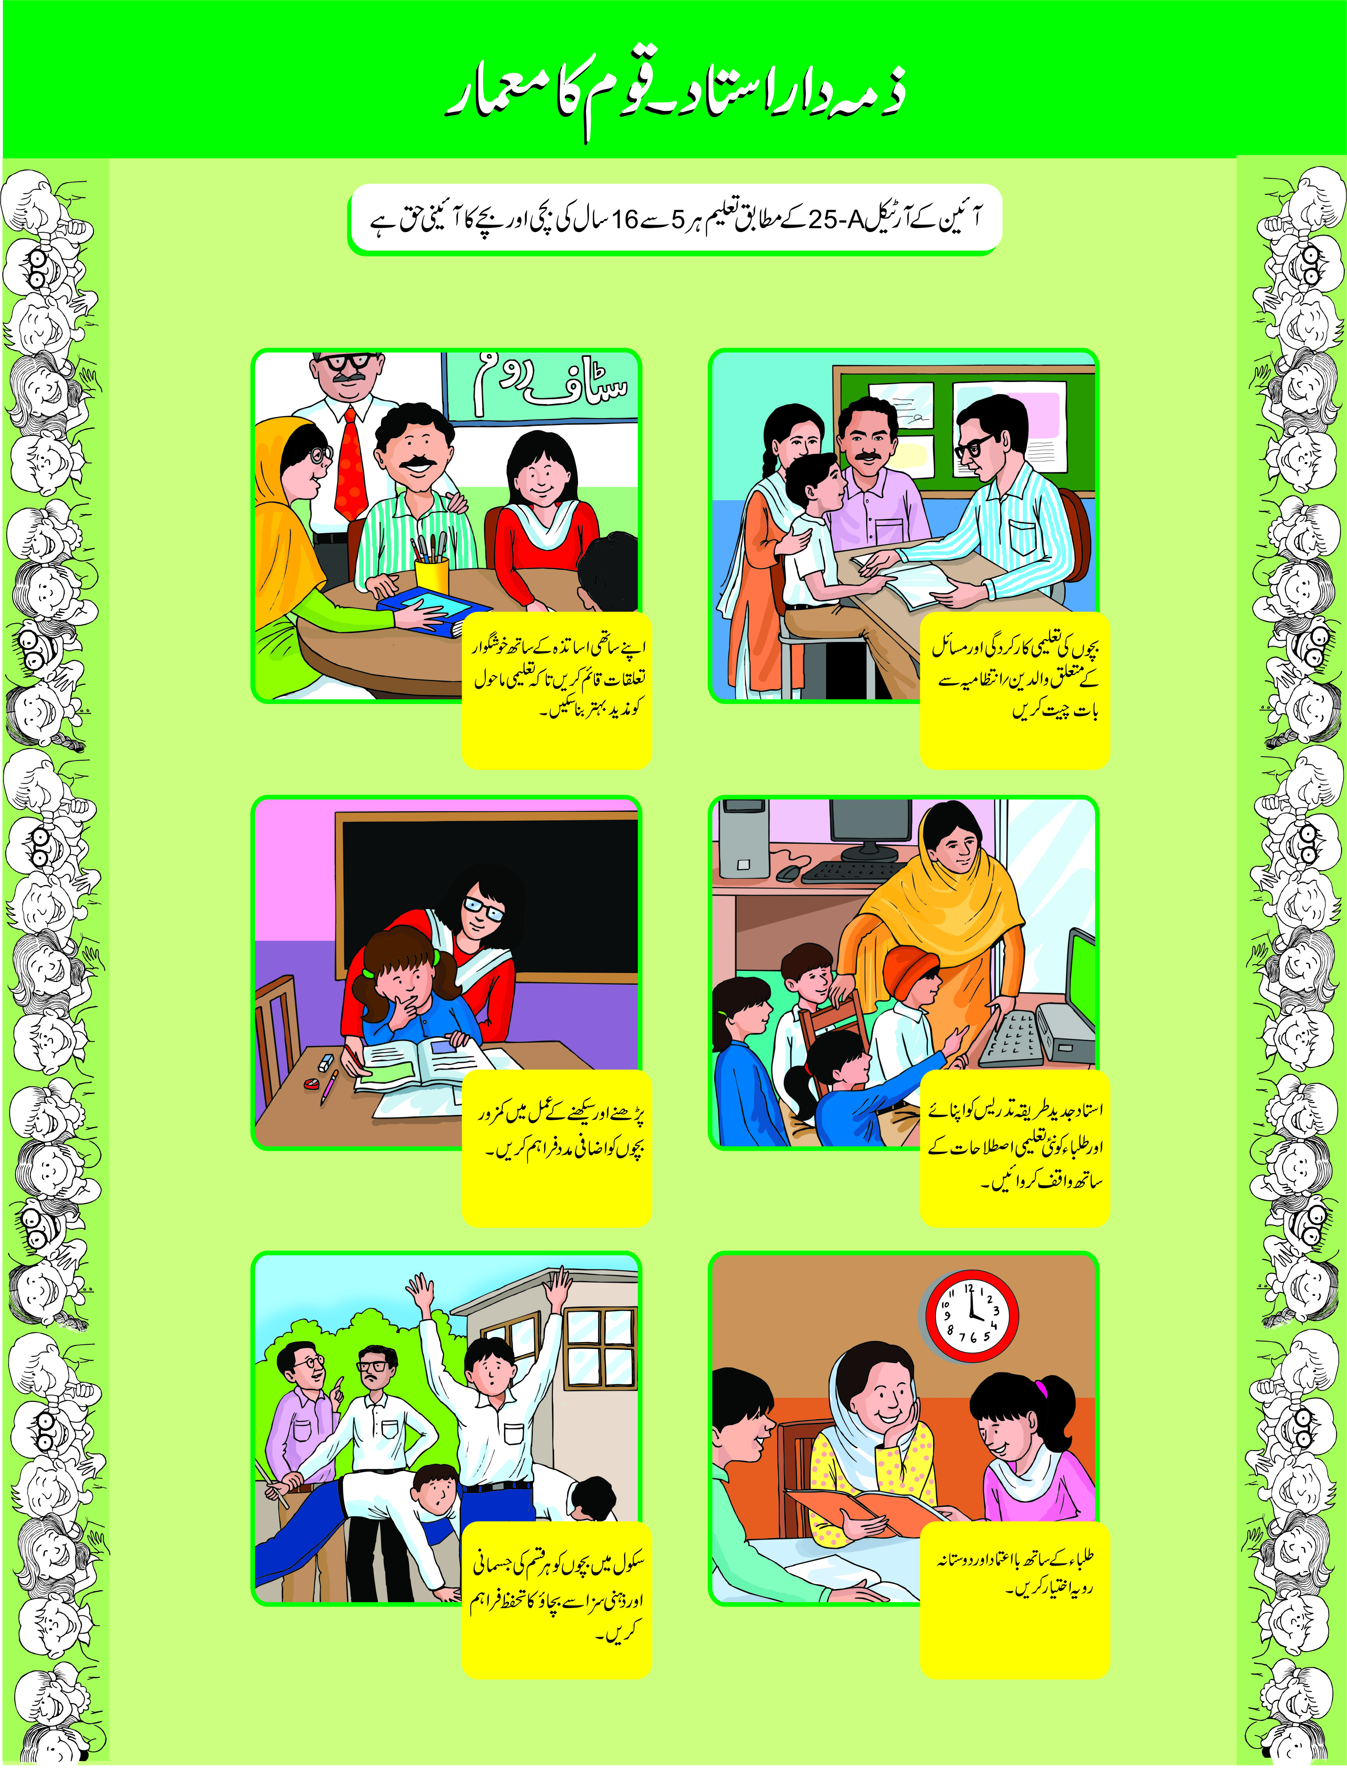
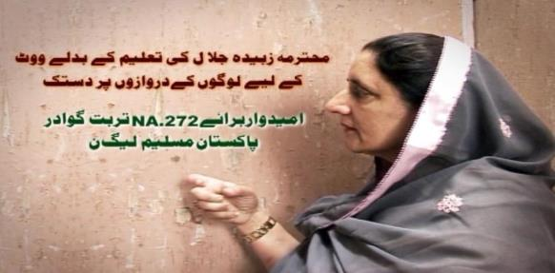
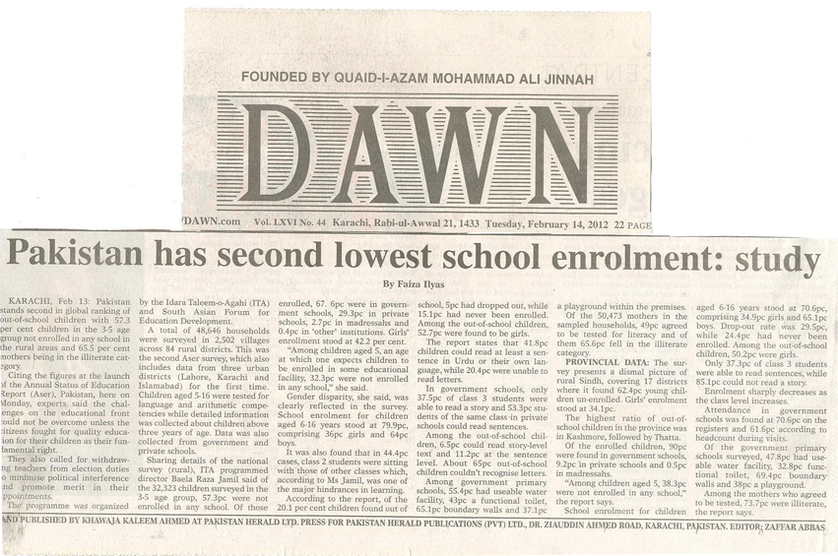
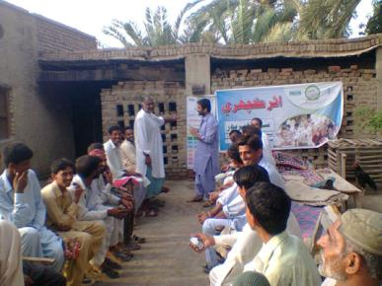
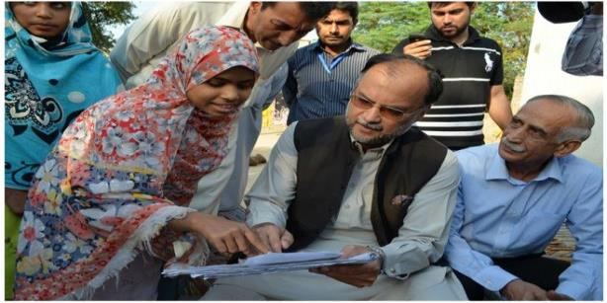
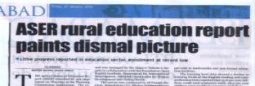
Citizens Involved in Research & Advocacy
Policy Briefs
Posters
District Report Cards
ASER Baithaks
(Community Gatherings)
Videos: Politicians Knocking on the Door for Education
Media Coverage

Slide 19
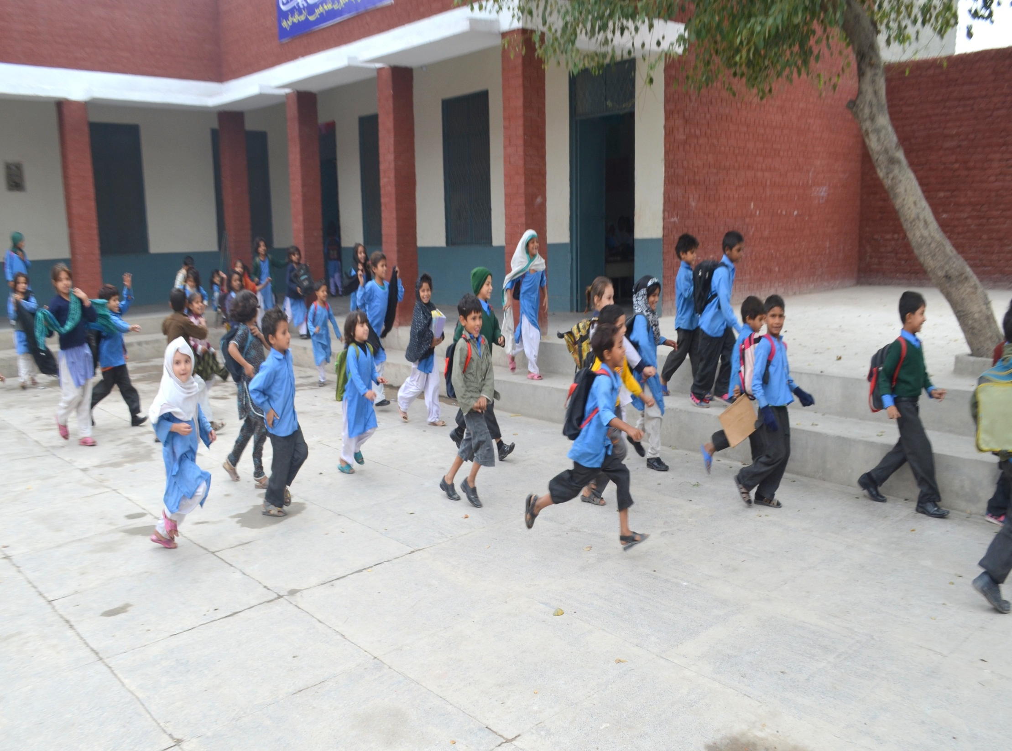
ASER FOR LEARNING IMPROVEMENT

Slide 20
Citizens’ Movement for Quality Education (CMQE)
RTE Right to Education
Learning 4 Access
Chalo Parho Barho (CPB)
Childrens’ Literature Festival
A
S
E
R
Annual Status of Education Report
Citizens’ Movement For Quality Education (CMQE)
Nationwide scalable campaigns triggered by evidence on quality and access
Alliances & Partnerships are at heart of ITA's work

Slide 21
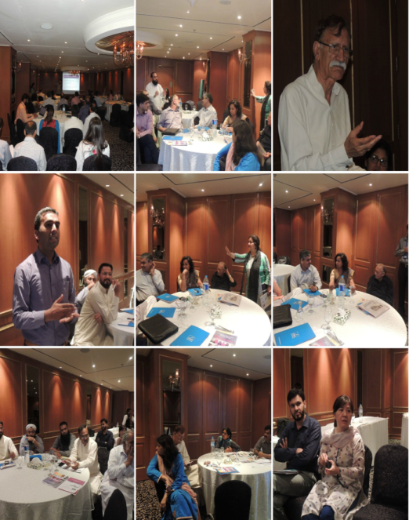
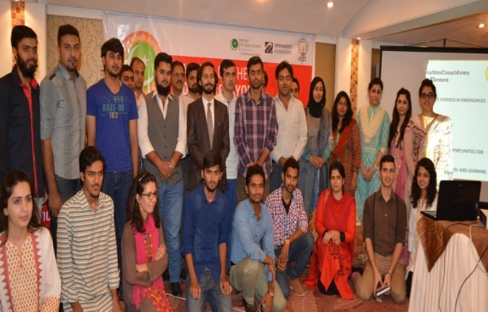
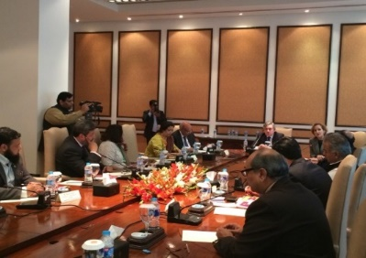
Right To Education Campaign
Education Youth Ambassadors: September 22nd 2014, saw the birth of the Education Youth Ambassadors in Pakistan launched in Collaboration with A World at School (AWAS), an initiative by Sir Gordon Brown, Special Envoy for Education with the UN Secretary General
Policy Dialogues: A series of Dialogues were held across Pakistan to highlight and understand the status of RTE from the perspective of the government bodies, civil society, NGOs and all stakeholders
#Up4School: Pakistan to break all records by collection 3 million signatures in support of making the Right of Education to ALL.
Global Business for Coalition: Private sector cooperation across Pakistan have joined hands under one umbrella to further the cause of education
Education Countdown:
1. Provide Safe schools in emergencies
2. Stop Child Marriage
3. Abolish Child Labor
4. End discrimination against girls
5. Teacher training

Slide 22
Education Youth Ambassadors (EYAs)
400 youth ambassadors campaigning in Pakistan for education.
#Activities- Many ..
- UpForSchool Signatures –collected and presented 2.2 Million #UpForSchool signatures to parliamentarians urging action for education !
- RTE Implementation across Pakistan
NEP: EYAs engaged in consultative meetings for NEP 2016 from all over the country. - SDGs: EYAs in Sindh and KPK trained regarding the SDGs, more training sessions coming up soon.
Enrolment Campaigns in their regions 2016.
Safe Schools in KPK and FATA regrouped to take initiatives in Schools – Universities and Emergencies –
Ending Child Marriages
Tracking schools – missing teachers and facilities
Mobilizing Parliamentarians
ASER II – learning improvement

Slide 23
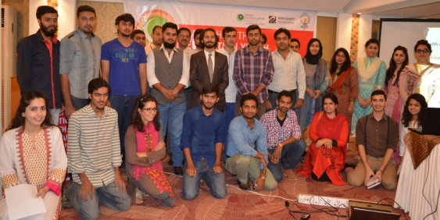
EYAs on the March!
- 6 EYAs participated in the UNGA and presented their work along with forming links for future collaborations.
- EYAs appointed as Youth Parliamentarians throughout the country.
- EYAs involved as trainers in various training workshop opportunities conducted by ITA to lead groups on global citizenship, leadership and effective communication.
First EYA Publication
EYA Booklet, Meet Our EYAs, published last month and presented at the UNGA featuring 10 EYAs and their work. May be viewed here: http://rtepakistan.org/wp-content/uploads/2015/09/booklet-eya-stories-1.pdf

Slide 24
National Education Policy (NEP) 2016
Objective: ITA engaged with focused youth stakeholders through consultations, face to face and social media for the NEP 2016 ensuring links with 25 A and the Sustainable Development Goal (SDG) No 4 for voice and recommendations.
Progress: 13 consultation sessions across Pakistan supported by UNDP & Dubai Cares
Attended by over 900 participants including youth, teachers and administrative staff, civil society member, government officials, and media personnel
ITA leading this advocacy /engagement of citizens with local partners & teachers
Developed hugely resourced NEP website http://itacec.org/nep.php
The reports/recommendations of each consultation formally signed off by the provinces and federal government representatives, to ensure recommendations are integrated within specific segments of the NEP 2016.

Slide 25
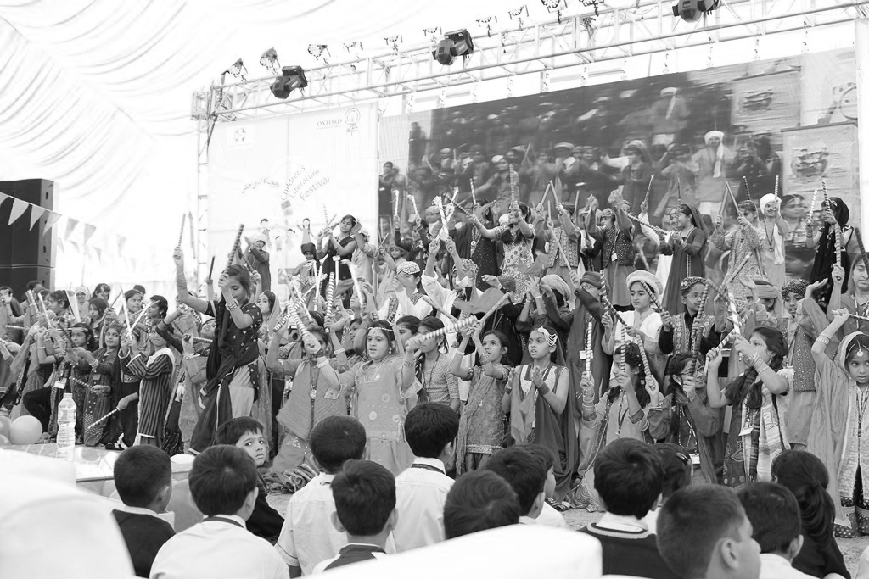
The CLF Journey-its nuts and bolts & roll out
Overwhelming Response
2011-2013
CLFs crafted at
2013-2016
CLF contd.. 2 days 1 day
Teachers Lit Festivals 1 day
2016-2020
Innovations cont..
Districts –& School Based
Publications
Provincial & National –
CLF regd. as (NFP) Company
Social Movement mode
Alliances local and global
Think Big w. OSF
Resources for CLFs
23 CLFs attended by 500,000 so far.. !

Slide 26
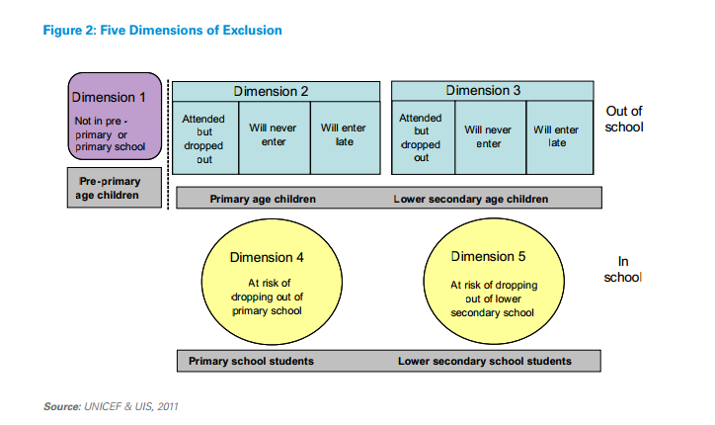
Learning for Access Program
The program builds on Five Dimensions of Exclusion framework; targets children of Dimensions 1, 2, 3 & 4
For learning levels it is implemented at village level for one year duration in two phases
For ECE it is implemented for 2 years in the same locality & schools

Slide 27
How is it different from other programs?
Mainstreaming OOSC by Identifying the ‘as is’ learning levels of children.
Targeting potential drop outs and in school children at risk from grades 3-4-5
Adopting “Accelerated learning program Combined Activities for Maximized Learning (CAMaL)”.
Para teachers are from the same community- trained
In each government school, a focal teacher is also trained in the methodology to sustain the program
Innovations on advocacy learning and assessments through : ASER+RTE, Technologies –Blended learning TWF; CLF alternative pedagogies & LMTF – learning champions

Slide 28
Calling ALL CITIZENS, GOVERNMENTS & PARTNERS TO SUPPORT LEARNING IMPROVEMENT- ASER II (2016-2030)
FROM EVIDENCE TO ACTION!
2
2008- 2015
2016-2030
FROM ASSESSMENT TO LEARNING IMPROVEMENT

Slide 29
THANK YOU…!

Slide 30
ASER a Powerful Reference & Benchmarking Document!
Governments launch their own learning and numeracy drive (Punjab govt.) and conduct assessment of children in low primary levels.
Each province has developed 4 year Education Sector Plans up to 2018/19. 3 out of 4 are benchmarked to ASER with elaborate targets, strategies, costing and implementation details.
Endorsed by Ministers – Education Ministers (Ahsan Iqbal, Baligh ur Rehman, Nisar Khuro, ..etc)
Used by major TV channel and programs-- Zara Sochiye Campaign.
ASER part of Economic Survey of Pakistan since 2012, Global Monitoring Report since 2013 and many research institutions.
Influencing post 2015 development agenda and goal setting in regional and international consultations.
ASER Data set is linked to the website of all leading think tanks, provincial education Departments such as PMIU, RSU, Ministry of Finance, Minister of Federal Education and Provincial Training etc.

