Slide 1
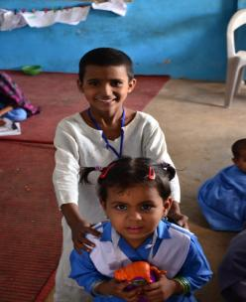

ACCESS AND LEARNING IN EARLY CHILDHOOD EDUCATION: EMERGING TRENDS & CHALLENGES FROM ASER PAKISTAN
HUMA ZIA
SAHAR SAEED
SABA SAEED
Comparative and International Education Society (CIES)
10th to 15th March, 2014
PARTICIPATION AT CIES SUPPORTED BY: OPEN SOCIETY FOUNDATION (OSF)

Slide 2
Presentation Overview
Background
Data Trends (ASER Pakistan) – Access & Learning
ECE Programmes (By ITA)
Action & Implementation

Slide 3
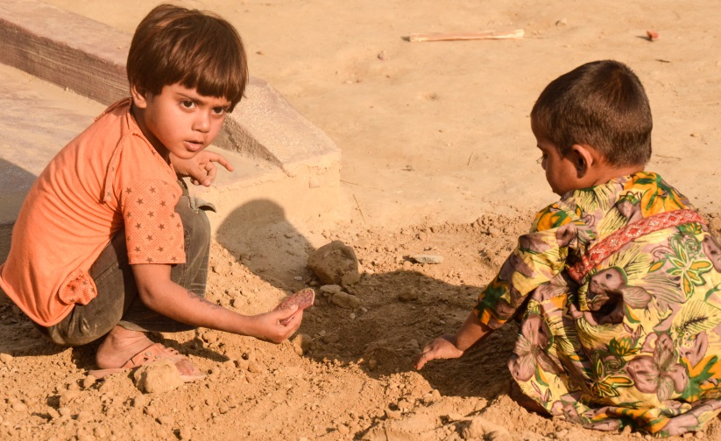
BACKGROUND

Slide 4
The Jomtien Declaration for Education For All
2000 Dakar Framework for Action → 180 world leaders signed the Education For All → Goal 1: ECE
Healthy development in early years → foundation for successful adaptation & effective learning → leading to:
  academic achievement,
  responsible citizenship,
  lifelong health, and
  economic and
  human development (Shankoff, 2010)

Slide 5
Children waiting to be the centre of attention!!!
Affected due to many reasons including poverty, vulnerability, lack of resources.
A chronic lack of inter-departmental collaboration for challenges of health, nutrition, care/protection & learning.

Slide 6
GMR (2013-2014)
Poor levels of learning (at lower grades)
of primary school resulting in millions of
children leaving education before acquiring
basic skills.
The linguistic, cognitive and social skills
that children develop in early childhood
are the foundations for lifelong learning.
Studies from many countries, including Chile, India and
Madagascar, show the contribution of pre-school to
overall cognitive abilities.

Slide 7
Transitions ECE, Primary & Middle Levels-National & Provincial
REGION AND PROVINCE | GER ECE, NET PRIMARY and Elementary Level ENROLMENT (PERCENT)
 | 2011-2012 GER ECE (Age 3-5) |  |  | 2011-12 NER Primary (Age 6-10) |  |  | 2011-12 NER Middle (Age 11-13)
 | MALE | FEMALE | BOTH | MALE | FEMALE | BOTH | MALE | FEMALE | BOTH
Pakistan | 43 | 41 | 44 | 72 | 63 | 68 | 41 | 33 | 38
Punjab | 49 | 50 | 50 | 77 | 72 | 74 | 43 | 38 | 40
Sindh | 33 | 31 | 32 | 65 | 53 | 59 | 39 | 29 | 34
KPK | 39 | 45 | 41 | 72 | 59 | 66 | 41 | 30 | 36
Balochistan | 25 | 41 | 30 | 59 | 36 | 49 | 32 | 14 | 24
Source PSLMs 2011-2012

Slide 8
ECE: What is promised?
(National Education Policy -NEP 2009 & Article 25 A – Right to Education –for 5-16 years )
At least one year pre-primary education to be provided by the State.
Universal access to ECE shall be ensured within the next ten years.
Provision of financial and food support to children who drop out because of poverty at ECE
Two year pre-service training to ECE teachers.
Recognition and strengthening of Katchi class as part of formal system.

Slide 9
ECE in Pakistan: What we have…
National Curriculum 2007 aligned with developmental domains
  Contextualized, consultative and research based
Frameworks for classroom implementation in rural and urban areas for ECE
Early Learning Development Standards (ELDS) – validation still not done
Specific policies for ECE introduction, budgetary provisions and plans across Pakistan:
  Sindh Sector Plan
  Balochistan Sector Plan
  Punjab ECE Sector Plan
  KP Sector Plan
  RTE Acts in ICT, Sindh and Ordinance in Balochistan
A robust mix of technical and grassroots expertise for Teacher Education, best practices; innovations follow-up and support

Slide 10
Sector Plans in Pakistan- 2010-2013 A Provincial Business after 18th Constitutional Amendment 2010
Objectives of Sindh Sector Plan –
Develop ECE/ECD policy and minimum standards for ECE
Enhance ECE NER from 32 percent to 45 percent.
Transforming 8000 katchi into ECE classes Establish ECE teachers’ cadre.
Review and revise ECE curriculum 2007.
Ensure provision of teaching learning materials, as prescribed in the ECE-curriculum
Support learners’ transition from ECE to class I (Primary)
Objectives of Punjab Sector Plan –
Institutionalize pre-primary ECE through policy.
Create awareness and train education managers on ECE.
Implement expansion of pre-primary ECE programs to 5000 primary schools

Slide 11
Target Population for ECD and ECE in Pakistan
Target Age Group as % of Total Population
ECD : 0-8 Years = 24.22 %
ECE : 3-5 Years = 8.5 %
Source: Pakistan Social Living Standards Measurements survey (PLSMs) 2011-2012

Slide 12
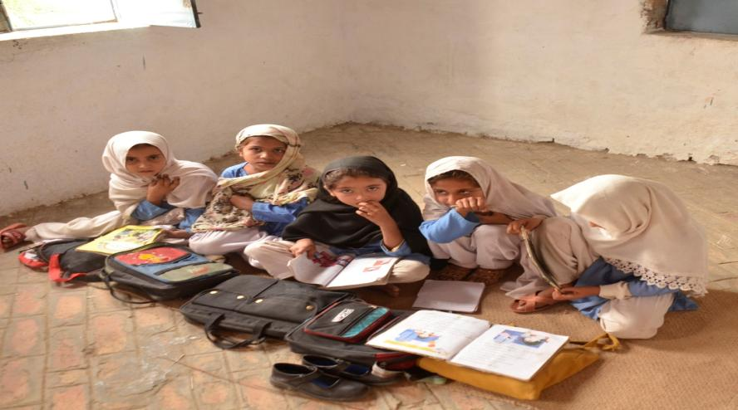
DATA TRENDS (ASER PAKISTAN)

Slide 13
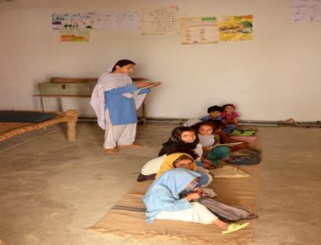
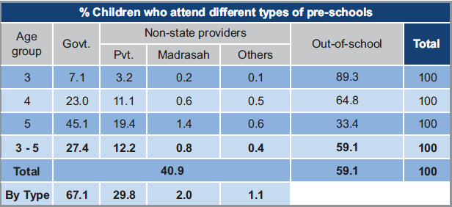
Pre-School Enrollment (3-5 Years) – ASER (Rural)
Enrollment of children: 3 – 5 years = 41% in 2013 -Rural
ECE in Public Sector: 67 %.
ECE in Private Sector 33%

Slide 14
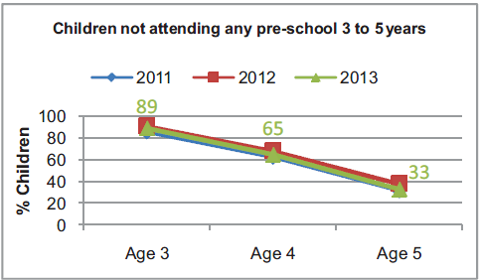
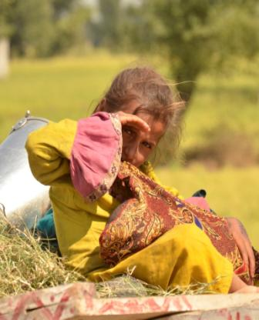
Children not attending any Pre-School 3 to 5 yrs
Out of school children (3 years):
89% in 2013.
Out of school children (4 years):
65% in 2013.

Slide 15
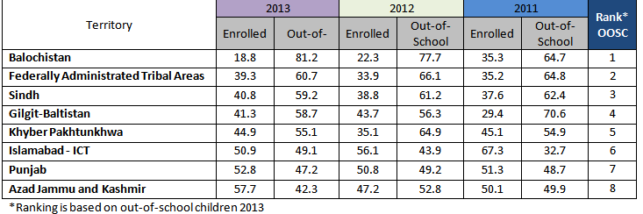
Region Wise Enrollment Trends (3-5 Years)

Slide 16
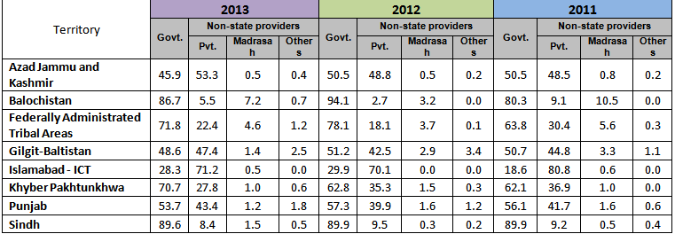
Sector Wise Enrollment Trends (3-5 Years)

Slide 17
Half of the critical period of Early Childhood years (o-8 age group) falls in the schooling age i.e. from age 5-8 years.

Slide 18
Evidence of Readiness of Children
Transiting from Pre School to Primary (ASER NATIONAL-RURAL)

Slide 19
Evidence of Readiness of Children
Transiting from Pre School to Primary (ASER NATIONAL-RURAL)

Slide 20
Evidence of Readiness of Children
Transiting from Pre School to Primary (ASER NATIONAL-RURAL)

Slide 21
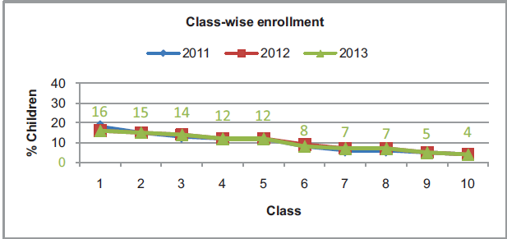
Poor Readiness leading to HIGHER DROP OUTS!!!
Enrollment decreases as class level increases
One third children are lost after primary schooling due to learning & facility gaps

Slide 22
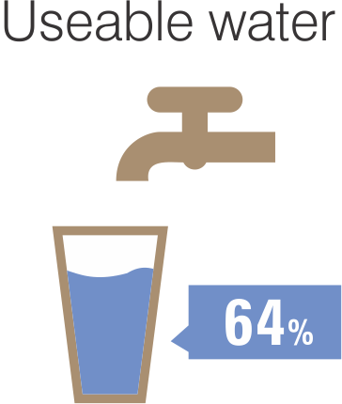
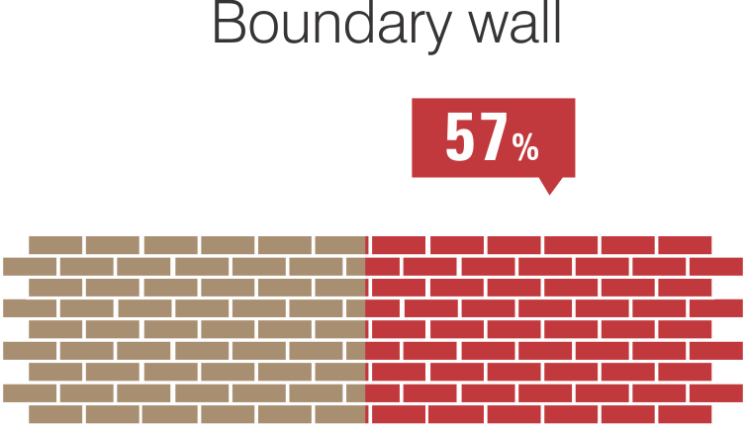
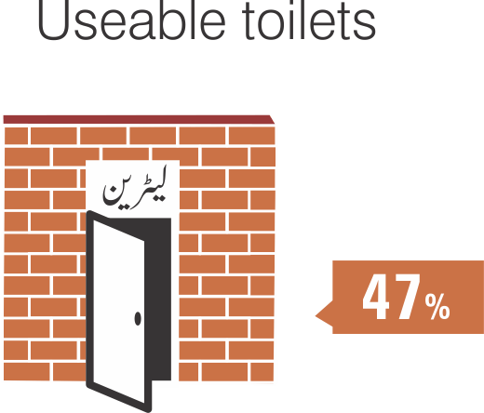
Basic Facilities
GOVERNMENT PRIMARY SCHOOL
(RURAL)
Basic facilities in schools are still missing: only 64% government primary schools have drinkable water facility, 57% have complete boundary walls and 47% have usable toilets.

Slide 23
Points to Ponder:
Although much stress is on enrolment, the real question is whether the schools are ready to induct young children and provide them with a thriving, curious and positive nurturing learning environment?
Do the schools have sufficient learning resource material to make the experience meaningful?
Do the teachers’ realize the significance of ECE and do they see themselves as quality caregivers?
Q: Are there teachers available and trained to facilitate a batch of 30-50 -90 children?

Slide 24
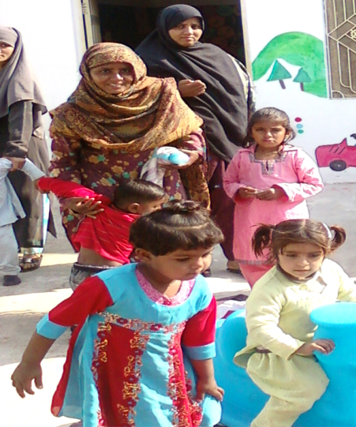
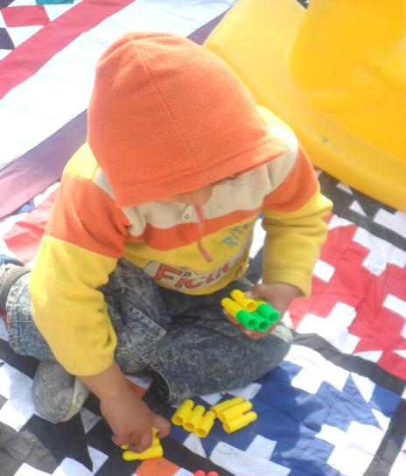
ECE PROGRAMES (BY ITA)

Slide 25
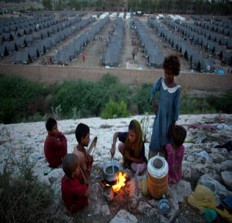
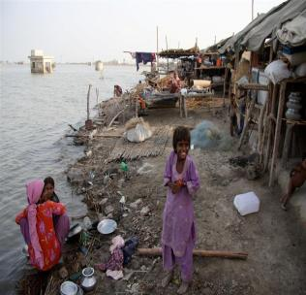
Establishment of ECD Centers
Widespread emergencies in Pakistan since 2005
Natural disasters, conflicts & displacements – 30 -40 million affected since 2005 .
Aftermath of 2010 floods - ITA designed a comprehensive multi-sectoral community based program informed by ASER 2010 results – (low access/low learning) – catering to 0-5 year olds and their guardians .
Established 16 centers in 3 flood affected districts of Punjab & Sindh. (Rahim yar Khan, Muzaffargarh, Shikarpur)
To support transitions from pre – primary, to primary and post primary levels.

Slide 26
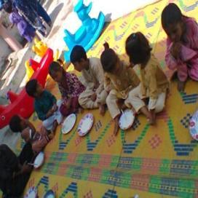
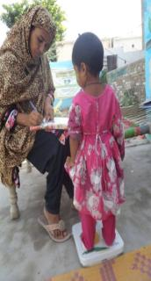
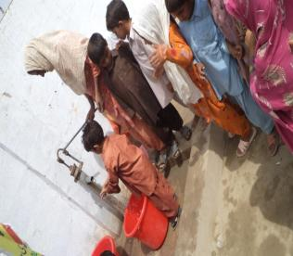
Establishment of ECD Centers (SV/PV)
“SANJAH/ PANJHO VEHRA/O”(SV/PV) literally translated as
“OUR COURTYARD”
conveys several meanings:
an abode of togetherness , protection and development, ownership, community participation and empowerment.
Duration of the Program = 18 Months

Slide 27
Activities of ECD Centers (SV/PV)
Mother & Child Development (Health & Nutrition)
Centres provided with equipment for playing and other interactive activities..
Children are mainstreamed into formal schooling.
The children (4-5 years) in ECD centers are mainstreamed into nearby govt schools (triggers enrollment)
Care givers are trained to use and develop safe and stimulating learning material.
Enrollment of children (6 months-5 years)
To provide quality learning, growth mentoring, health and nutrition support to mothers as well as children
Lady Health Workers are responsible for regular check ups and growth mentoring.
Need based vocational skills are provided for female empowerment.

Slide 28
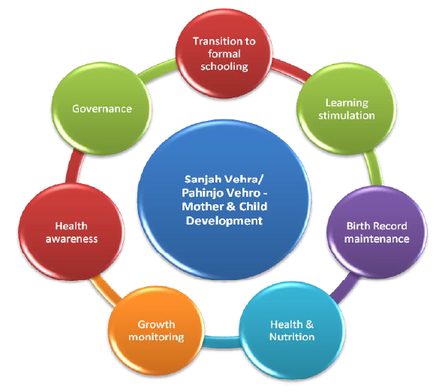
Integrated approach of ECD Program

Slide 29
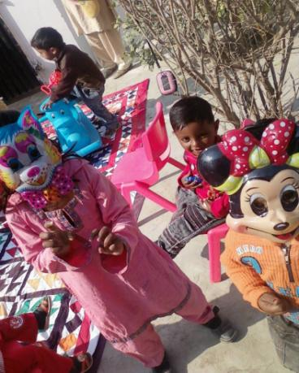
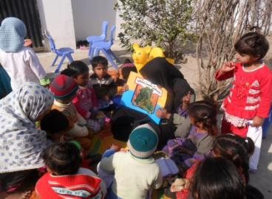
Activities done with Children at SV:
Color Identification
Story telling
Identification of fruits
in local language (Seraiki)
Rhymes and Lories (lullabies)e
Toys & Puppet exploration

Slide 30
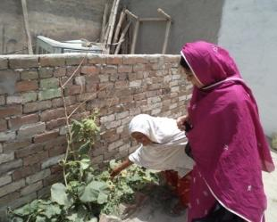
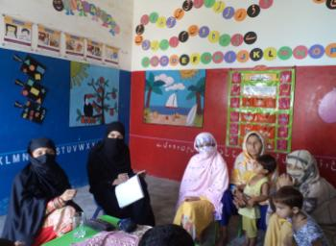
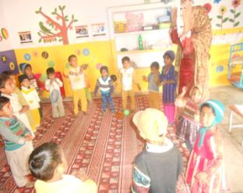
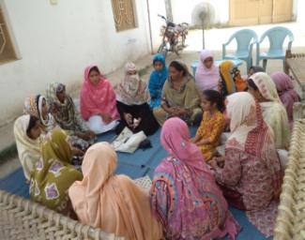
Female Support Group for Empowerment & Decision Making:
Activities undertaken by “SANJH “ Mothers’ Committee
Mothers engaged in:
Farming, sowing, harvesting, cattle farming; brick kilns handicrafts etc.
Kitchen Gardening
Regular Meetings
Assisting Teachers
Planning & Management

Slide 31
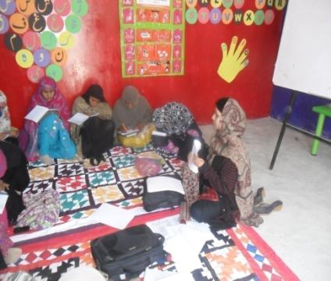
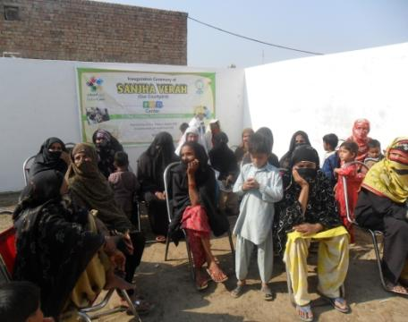
Session with LHWs/Doctors for Teachers & Mothers in ECD
Mothers sessions with LHW and Doctors on primary health issues under ECD-SV
Teachers and LHWs being trained under ECD-SV

Slide 32
Highlights of ECD Program
80% working females have benefitted providing safe and protected space for their children .
1069 females were benefitted from health sessions organized by Lady Health Worker (LHW) on child and maternal health.
Mothers were also given awareness on the importance of healthy and nutritious meal for their children .
127 females received vocational course certified by TEVTA for their livelihood.
Catered a total of 1800 children, out of which 340 children have been mainstreamed/transited to formal schooling successfully .
350 children have been facilitated for their birth record.

Slide 33
Marching towards 2015: What we need to do
Pay heed to research & start implementing policies!
Move from ECE to ECCE! (0-8 years)
End the randomness – use of terms, introduction of textbooks, lesson plans, formulas, investment of & on resources
Connect – research & policy, school & community, numeracy/literacy with cognition & development
To turn attention to the role of teachers in early grades and the contributions made by pre-service and in-service training.

Slide 34
Marching towards 2015: What we need to do
Without an investment and resource strategy for quality, children will continue to suffer from social, emotional and learning stress….especially the bottom ones.
Emergent health and education collaboration must be strengthened for institutional ownership and the beginning of an ECCE program in Pakistan.
Need for a multi-sectoral stakeholders group to formulate ECD/ECCE national strategy document with provincial ownership.
Post 2015 – ideally a stand alone goal for ECE (Arnic, ECCE Consultative group)

Slide 35
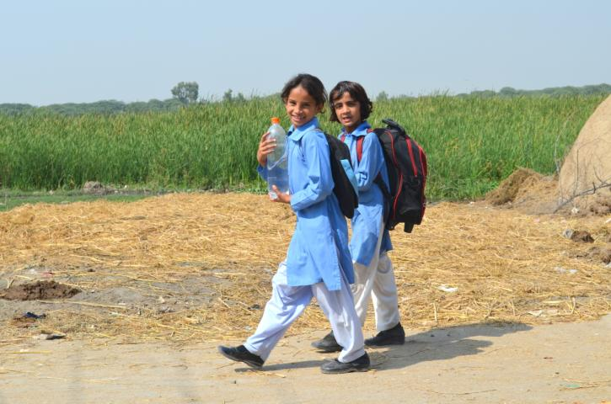
THANK YOU!

