Slide 2
2015-16 a critical year for evidence based policy & alignment to provincial national and global commitments
National Education Policy 2009 review towards a new NEP…..
“The State shall provide free and compulsory education to all children of age 5-16 years in such a manner as may be determined by law”
Endorsed by Govt. of Pakistan

Slide 3
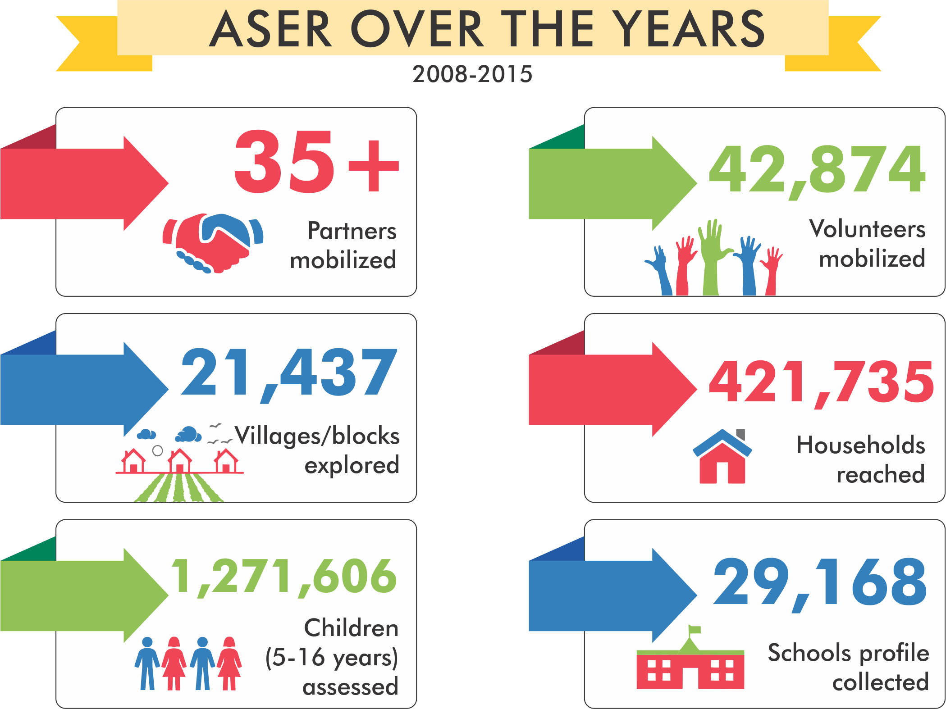
ASER mobilizing partners, community, volunteers in its journey

Slide 4
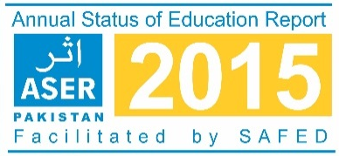
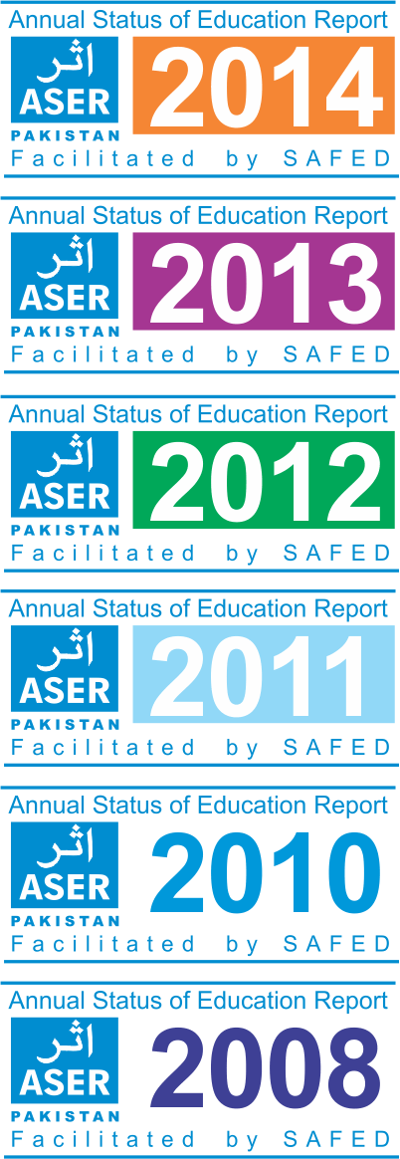
Movement for making the invisible visible
LEARNING at the centre of SDG 4
Citizen led large scale national household survey (3-16 years).
Quality of education in rural and selected urban areas (5-16 years).
Provides evidence on learning, access and equity.
Influence National & Provincial policy and actions for Right To Education (RTE) Article 25-A, MDGs & SDG 4.
Provides information for tracking MDGs/EFA trends and targets up to 2015 and now 2030.
Influenced goal setting for SDG 4.
ASER I the basis for ASER II- FROM EVIDENCE TO ACTION.

Slide 5
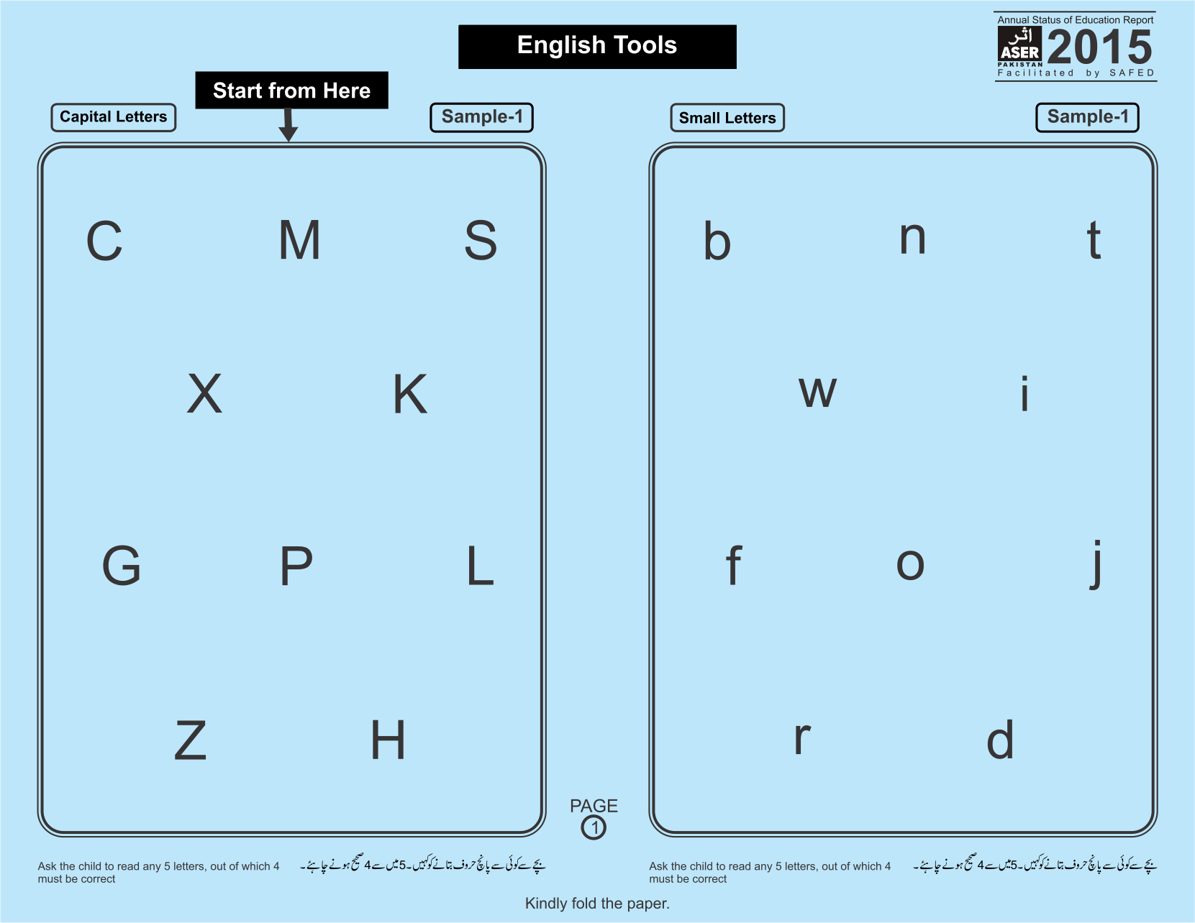
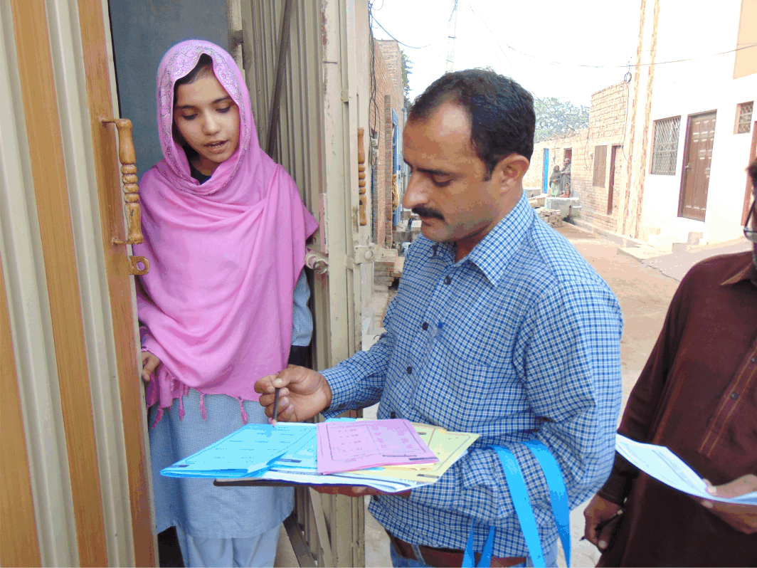
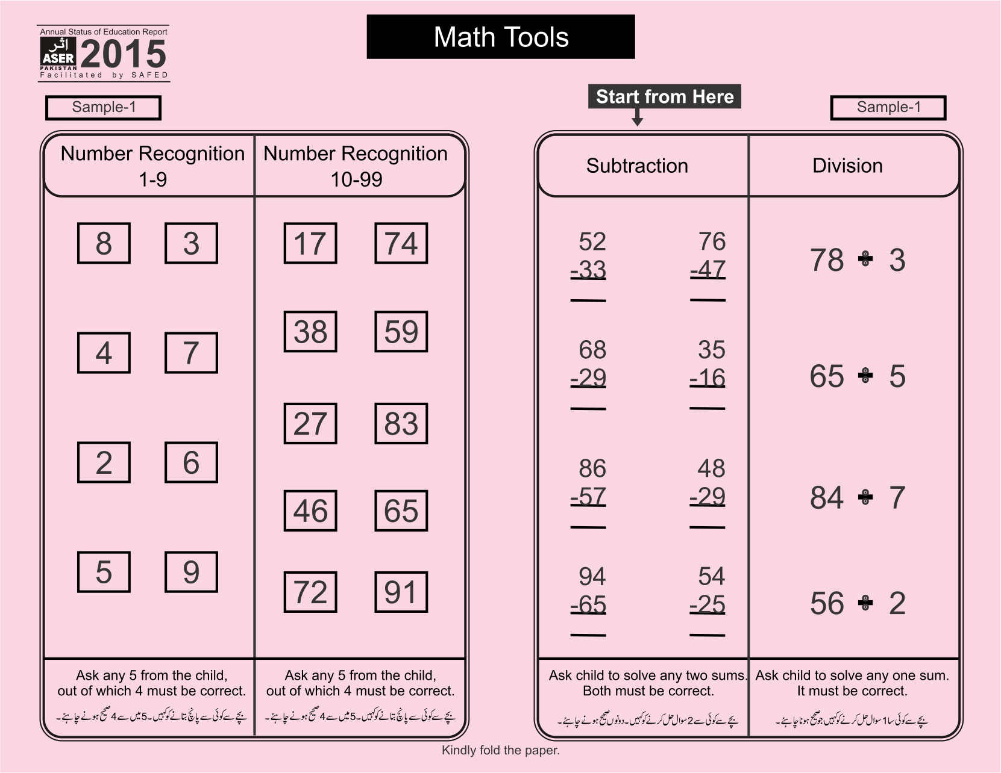
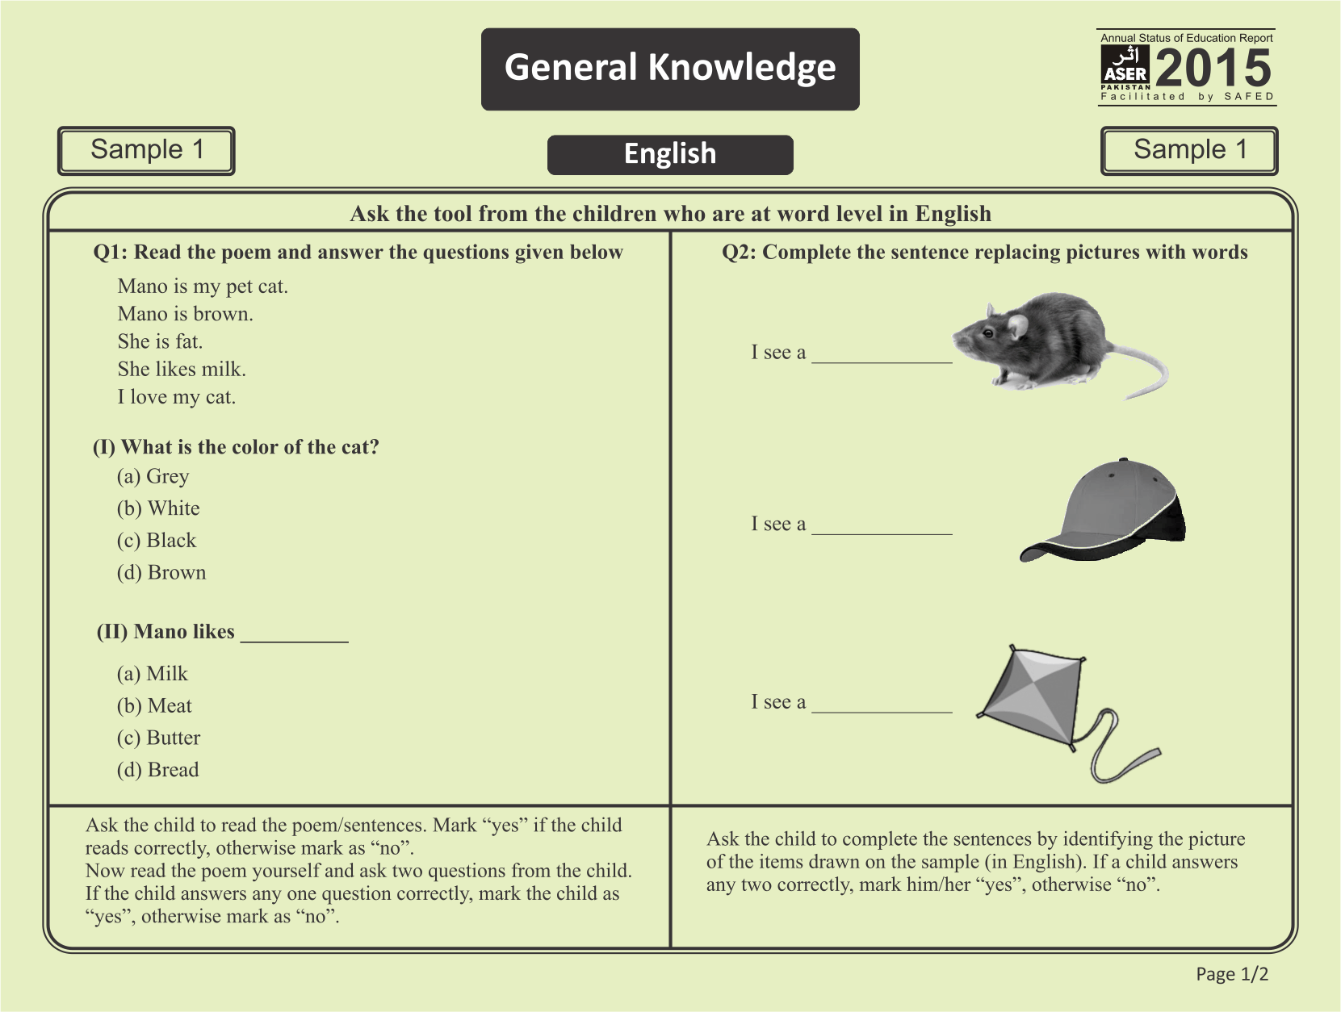
Testing basic competencies in Reading, Arithmetic, English and General Knowledge
ASER Assessment tools are prepared in following categories:
Reading (Urdu/Sindhi/Pashto)
Arithmetic
English
General Knowledge
Assessments are based on Class II level curriculum for English & Urdu/Sindhi/Pashto and Class III level for Arithmetic.

Slide 6
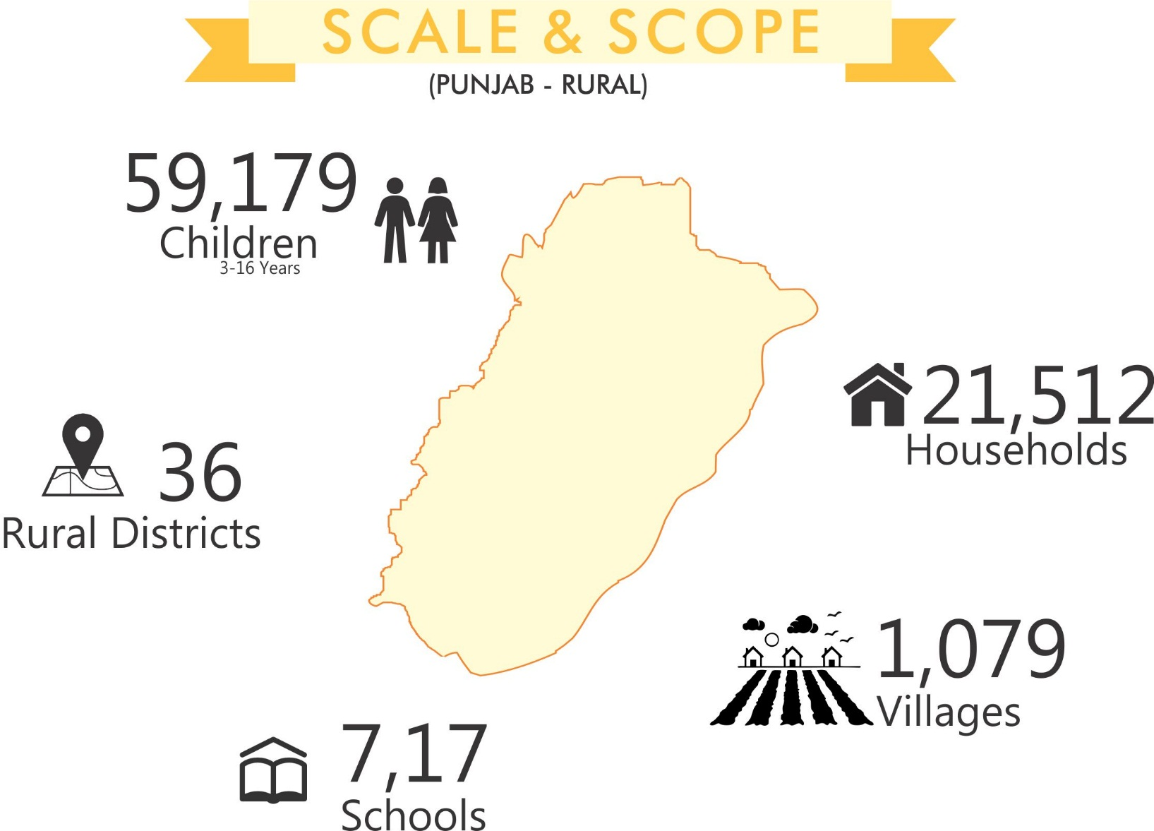
ASER casting a nationwide footprint-2015

Slide 7
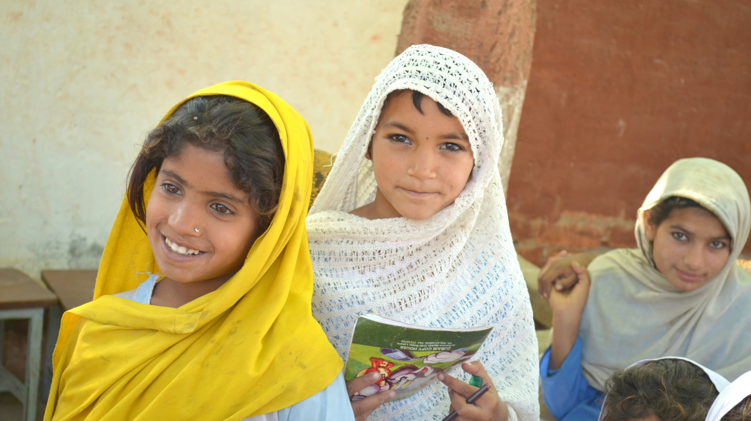
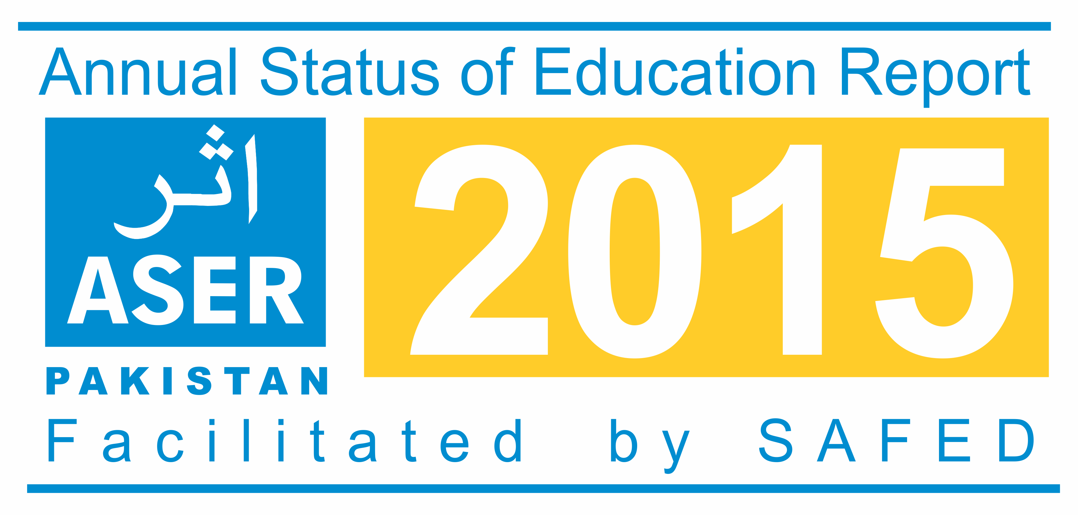
FINDINGS - PUNJAB

Slide 8
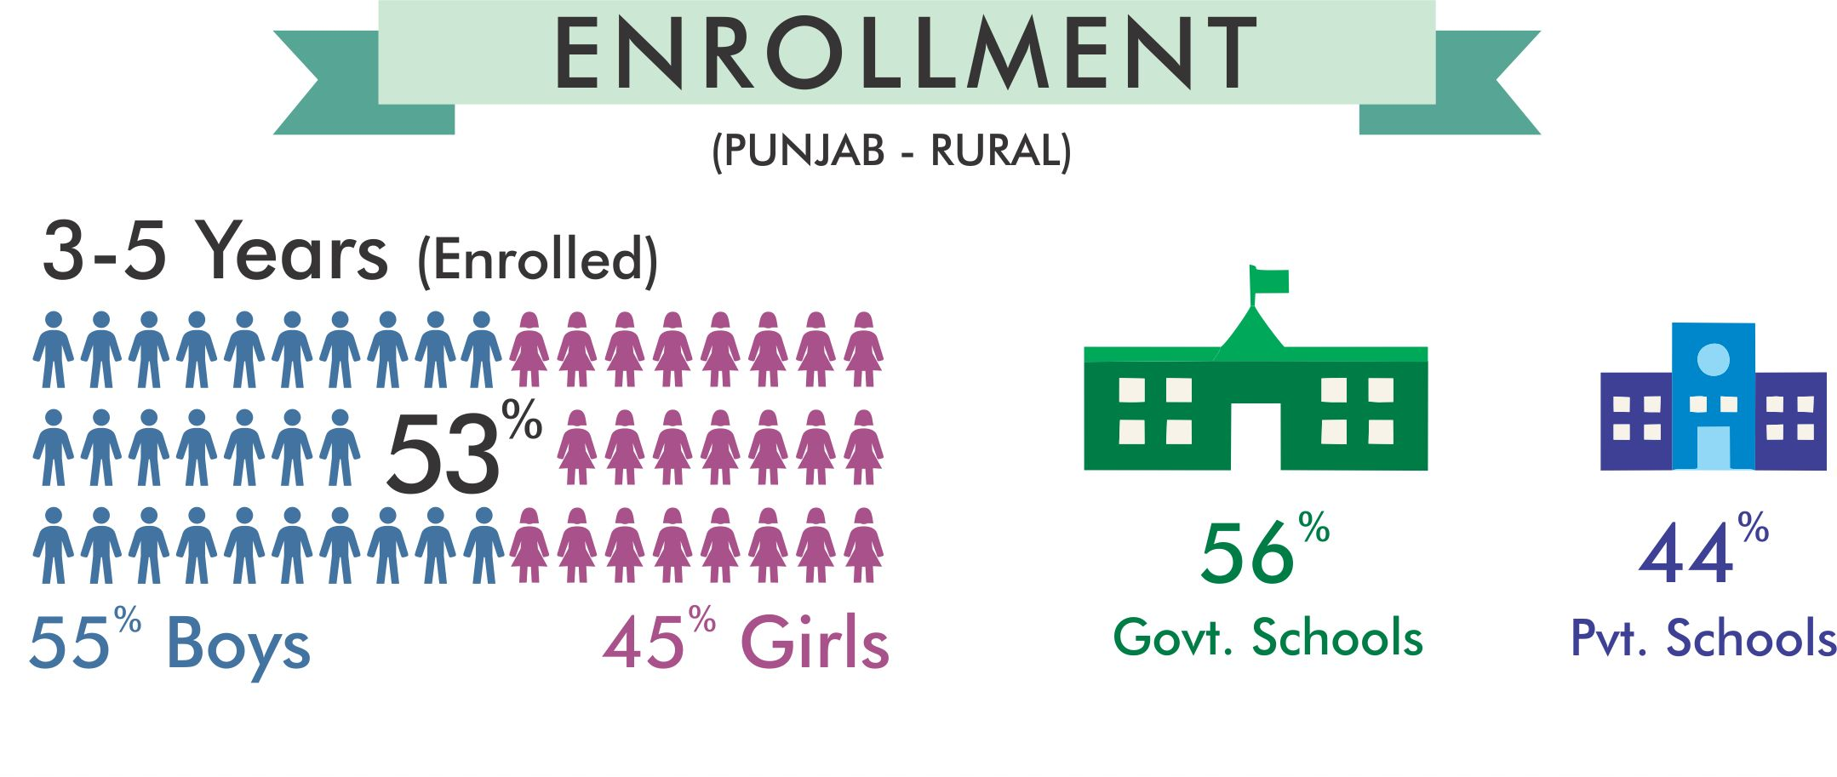
Proportion of enrolled children (3-5 years) has decreased (53%) as compared to 2014 (55%)

Slide 9
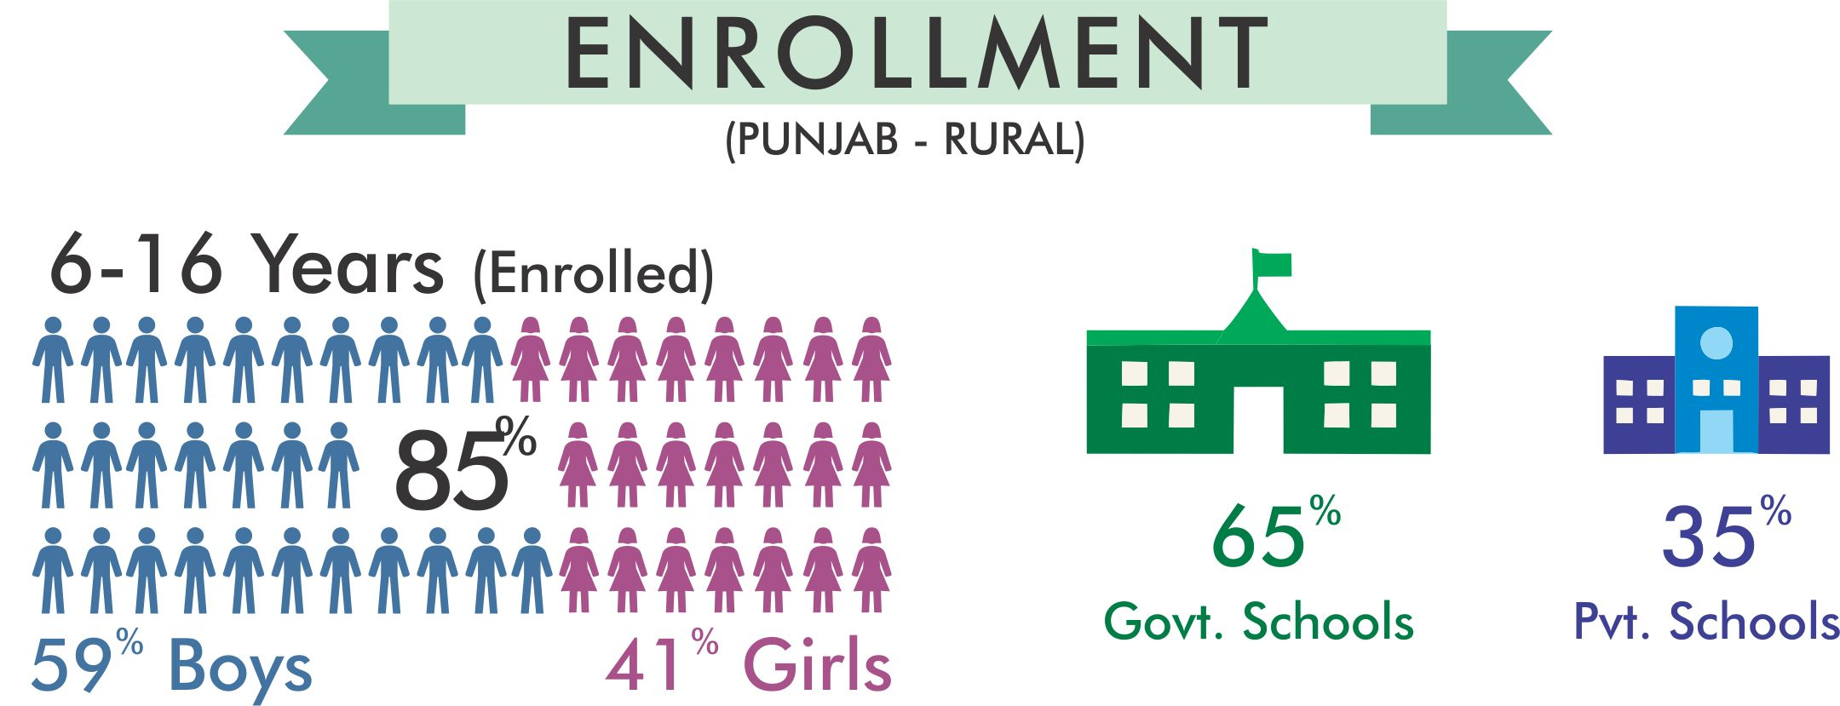
Proportion of enrolled children (6-16 years) has remained same as in previous year

Slide 10
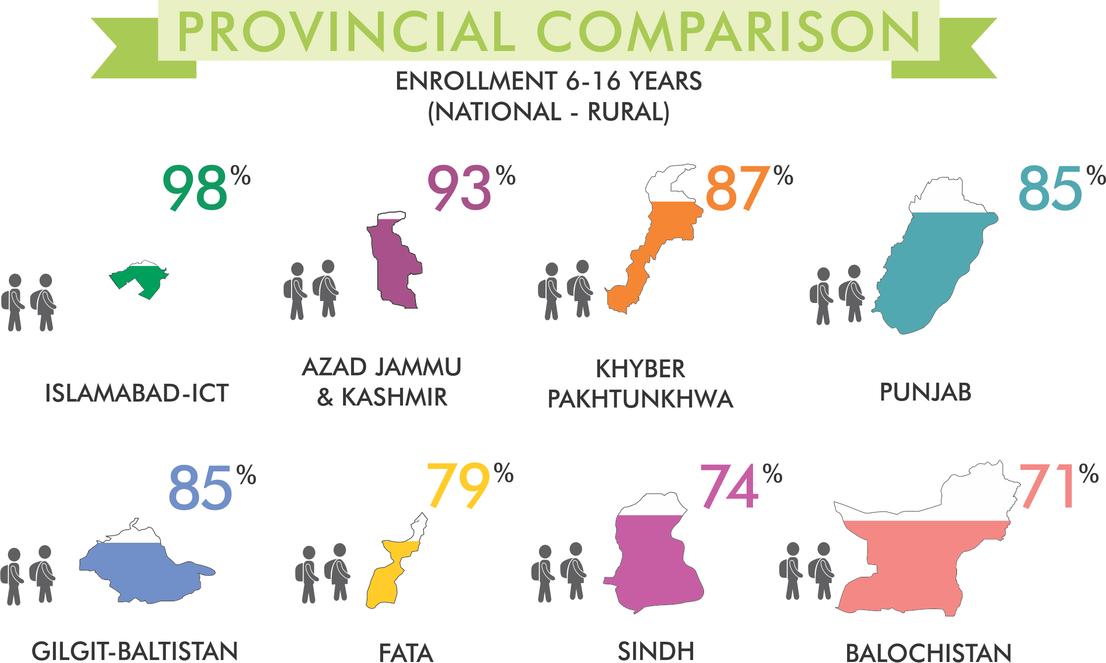
ICT has the highest percentage of children (age 6-16 years) enrolled

Slide 11
Gender gaps persists but the percentage of out-off-school children has remained the same as compared to 2014.
2014
2015
8%
8%
7%
7%

Slide 12
More children are found to be going to government schools
2014
2015
37%
65%
63%
35%

Slide 13
Class wise enrollment of children decrease with every class

Slide 14
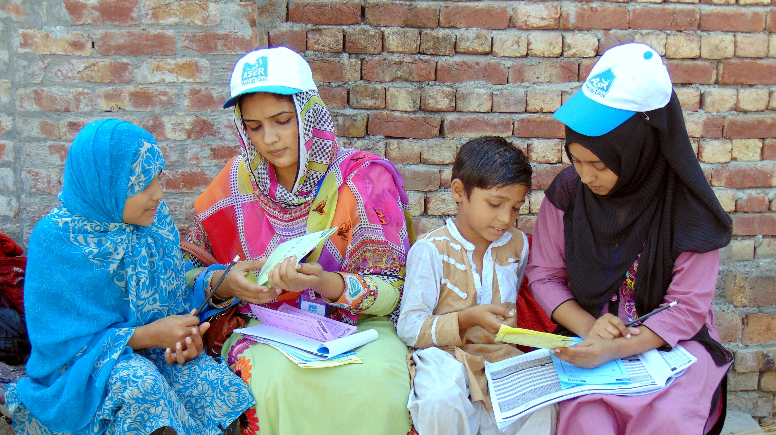
LEARNING LEVELS

Slide 15
Urdu (Class 5)
Learning levels of children show improvement
70%
63%
Can Read Story
2014
2015

Slide 16
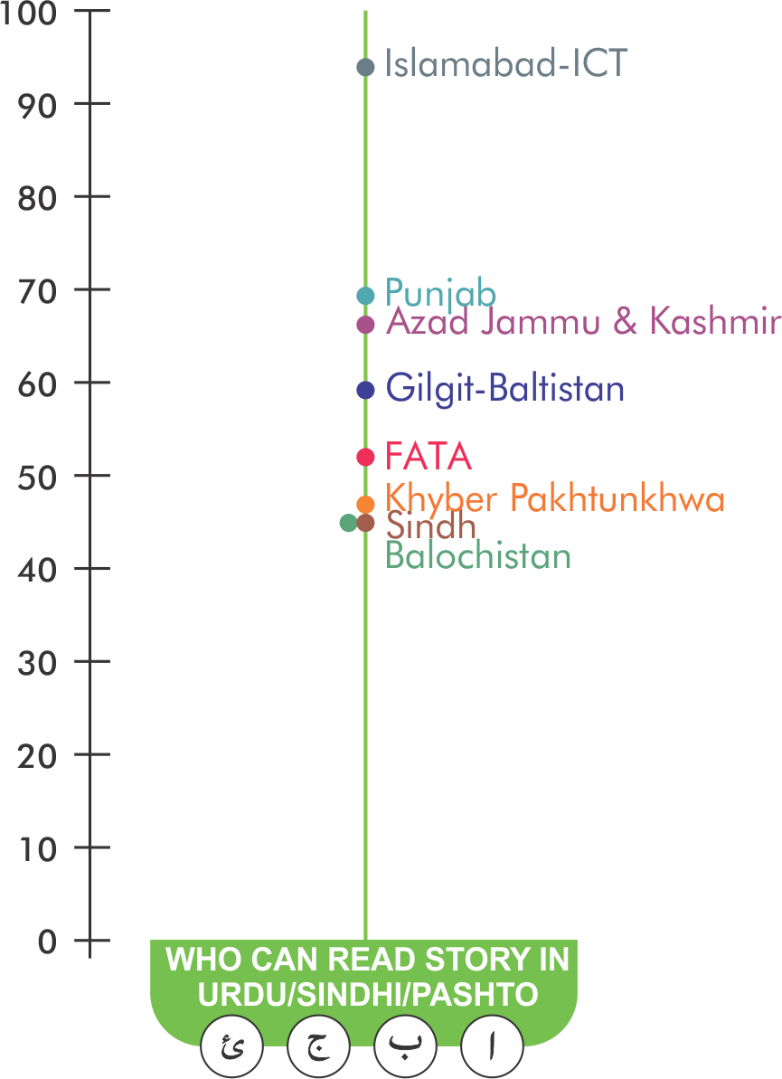
Urdu/Sindhi/Pashto (Class 5) Provincial Comparison
Balochistan still on the bottom
Balochistan has the lowest learning level (Urdu/Sindhi/Pashto) of children enrolled in class 5
Province/Territory-wise map showing % children who can read story of class 2 level.

Slide 17
Learning levels of children show improvement
English (Class 5)
60%
57%
Can Read Sentences
2014
2015

Slide 18
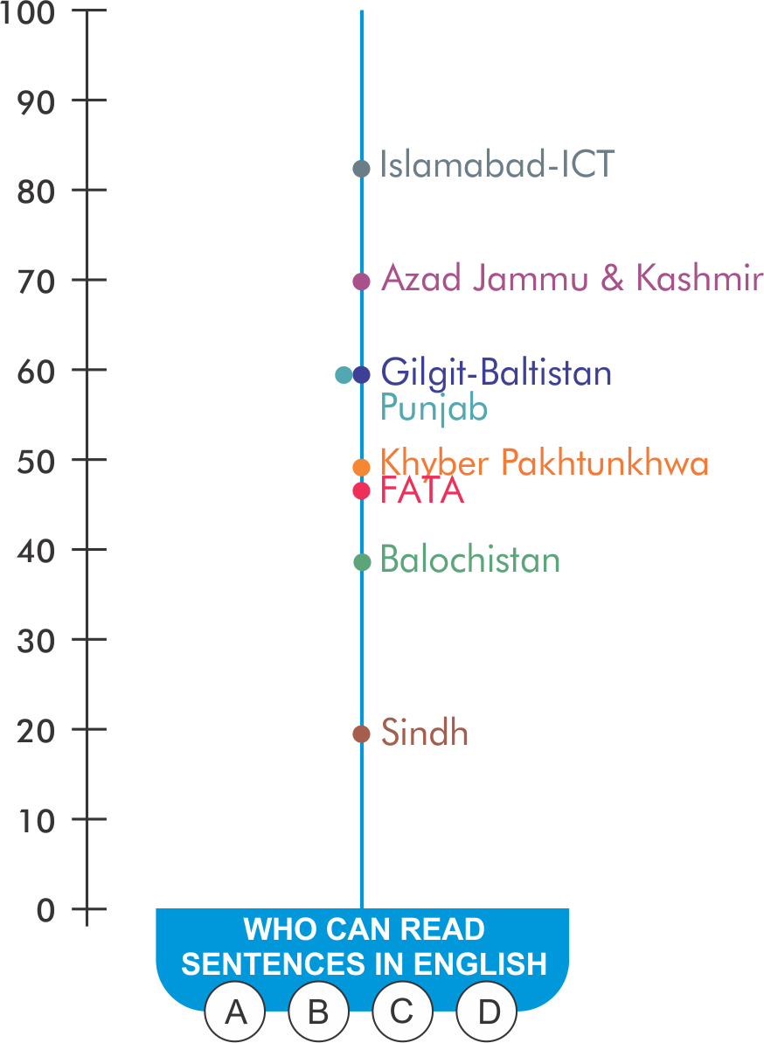
Sindh performing the worse
English (Class 5) Provincial Comparison
Sindh has the lowest learning level (English) of children, enrolled in class 5.
Province/Territory-wise map showing % children who can read sentences of class 2 level.

Slide 19
Learning levels of children show improvement
Arithmetic (Class 5)
59%
51%
Can Do 2-Digit Division
2014
2015

Slide 20
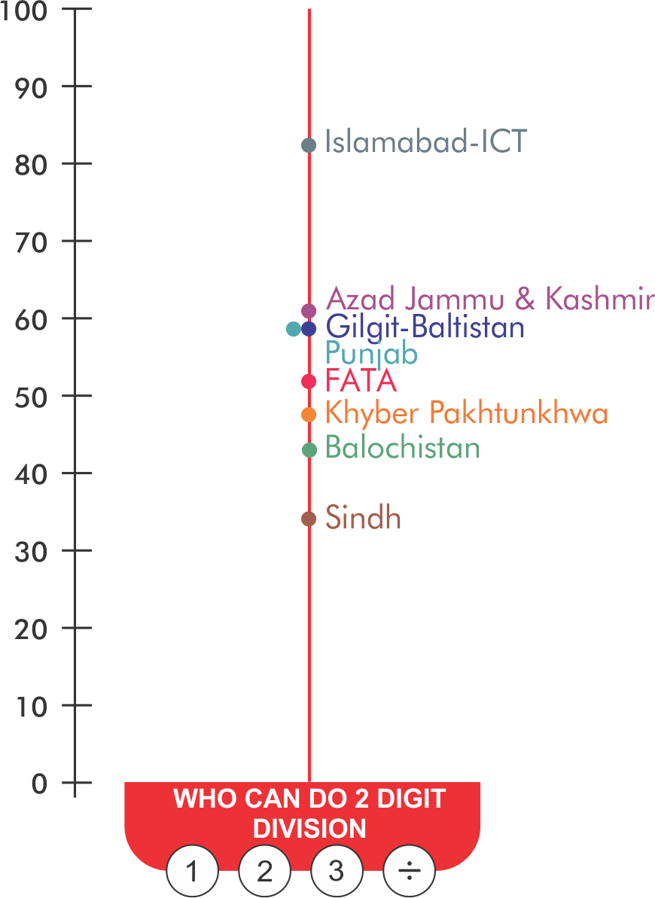
Sindh still on the bottom
Arithmetic (Class 5) Provincial Comparison
Sindh has the lowest learning level (Arithmetic) of children enrolled in class 5.
Province/Territory-wise map showing % children who can do 2-digit division of class 3 level.

Slide 21
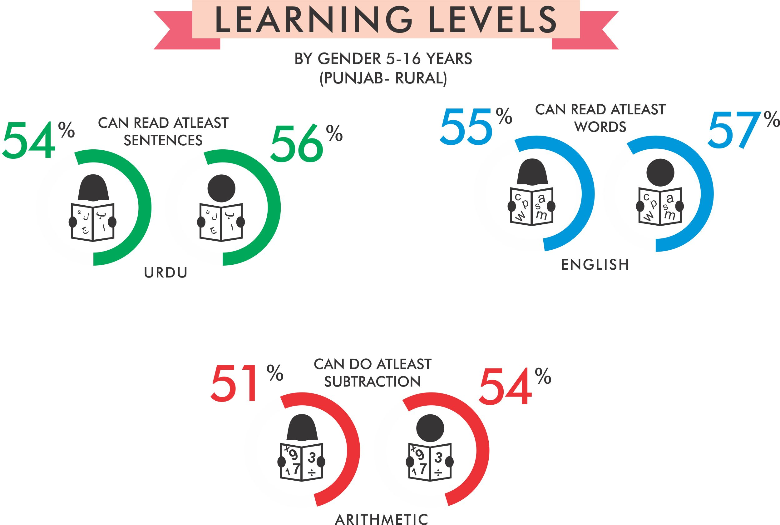
Gender gap in learning continues: Boys outperform girls

Slide 22
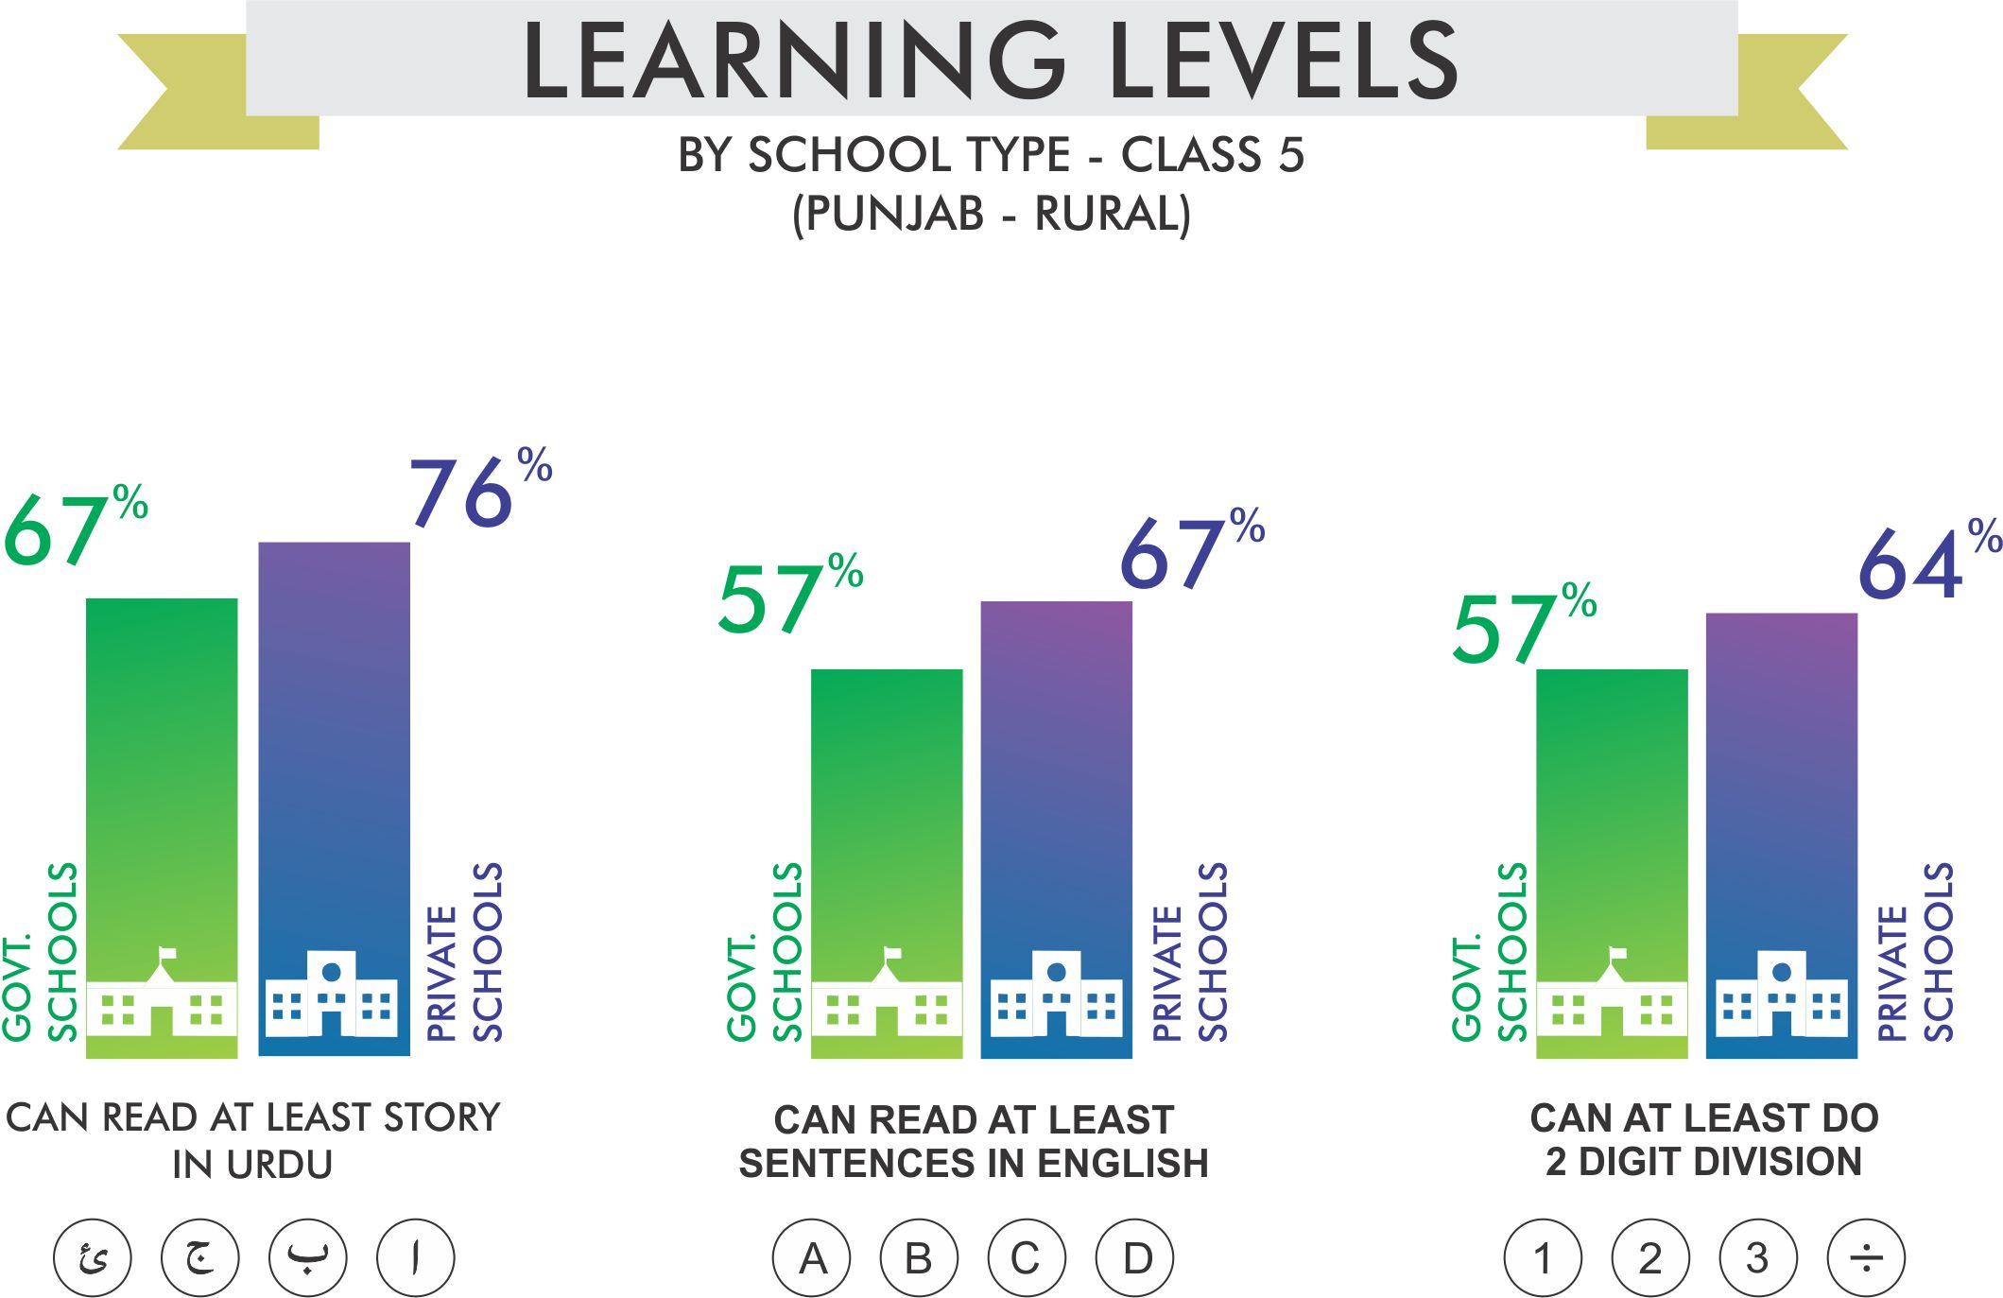
Children enrolled in private schools are performing better than their government counterparts

Slide 23
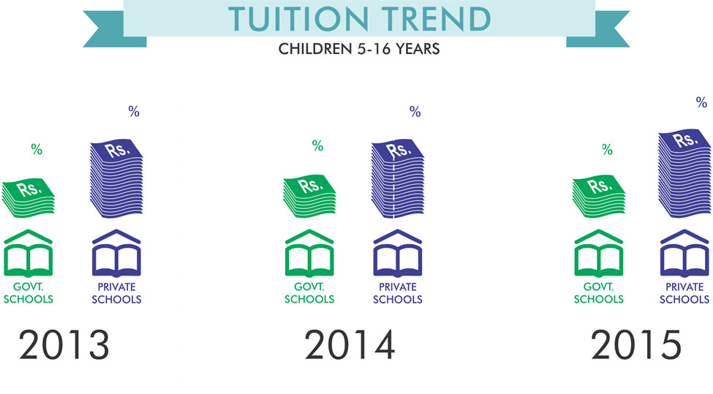
Private tuition incidence is greater in private school students
37
34
32
15
18
17

Slide 24
Out of the total parents in the sampled households, 38% mothers have not even completed primary education

Slide 25
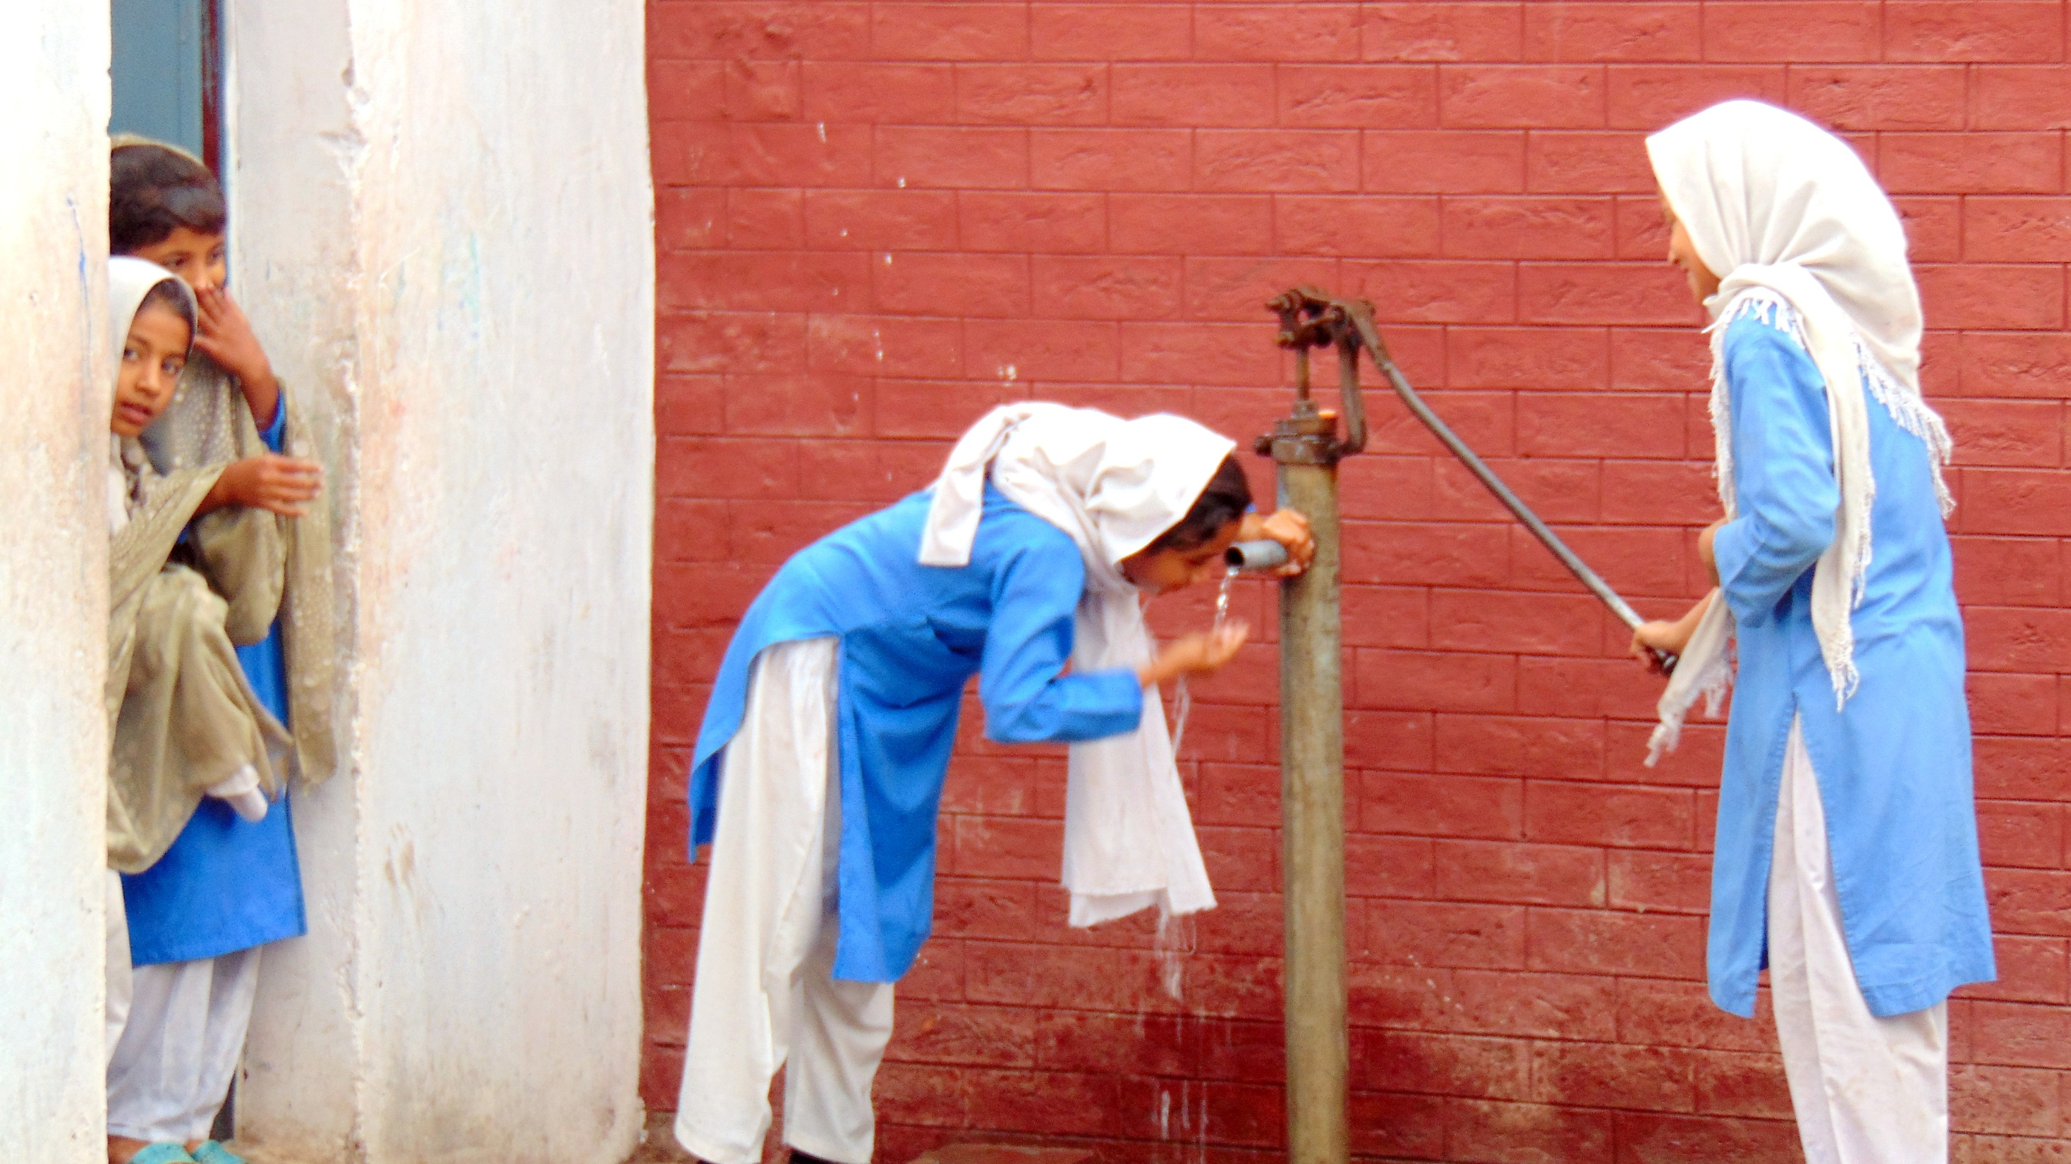
SCHOOL FACILITIES

Slide 26
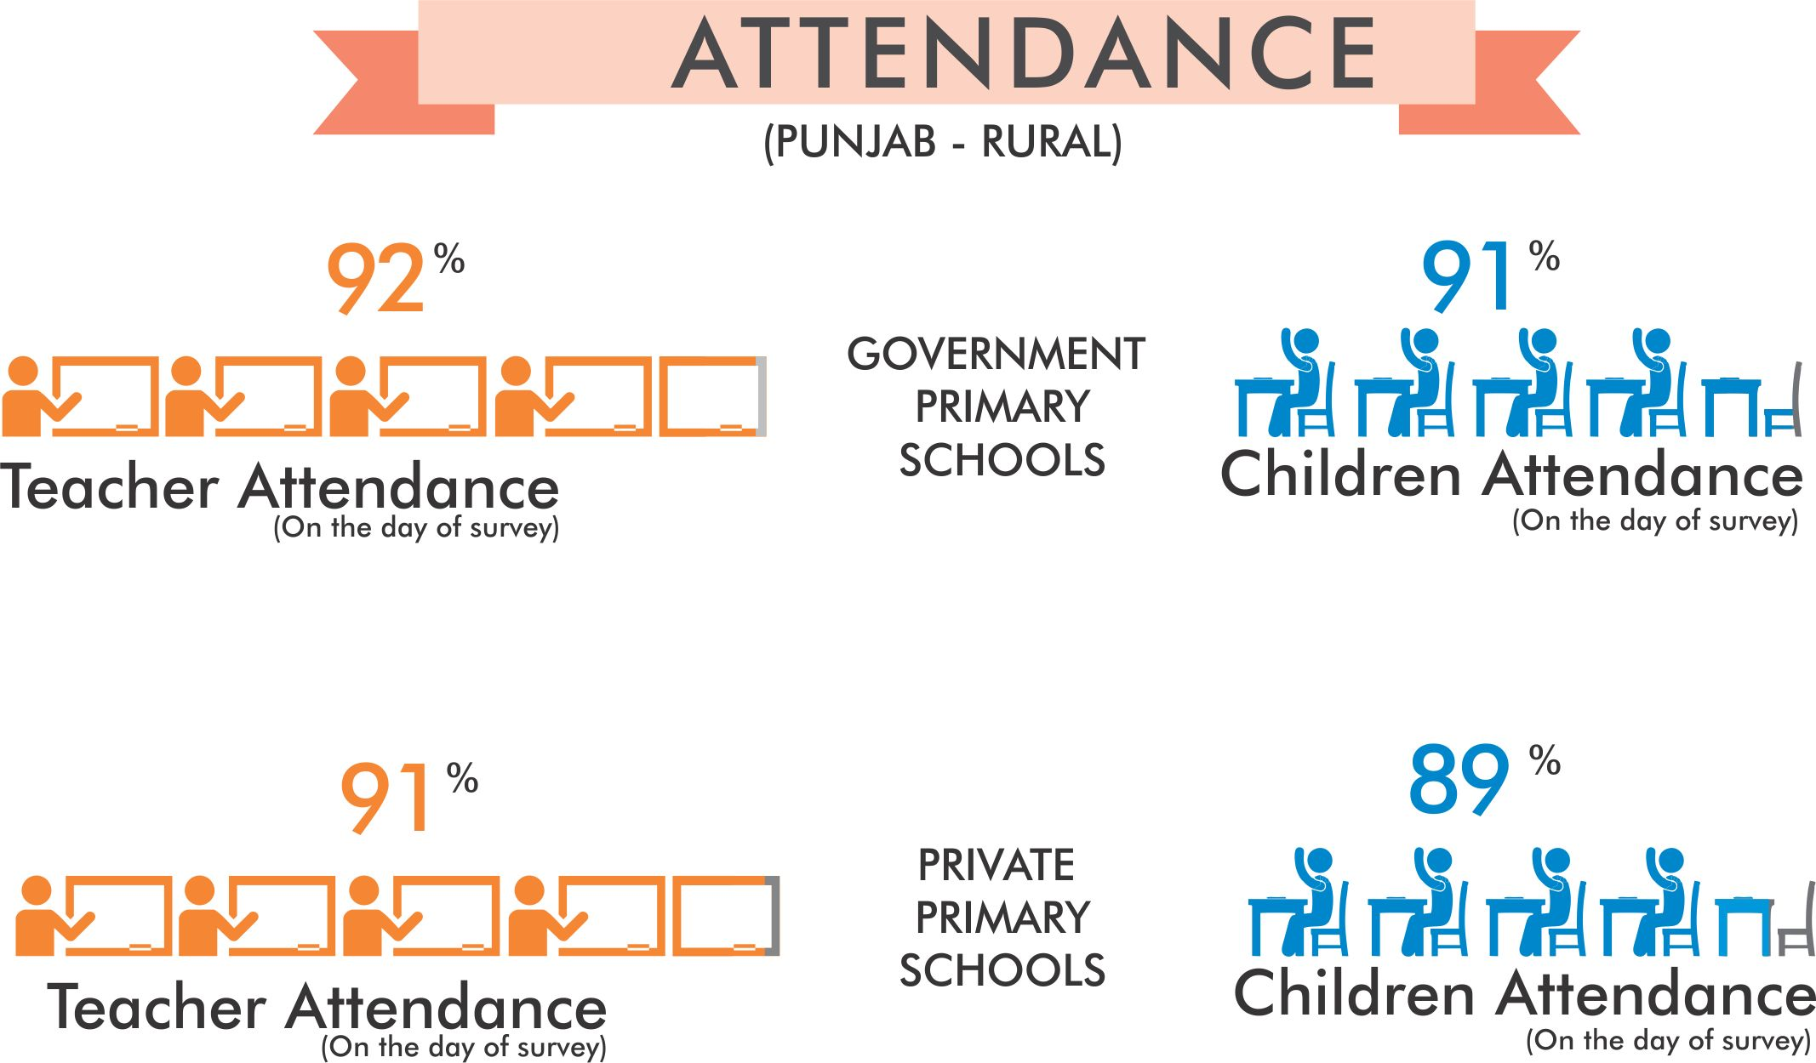
Teacher and student attendance better in government primary schools than private

Slide 27
More water and toilet facilities available in Govt. primary schools as compared to 2014

Slide 28
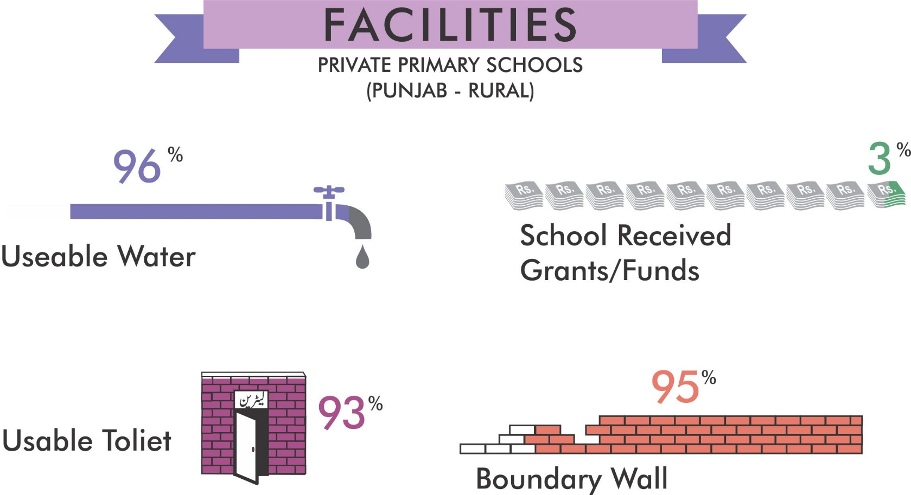
More water and toilet facilities available in private primary schools as compared to 2014

Slide 29
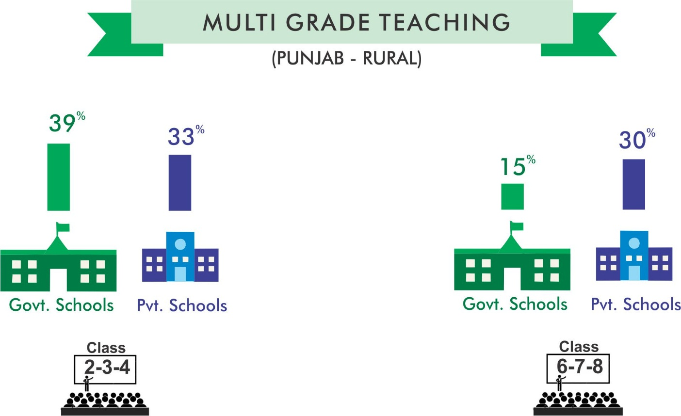
Problem of multi-grade teaching continues…..

Slide 30
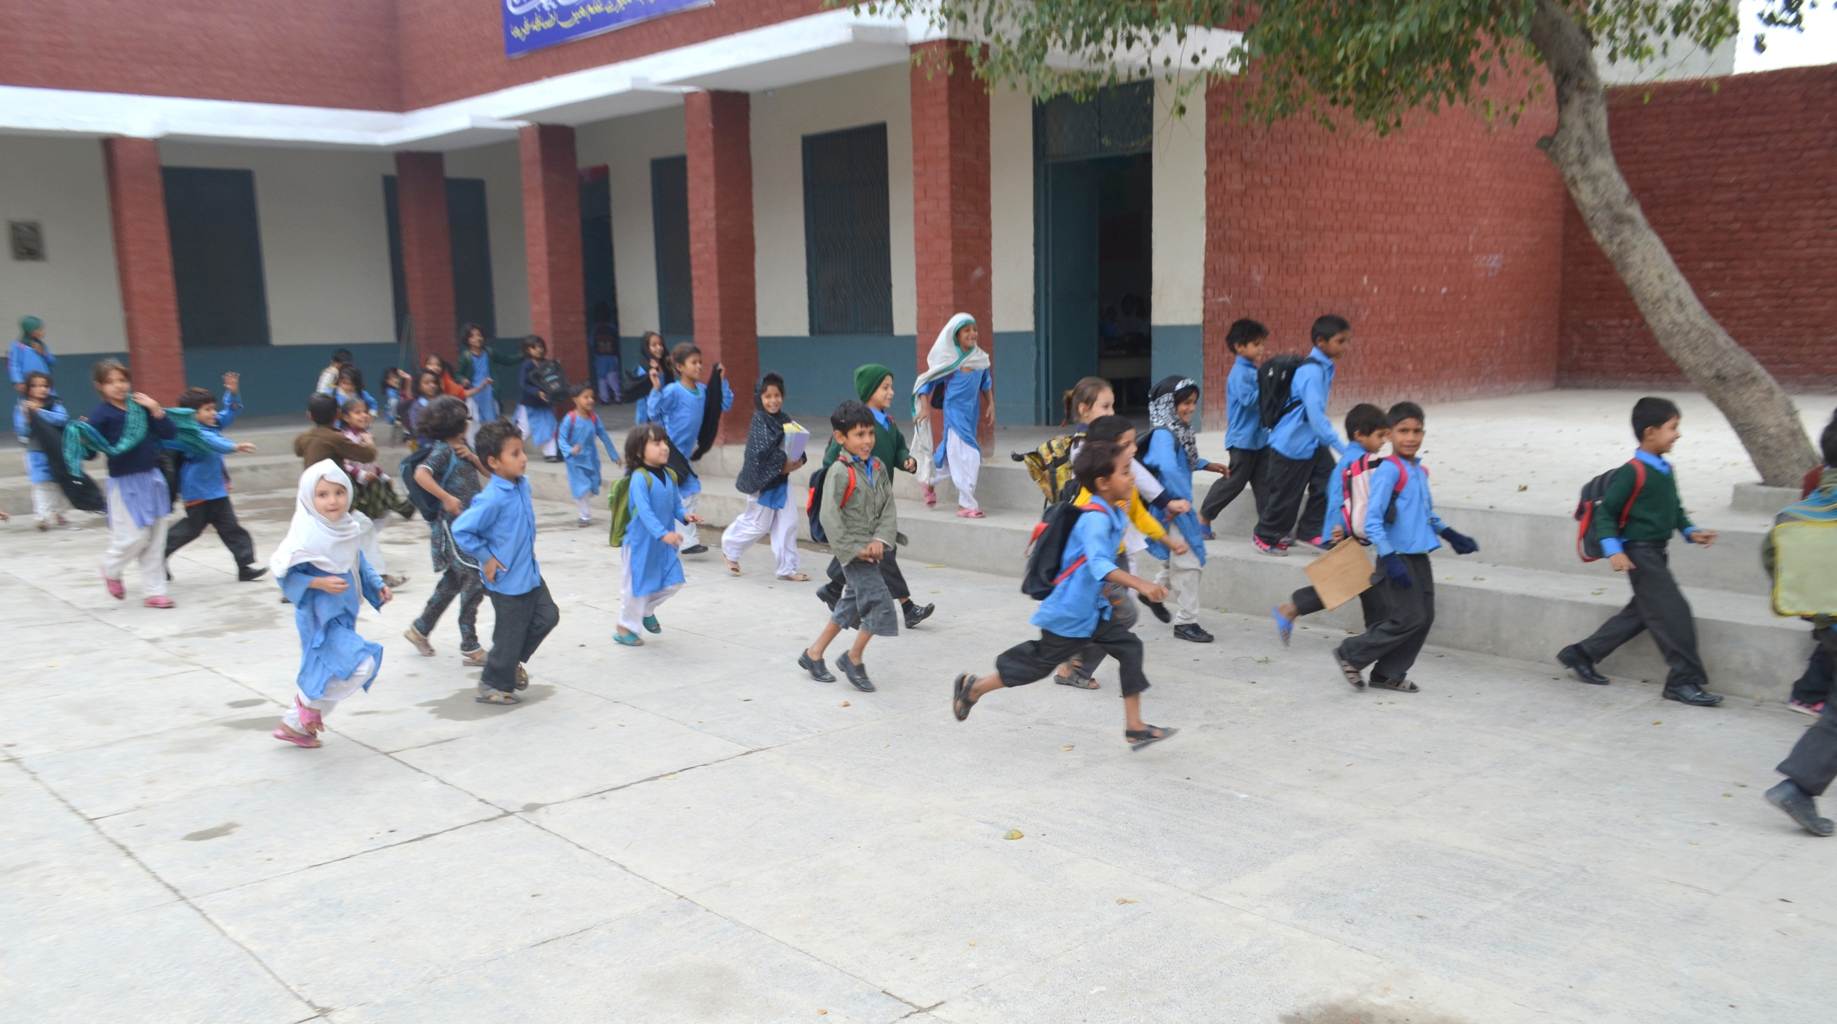
INNOVATIONS IN ASER 2015

Slide 31
What’s new in the tools
DISABILITY QUESTIONNAIRE
In collaboration with our senior ASER Fellows at Cambridge, London and Oxford Universities, one separate sheet comprising of 7 questions on disability/health and functioning was developed.
Disability / Health & Functioning Questionnaire has been conducted across 36 rural districts of Punjab in 2015.

Slide 32
DISABILITY FINDINGS
Findings of 36 rural districts of Punjab

Slide 33
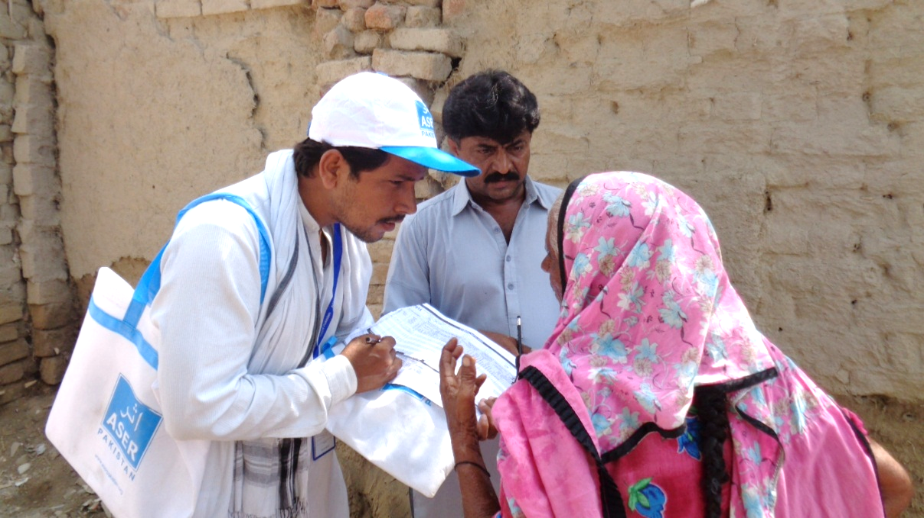
ASER IMPACT!

Slide 34
ASER a Powerful Reference & Benchmarking Document!
ASER IMPACT
Impact is when governments launch their own learning and numeracy drive (Punjab govt.) and conduct assessment of children in low primary levels.
Each province has developed 4 year Education Sector Plans up to 2018/19. 3 out of 4 are benchmarked to ASER with elaborate targets, strategies, costing and implementation details.
Endorsed by Ministers – Education Ministers (Ahsan Iqbal, Baligh ur Rehman, Gordon Brown etc)
Used by major TV channel and programs-- Zara Sochiye Campaign.
Quoted by high profile publications- incl. Michael Barber.
ASER part of Economic Survey of Pakistan since 2012, Global Monitoring Report since 2013 and many research institutions.
Influencing post 2015 development agenda and goal setting in regional and international consultations.
ASER Data set is linked to the website of all leading think tanks, provincial education Departments such as PMIU, RSU, Ministry of Finance, Minister of Federal Education and Provincial Training etc.
Availability of raw data set on the website for free.

Slide 35
ASER evaluated by external bodies- Research for Development (R4D) & Australian Council of Education Research (ACER)
EVALUATION FINDINGS
Work in Progress:
First draft has been shared by R4D. Key findings include:
ASER’s broad and varied coverage is unique among learning assessments in Pakistan and is its greatest strength.
ASER’s grassroots structure ensures cultural sensitivity and acceptance of volunteers by communities.
Concerted effort at the policy level has resulted in numerous citations of ASER Pakistan data.

Slide 36
Mobilizing 10,000 Volunteers – Citizens – Youth !
ASER PARTNERS
Al Fatah Organization
Azat Foundation
Change through Empowerment (CTE)
Community Research & Development Organization (CRDO)
Democratic Commission for Human Development (DCHD)
Department of Education, FATA
Department of Elementary and Secondary Education, Khyber Pakhtunkhwa
Directorate of Education, Gilgit Baltistan
EHED Foundation
Education Department, Balochistan
Education & Literacy Department, Sindh
Governance Assistance through Gender Mainstreaming and Social Restructuring (G & GS)
Hamza Development Foundation (HDF)
Health and Nutrition Development Society (HANDS)
Haq Development Foundation (HDF)
Idara-e-Taleem-o-Aagahi (ITA)
Institute for Professional Learning (IPL)
National Commission for Human Development (NCHD)
National Rural Support Program (NRSP)
Policy Planning and Implementation Unit, Government of Balochistan
Reform Support Unit (RSU), Sindh
Research and Community Development Organization (RCDO)
Society for Awareness, Advocacy and Development (SAAD)
School Education Department, Punjab
Sindh Education Foundation (SEF)
Sindh Student and Youth Development Organization (SSYDO)
Youth Association for Development (YAD)

Slide 37
Supporters of ASER!
ASER DEVELOPMENT PARTNERS

Slide 38
Calling ALL CITIZENS, GOVERNMENTS & PARTNERS TO SUPPORT LEARNING IMPROVEMENT- ASER II (2016-2025)
FROM EVIDENCE TO ACTION!
2

Slide 39
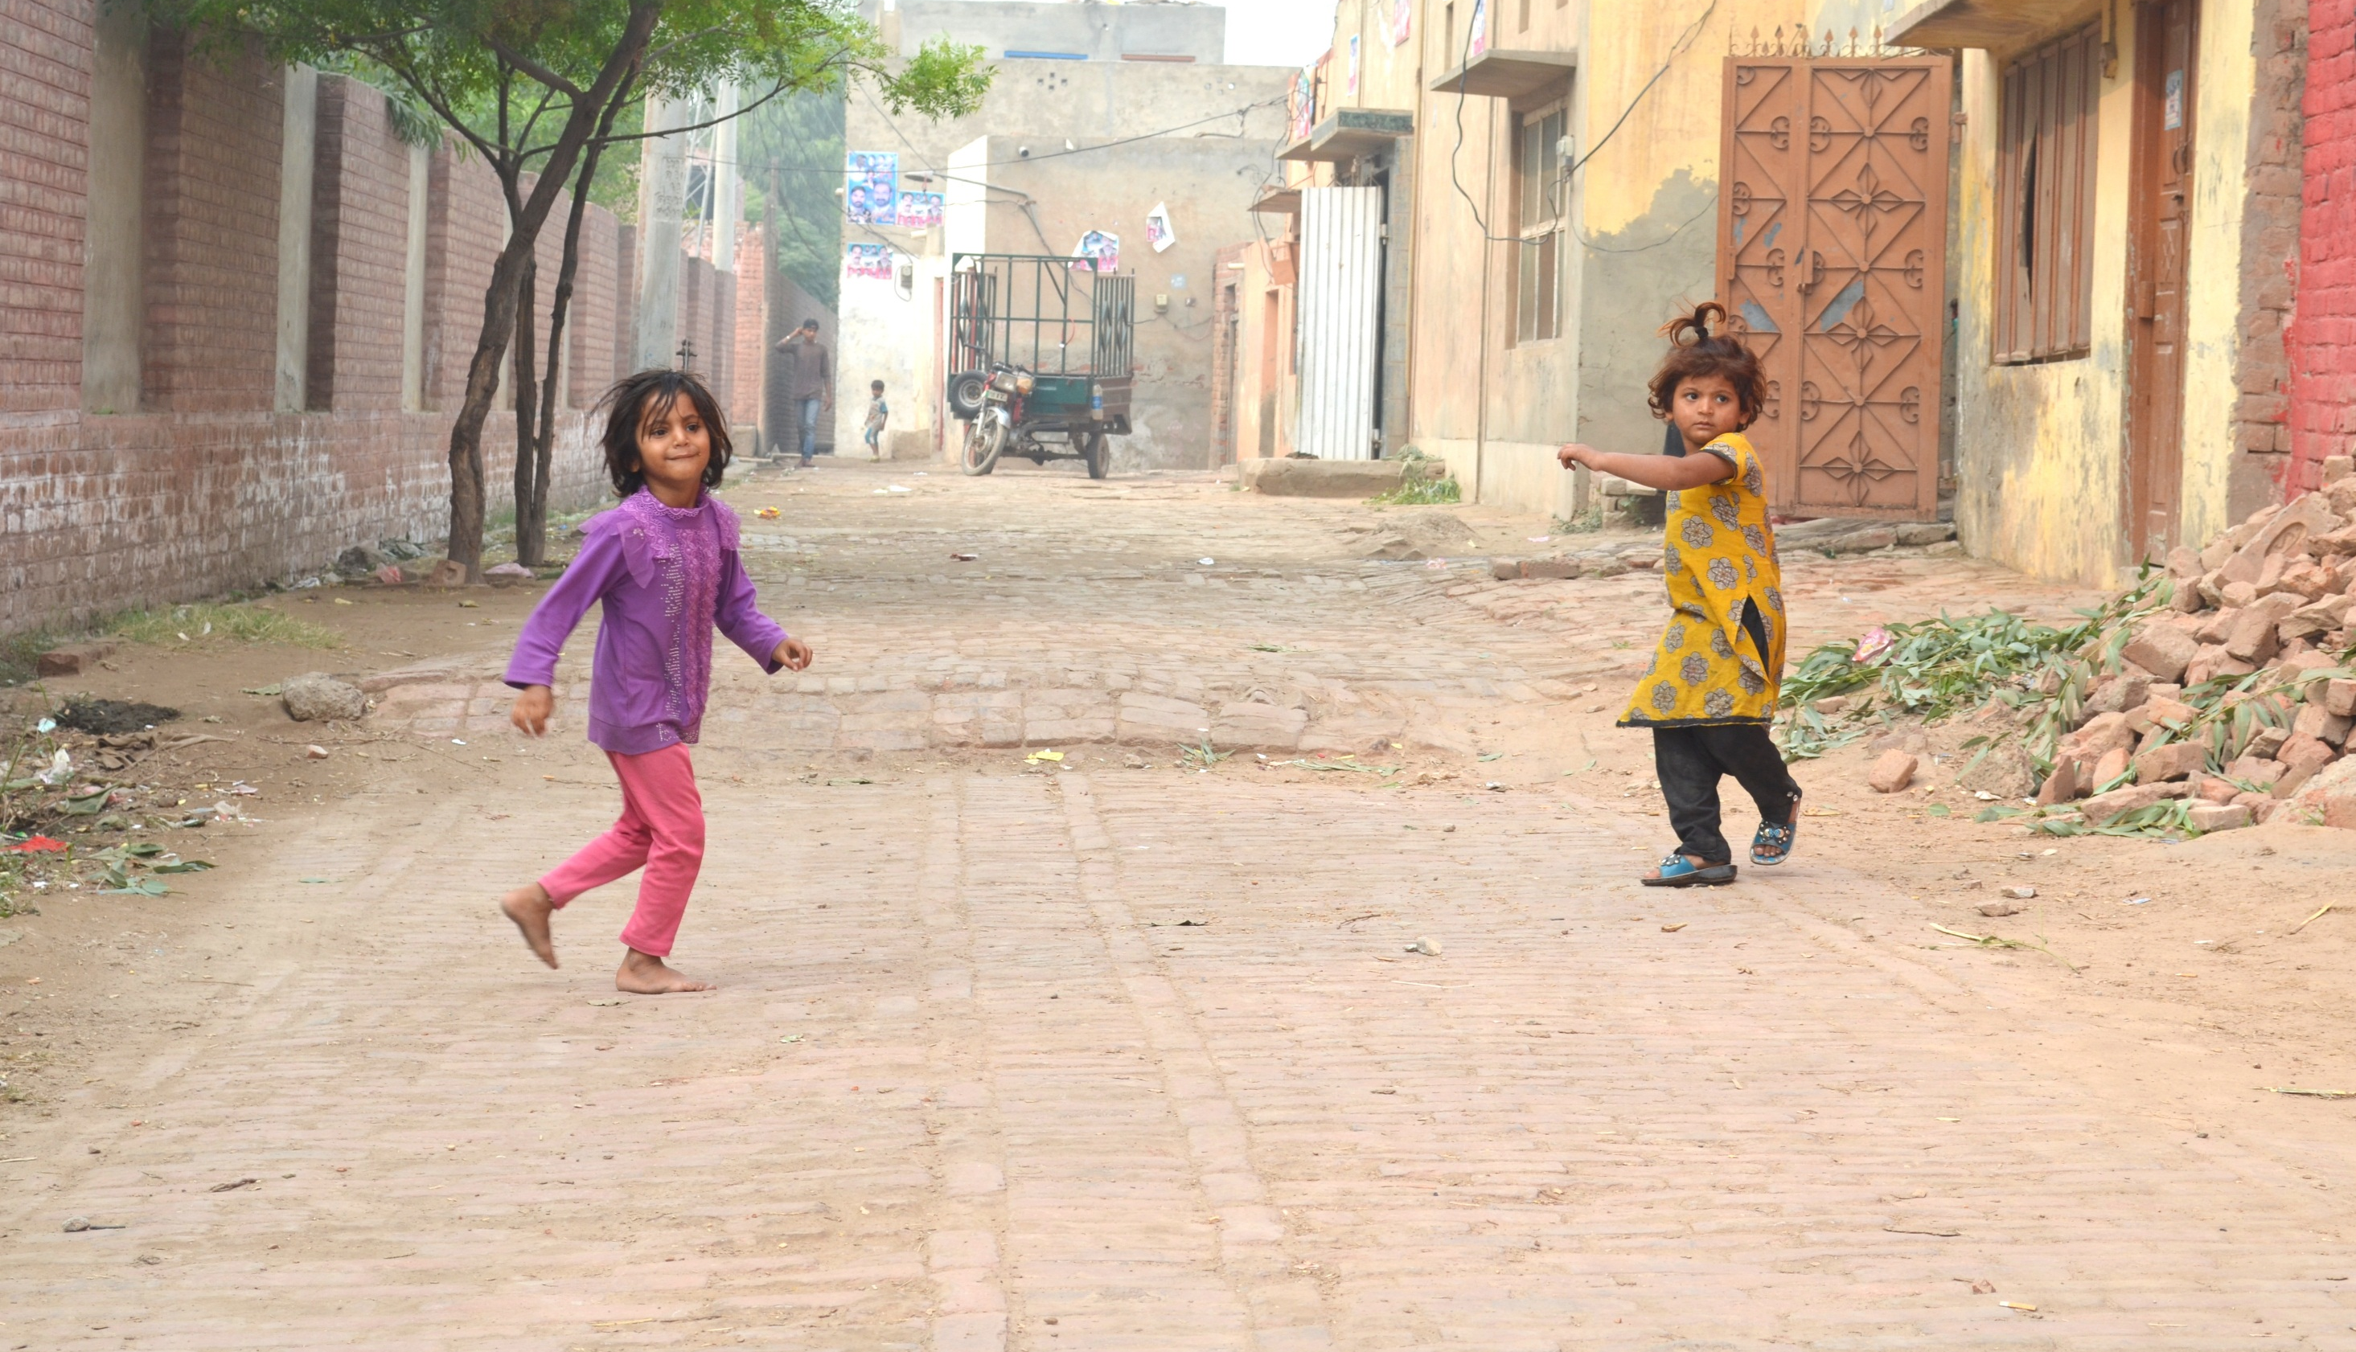
Thank You

