Slide 1
ASER PAKISTAN
A Citizen Led Initiative
National Launch
January 16, 2014
Islamabad

Slide 2
ASER PARTNERS
10,000 Volunteers – Citizens – Youth !

Slide 3
ASER PAKISTAN 2010-2015
Citizen led large scale national household survey (3-16 years).
Quality of education in rural and some urban areas (5-16 years).
Seeks to provide evidence on learning and access.
Influence National & Provincial policy and actions for Right To Education (RTE) Article 25-A.
Provides information for tracking MDG/EFA trends and targets up to 2015.
Influencing goal setting for Post-2015 agenda.

Slide 4
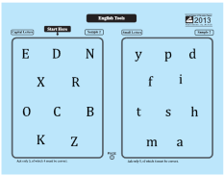
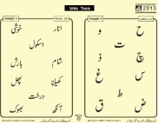
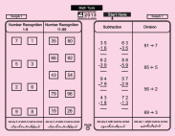
ASER ASSESSMENT TOOLS
ASER Assessment tools :
1. LEARNING
Reading (Urdu/Sindhi/Pashto)
Arithmetic
English
Assessments are based on Class II level curriculum for English & Urdu/Sindhi/Pashto and Class III level for Arithmetic.
HOUSEHOLD SURVEY
SCHOOL – GOVERNMENT & PRIVATE

Slide 5
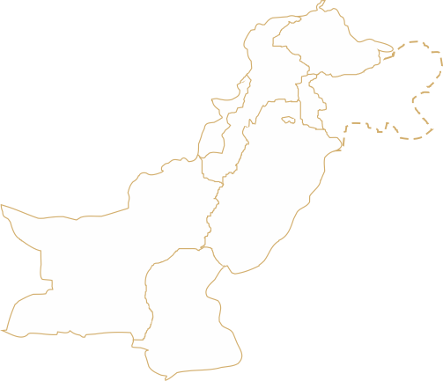
Scale of the Survey
138
Districts (Rural)
7
25
10
1
9
36
13
Districts (Urban*)
28
22
263,990 Children | 6,132 Schools | 4,382 Villages | 87,044 Households
*Urban: Karachi (East, West, Central, South and Malir), Hyderabad, Sukkur, Quetta, Rahim Yar Khan, Multan, Faisalabad, Lahore, and Peshawar.

Slide 6
FINDINGS

Slide 7
Enrollment (Pre-School 3-5 Years)
RURAL
4%
4%

Slide 8
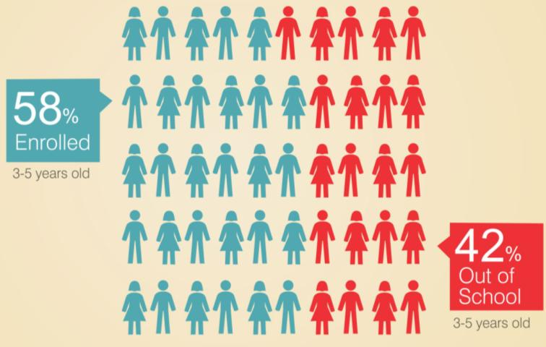
Enrollment (Pre-School 3-5 Years)
URBAN

Slide 9
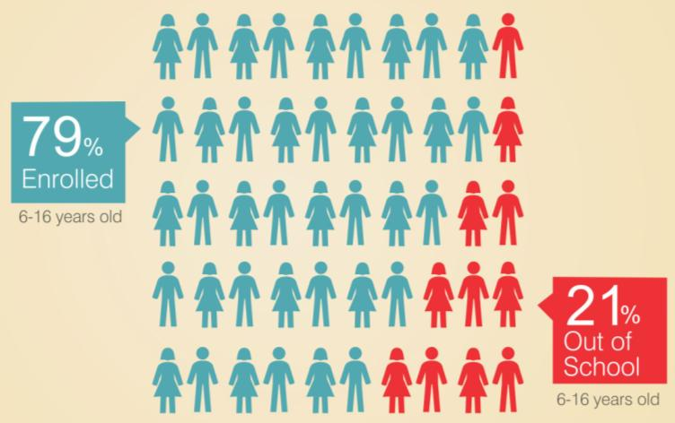
Enrollment (6-16 Years)
RURAL
2%
2%

Slide 10
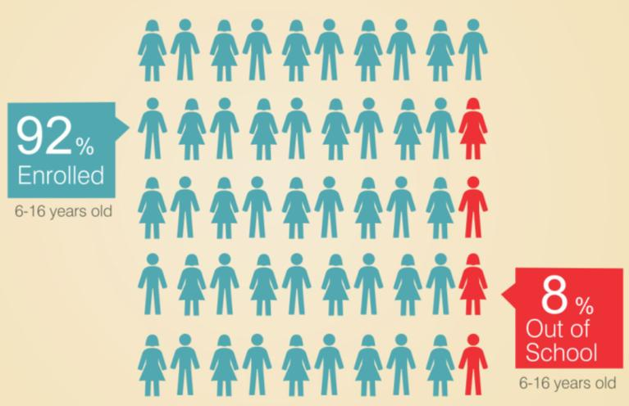
Enrollment (6-16 Years)
URBAN

Slide 11
Out of school children (6-16 Years)
RURAL

Slide 12
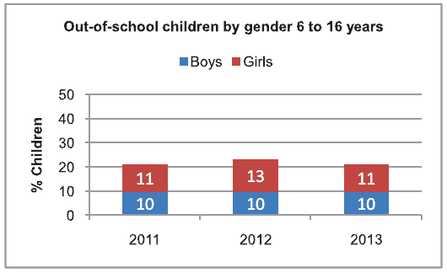
Gender Comparison
Out of School Children (6-16 years)
RURAL
More girls than boys continue to be out of school.
Proportion of out of school girls has decreased since 2012.

Slide 13
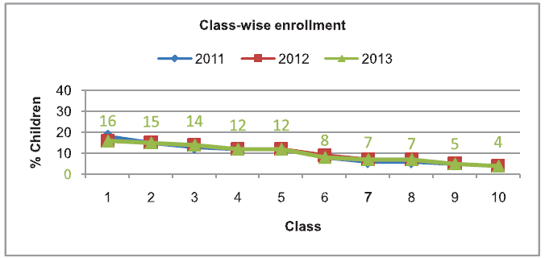
Class Wise Enrollment
RURAL
Enrollment decreases as class level increases
One third children are lost after primary schooling due to learning & facility gaps

Slide 14
QUALITY

Slide 15
50% children in class 5 can read Story in Urdu/Sindhi/Pashto
LEARNING LEVELS
URDU/SINDHI/PASHTO
RURAL

Slide 16
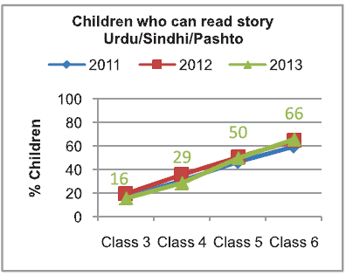
LEARNING LEVELS
URDU/SINDHI/PASHTO
RURAL
Learning levels remain poor: Half of the children from Class 5 cannot read Class 2 level story similar to 2012.

Slide 17
(Class 5)
LEARNING LEVELS
URDU/SINDHI/PASHTO
RURAL

Slide 18
43% children in class 5 can read Sentences in English
LEARNING LEVELS
ENGLISH
RURAL

Slide 19
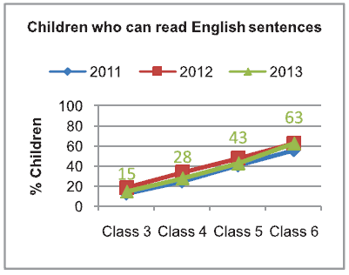
LEARNING LEVELS
ENGLISH
RURAL
43% of Class 5 children could read sentence in English (Class 2 level) in 2013 compared to 48% in 2012.

Slide 20
(Class 5)
LEARNING LEVELS
ENGLISH
RURAL

Slide 21
43% children in class 5 can do 2-digit division
LEARNING LEVELS
ARITHMETIC
RURAL

Slide 22
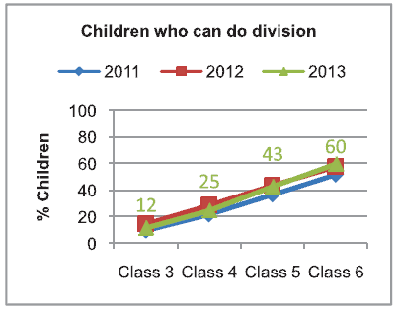
LEARNING LEVELS
ARITHMETIC
RURAL
43% of Class 5 children could do division (Class 3 level) in 2013 compared to 44% in 2012.

Slide 23
LEARNING LEVELS
ARITHMETIC
RURAL
(Class 5)

Slide 24
LEARNING LEVELS
BY GENDER (5-16 YEARS)
RURAL
Girls continue to lag behind boys in language and arithmetic competencies.

Slide 25
LEARNING LEVELS
Learning levels of children enrolled in private schools are better
TYPE OF SCHOOL
46% of children in government schools (Class 5) while 61% of children can read a story in Urdu/Sindhi/Pashto.
38% of children in government schools while 63% of children in private schools (Class 5) can read sentences in English.
40% of children in government schools while 54% of children in private schools (Class 5) can do division. .

Slide 26
ADDITIONAL LEARNING SUPPORT
PAID TUITION
Rural
Urban
Children in urban centers are more inclined to take paid tuition

Slide 27
ADDITIONAL LEARNING SUPPORT
PAID TUITION
RURAL

Slide 28
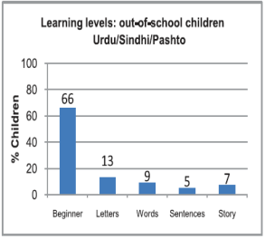
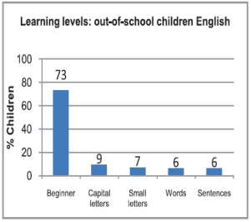
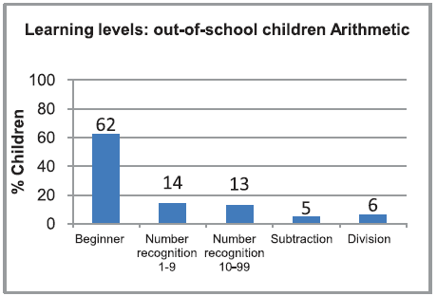
LEARNING LEVELS
OUT OF SCHOOL CHILDREN
RURAL
More than 30% out of school children are at more than ‘beginner’ level

Slide 29
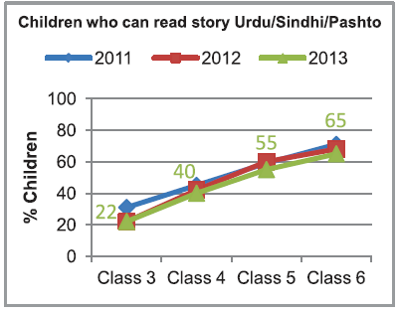
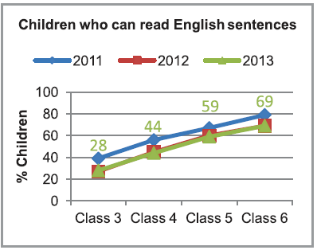
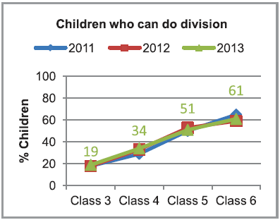
LEARNING LEVELS
URBAN
Learning levels of children living in urban centers are better compared to rural counter parts;
numeracy much better than rural (59% vs. 43%)

Slide 30
Rural-Urban Comparisons
 | Rural | Urban
Enrollment (3-5) | 41% | 58%
Enrollment (6-16) | 79% | 92%
Public Schools | 74% | 41%
Private Schools | 26% | 59%
Learning (Urdu /Sindhi/ Pashto)* | 50% | 55%
Learning (English) * | 43% | 59%
Learning (Arithmetic)* | 43% | 51%
Tuition: Govt. School Children | 5% | 24%
Tuition: Private School Children | 25% | 47%
Mothers Education (At least primary) | 24% | 60%
*Learning levels are taken for children enrolled in Class 5

Slide 31
School Attendance & Facilities

Slide 32
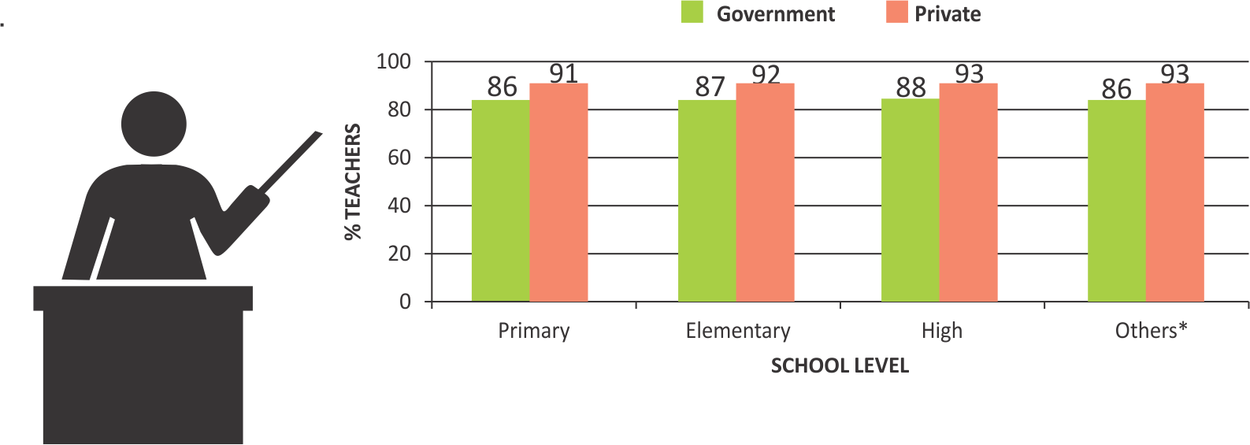
ATTENDENCE
TEACHER
RURAL
Overall teacher attendance is better in private schools
Teacher attendance trends have remained the same as in 2012.

Slide 33
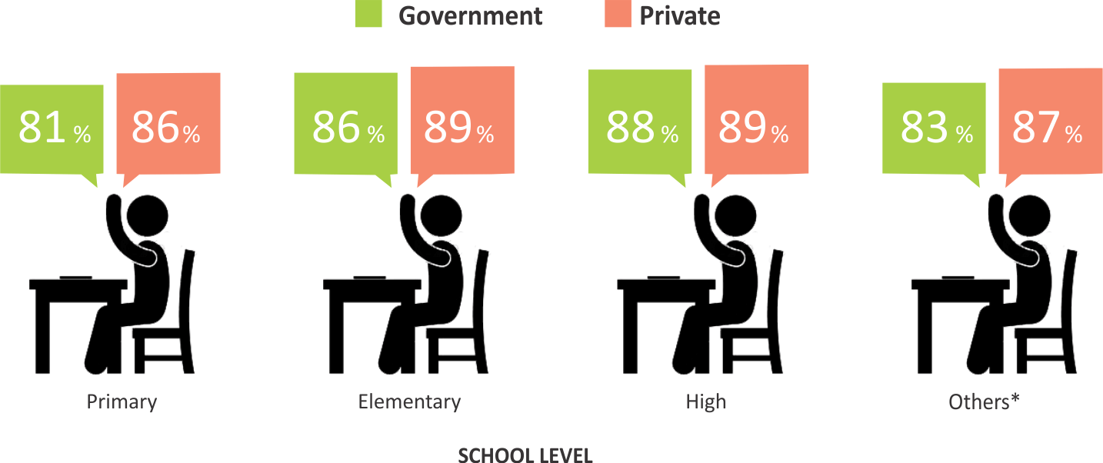
ATTENDENCE
CHILDREN
RURAL
Overall children attendance is better in private schools

Slide 34
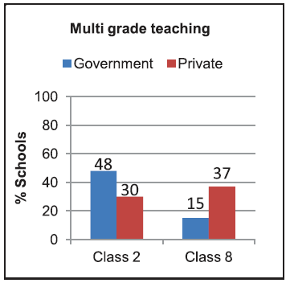
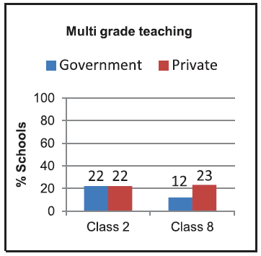
MULTI-GRADE TEACHING
Rural
Urban
Multi-grade teaching is higher in rural areas of Pakistan

Slide 35
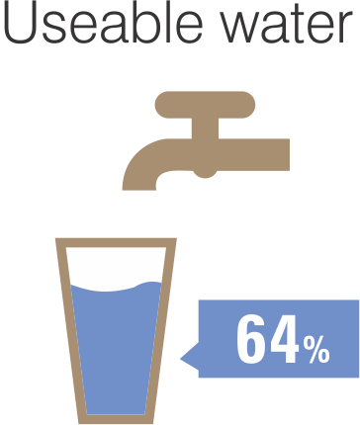
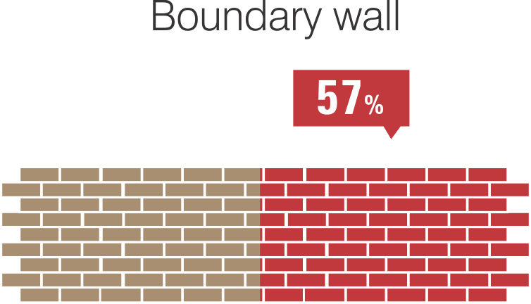
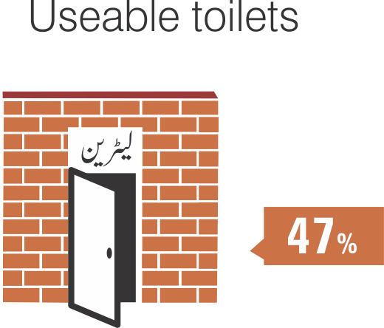
BASIC FACILITIES
GOVERNMENT PRIMARY SCHOOL
RURAL
Basic facilities in schools are still missing: only 64% government primary schools have drinkable water facility, 57% have complete boundary walls and 47% have usable toilets.

Slide 36
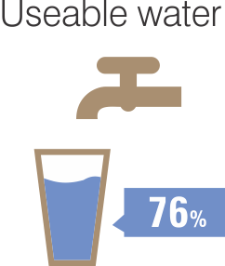
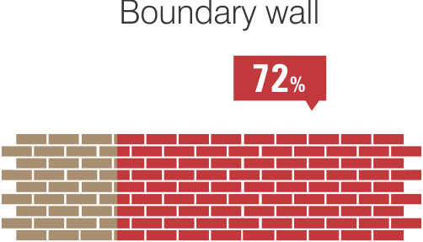
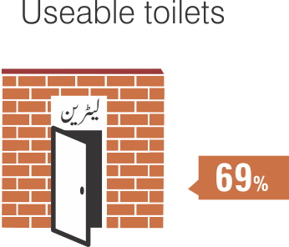
BASIC FACILITIES
GOVERNMENT PRIMARY SCHOOL
URBAN
Basic facilities in schools are missing in Urban as well: 76% government primary schools have drinkable water facility, 72% have complete boundary walls and 69% have usable toilets.

Slide 37
Dissemination with a Difference!
Mobilizing a Citizens’ Movement for Quality Education in Pakistan

Slide 38
ASER Dissemination
Segmented Groups for
Accountability & Action
ASER Baithaks/Jirgas/Katcheries (village/area gatherings) stakeholders: parents, communities, children, teachers . teachers, parents, children, government field officials to demand ACTION FOR IMPROVEMENT!
Teacher Unions & Associations Baithaks
District/Provincial/Federal Education & Literacy Departments
(Local, District, Provincial, National & International)
Youth Groups - mobilizing Ambassadors for Learning
Parliamentarians – politicians knocking on the doors in their constituencies
Judiciary & Judicial Academies- evidence backed judgments on 25 A
Academia/University /Research Groups - Pakistan & Abroad
Civil Society Organizations – nationwide- globally
Social Media
Media – Media – Media !

Slide 39
Supporters of ASER Pakistan

Slide 40
Thank You

