Slide 1
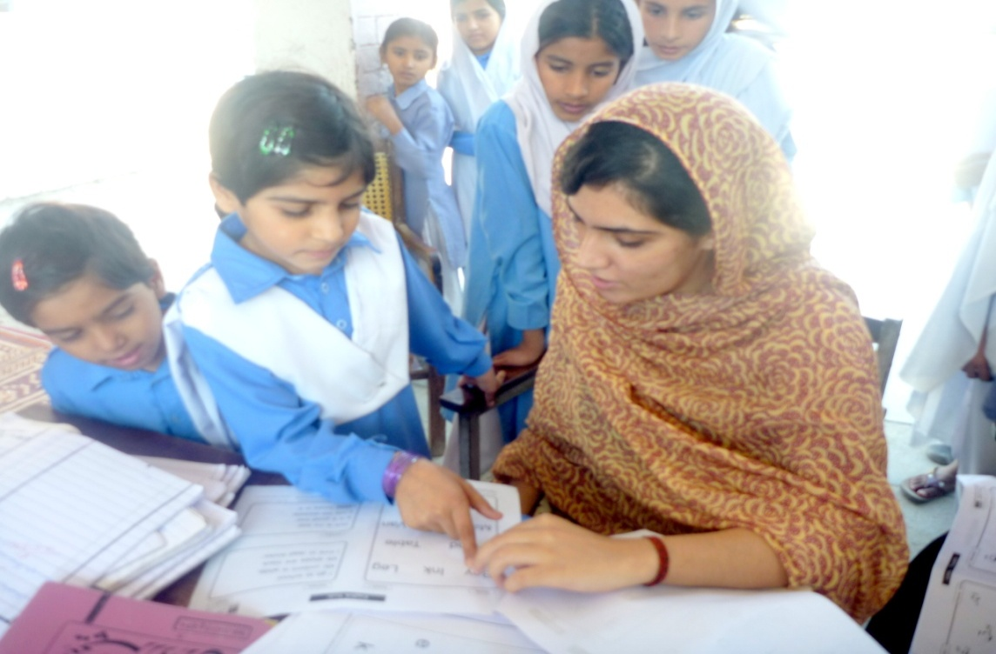
ANNUAL STATUS OF EDUCATION REPORT (ASER)
2012
Mandi Bahauddin

Slide 2
ASER PAKISTAN 2010-2015
Citizen led large scale national household survey (3-16).
Measure quality of education in rural and some urban areas (5-16 years).
Seeks to provide evidence on learning and access gaps.
Objectives are:
To get reliable estimates of the status of children’s schooling and basic learning (reading and arithmetic level) at the district level.
To measure the change in these basic learning and school statistics from last year.

Slide 3
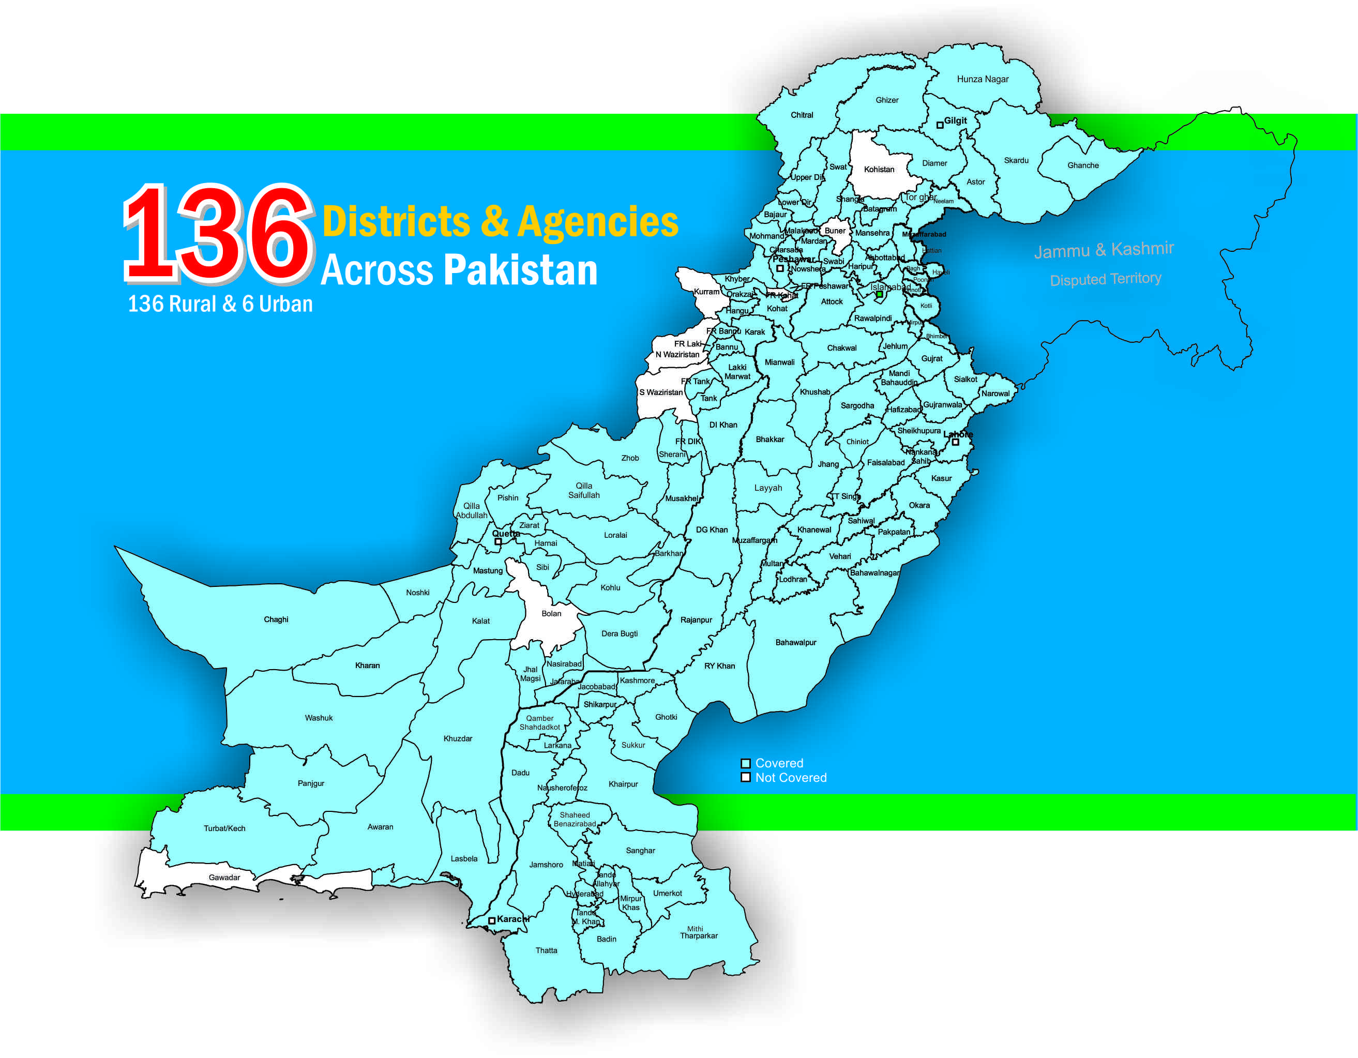
ASER Outreach over the last 3 years
2010 – 32 districts
2011 – 85 districts
2012 – 142 districts

Slide 4
Scale
Coverage: Across Pakistan
ASER 2012: 136 districts across Pakistan
(136 Rural + 6 Urban /5 overlap with rural districts)
Punjab : 36 district in 2012 compared to 28 districts in 2011
Sample: 600 households per district. Two-stage stratified sample;
30 Villages
20 Households per village
60 Schools per district
2 Schools per village (1 Govt. & 1 Private school)

Slide 5
Scope
Access:
Enrollment, Type of School etc.
Quality of Learning:
Tested Subjects: Urdu, English and Math
School Facilities:
Attendance teachers and children
Availability of drinking water
Availability of functional toilets, play ground and boundary walls

Slide 6
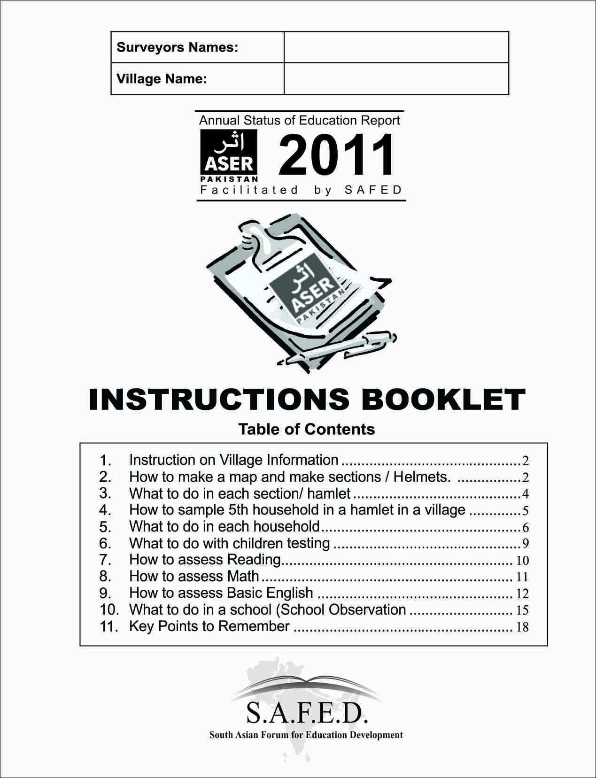
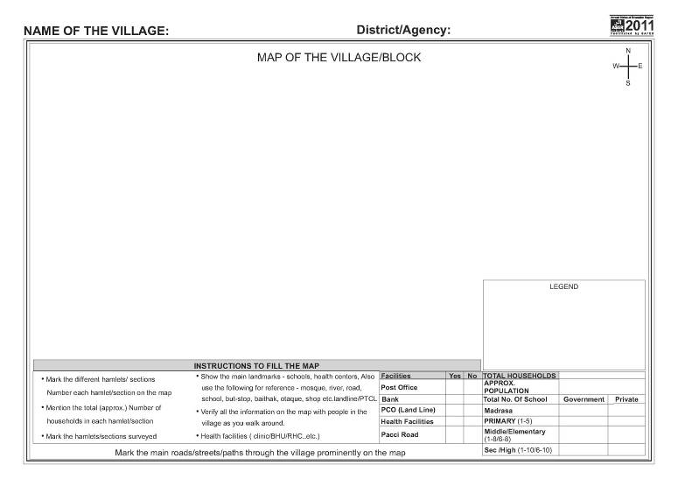
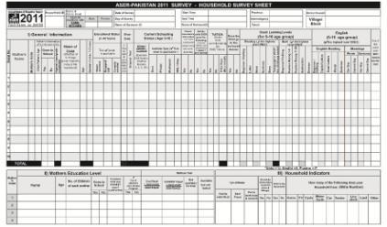
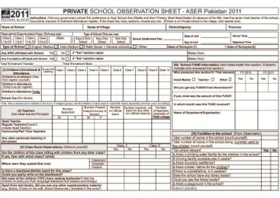
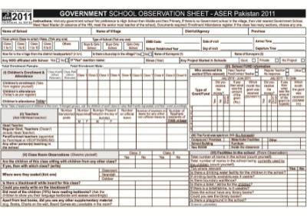
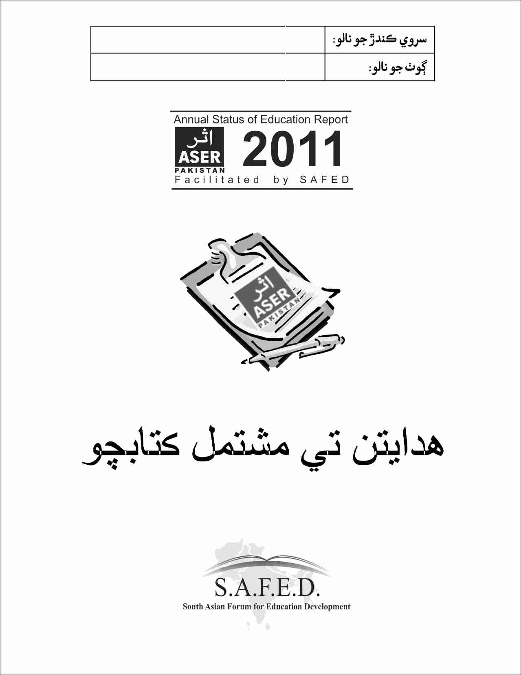
ASER Survey Sheets

Slide 7
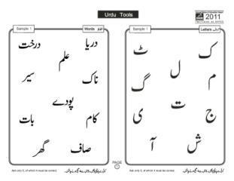
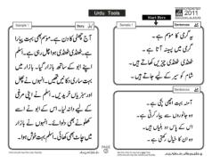
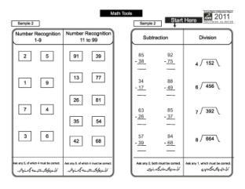
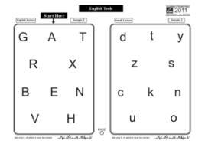
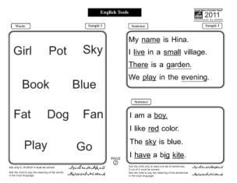
ASER Pakistan Assessment Tools Grade II
ASER Assessment tools are prepared in following Categories
Reading
Urdu
Sindhi
Pashto
Arithmetic abilities
English

Slide 8
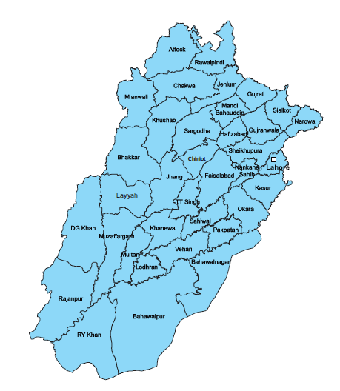
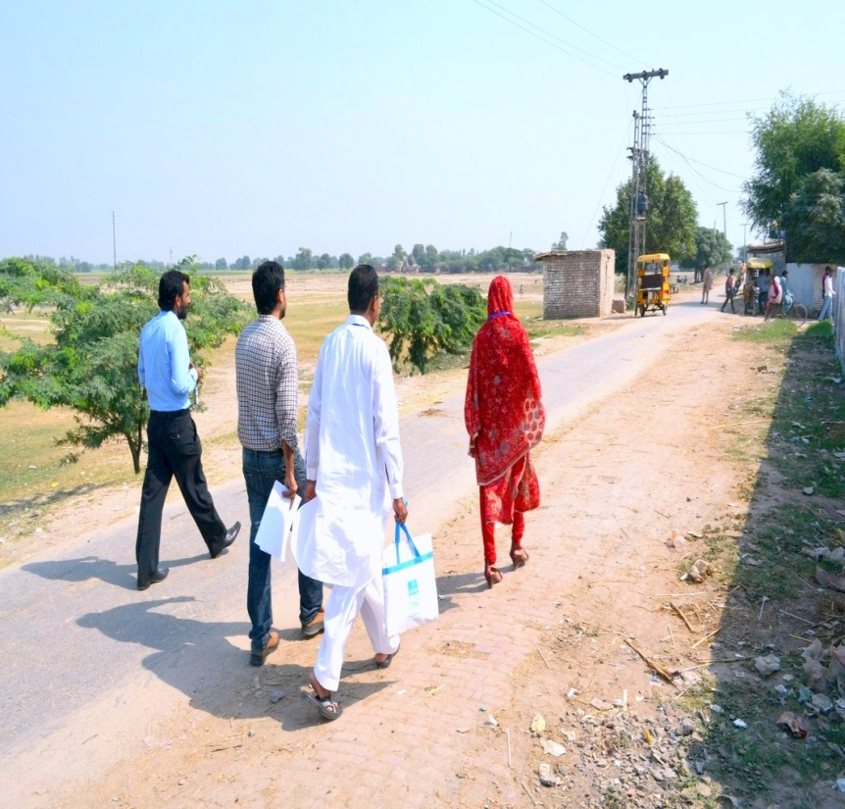
36 Districts Surveyed in Punjab

Slide 9
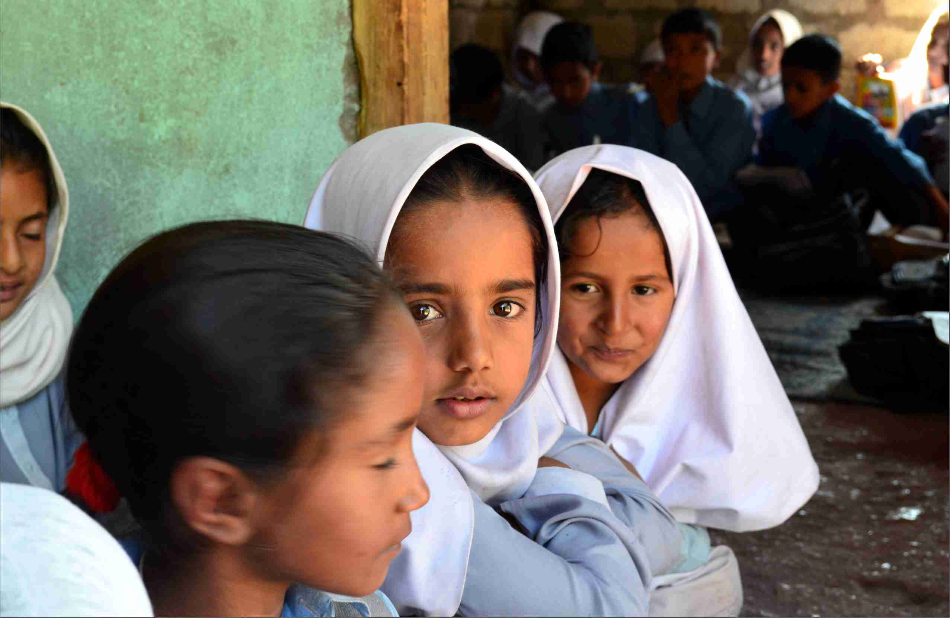
ASER Mandi Bahauddin

Slide 10
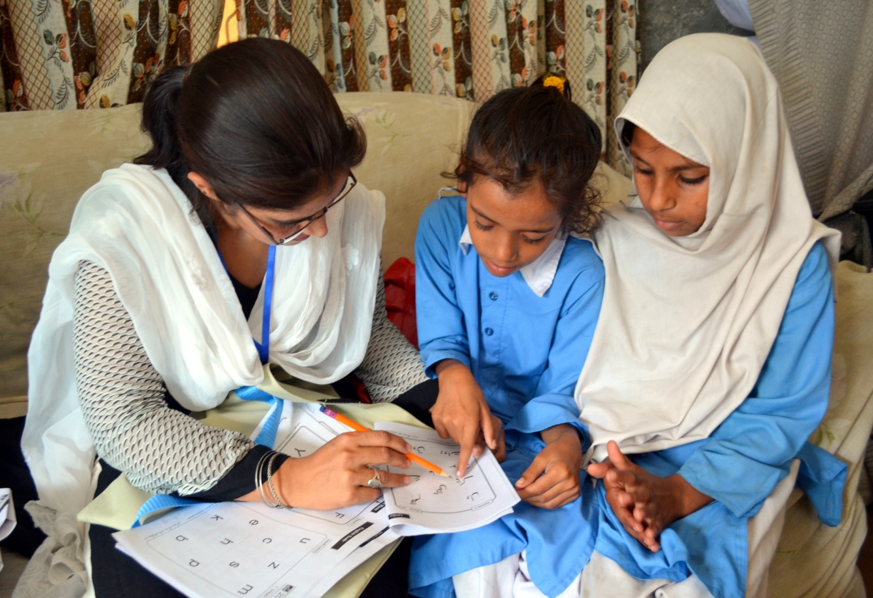
Access
What are our children doing?

Slide 11
Enrollment in Mandi Bahauddin
% Children in different types of schools |  |  |  |  | % Out-of-school |  | Total
Age group | Govt. | Non-state providers |  |  | Never enrolled | Drop- out
 |  | Pvt. | Madrasah | Others
6-10 | 57.6 | 37.4 | 1.5 | 0.3 | 1.7 | 1.4 | 100
11-13 | 65.3 | 23.8 | 1.6 | 0.0 | 2.6 | 6.8 | 100
14-16 | 53.8 | 19.1 | 2.0 | 0.0 | 2.3 | 22.8 | 100
6-16 | 58.6 | 29.2 | 1.7 | 0.2 | 2.1 | 8.2 | 100
Total | 89.7 |  |  |  | 10.3 |  | 100
By type | 65.4 | 32.6 | 1.9 | 0.2
Every 10th child is out-of-school in Mandi Bahauddin district!

Slide 12
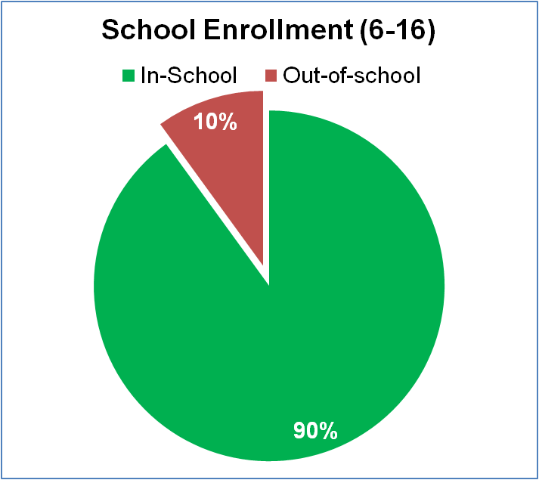
Enrollment in Mandi Bahauddin

Slide 13
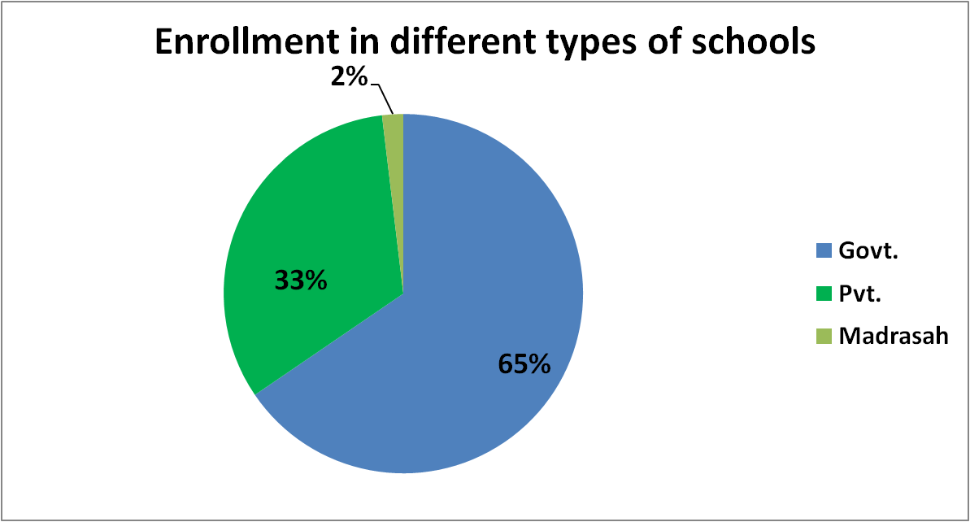
Enrollment in Mandi Bahauddin

Slide 14
Enrollment (Ranking)
DISTRICT | % OF OUT OF SCHOOL CHILDREN | RANK
Narowal | 4.5 | 3
Gujrat | 6.0 | 4
Gujranwala | 6.2 | 5
Mandi Bahuddin | 10.3 | 10
Hafizabad | 10.8 | 11
Sheikhupura | 12.8 | 13
Mandi Bahauddin is at 10th position in district ranking!

Slide 15
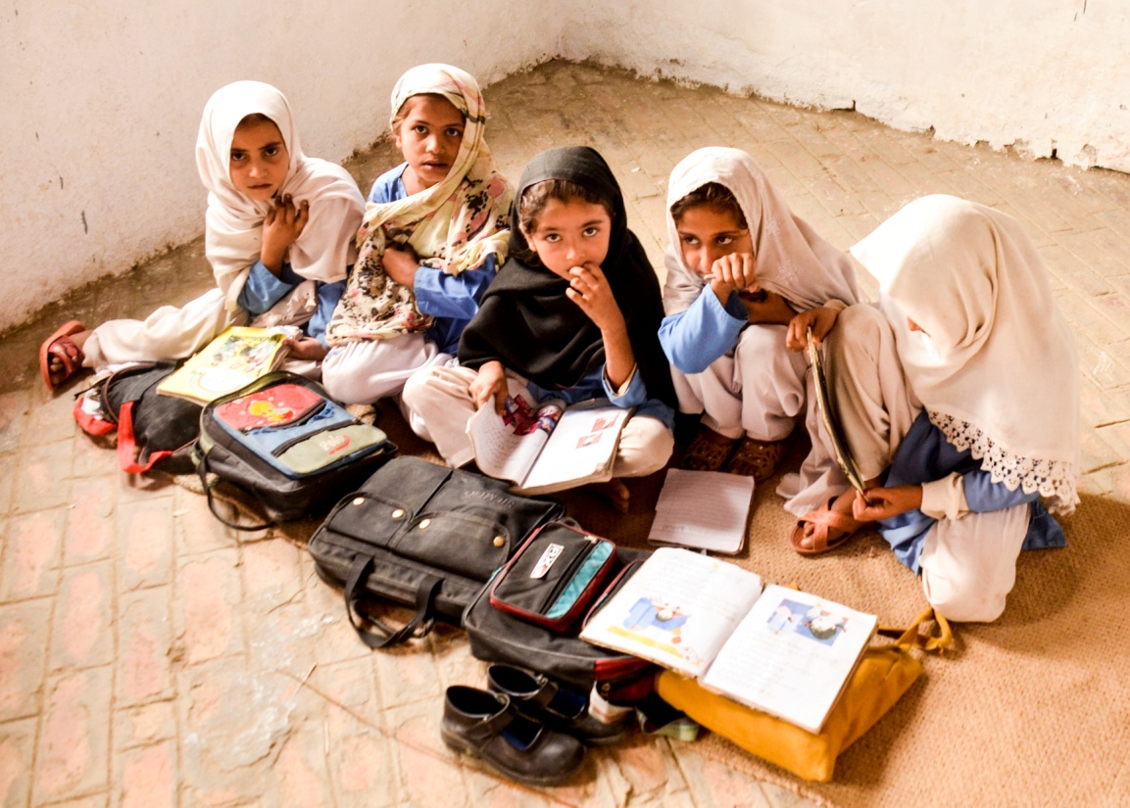
Quality Education?
What are children learning in
schools?

Slide 16
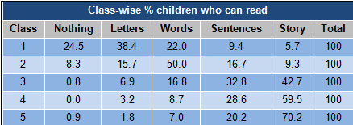
LEARNING LEVEL - URDU
30% Children in class 5 cannot read story (text of class 2) . In other words, 30% children are behind 3 classes with respect to their competency level.

Slide 17
LEARNING LEVEL – URDU (Ranking)
Mandi Bahauddin is at 18th position in district ranking (URDU)!
DISTRICT | % Children who can read URDU Stories in Class 5 | RANK
Narowal | 80.8 | 1
Gujrat | 72.5 | 11
Sheikhupura | 71.0 | 15
Hafizabad | 70.4 | 17
Mandi Bahuddin | 70.2 | 18
Gujranwala | 55.4 | 31

Slide 18
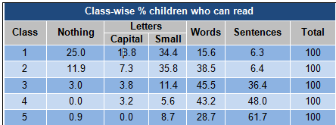
ENGLISH
38% Children in class 5 cannot read sentences (text of class 2) . In other words, 38% children are behind 3 classes with respect to their competency level.

Slide 19
ENGLISH (Ranking)
Mandi Bahauddin is at 20th position in district ranking (English)!
DISTRICT | % Children who can read English sentences In Class 5 | RANK
Narowal | 78.2 | 2
Sheikhupura | 68.5 | 12
Gujrat | 66.9 | 15
Mandi Bahuddin | 61.7 | 20
Hafizabad | 53.5 | 28
Gujranwala | 39.4 | 35

Slide 20
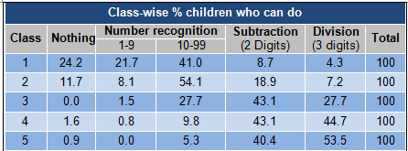
MATH
47% Children in class 5 cannot do division (3 digits by 1 digit) . In other words, 47% children are behind 2 classes with respect to their competency level in math

Slide 21
MATH (Ranking)
Mandi Bahauddin is at 21st position in district ranking (MATH)!
DISTRICT | % Children who can do 3 Digits Division in Class 5 | RANK
Narowal | 69.9 | 4
Sheikhupura | 56.9 | 16
Gujrat | 56.5 | 17
Mandi Bahuddin | 53.5 | 21
Hafizabad | 52.5 | 24
Gujranwala | 40.6 | 32

Slide 22
RANKING OF DISTT. Mandi Bahauddin (Summary)
Sr. No. | Indicator | % | Rank
1 | Out of School Children | 10.3 | 10
2 | Urdu Readings | 70.2 | 18
3 | English Readings | 61.7 | 20
4 | Arithmetic learning | 53.5 | 21

Slide 23
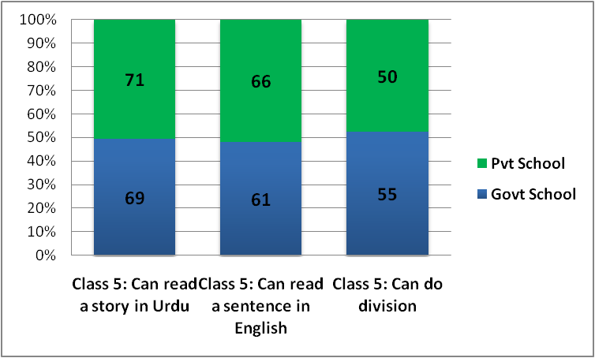
LEARNING LEVELS - PUBLIC vs. PVT SCHOOLS
Comparing Learning Levels of Private and Public Schools
69% of class 5 students in Public Schools and 71% in Pvt. Schools can read story in Urdu.
61% of Class 5 students in Public Schools while 66% in Pvt. Schools can read sentences in English.
Totally 55% of Class 5 students in Public while 50% in Pvt. Schools can do 3 digits division

Slide 24
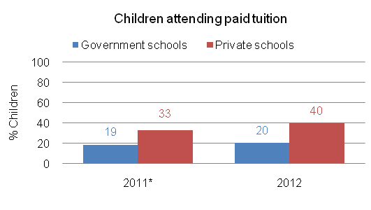
Private Supplementary Tuition?
Class-wise % children attending paid tuition
Type | I | II | III | IV | V | VI | VII | VIII | IX | X
Govt. | 9.3 | 13.7 | 17.9 | 20.9 | 15.9 | 31.7 | 25.0 | 32.3 | 32.0 | 40.7
Pvt. | 28.6 | 41.9 | 53.1 | 35.9 | 50.0 | 54.5 | 42.9 | 40.9 | 63.6 | 42.9
40% Children from Pvt. And 20% Children from Public Schools are attending Paid Tuition.

Slide 25
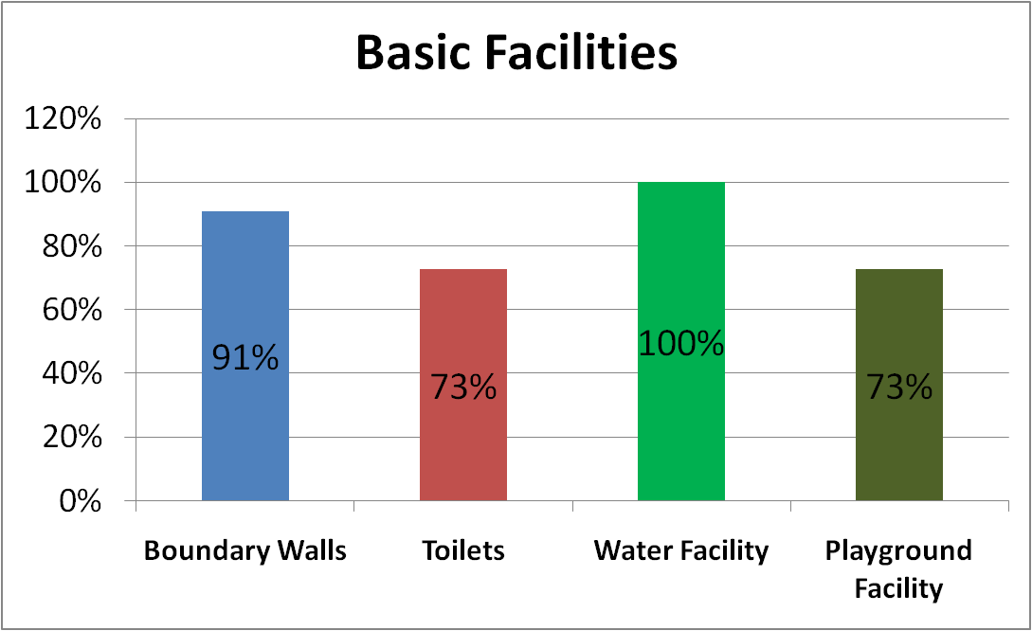
Basic Facilities in Govt. Primary Schools

Slide 26
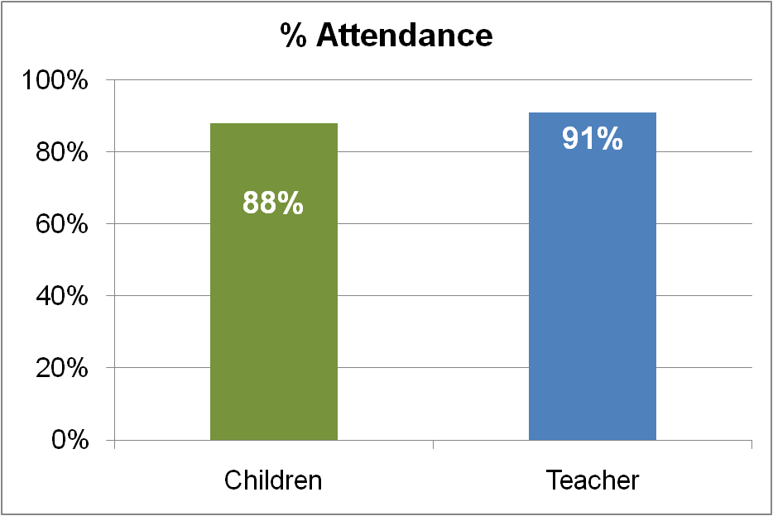
Attendance in Government Schools

Slide 27
What are children learning in
Mandi Bahauddin schools?
Mandi Bahauddin when compared to all the districts of Punjab the learning levels are not good in all three fields.
Mandi Bahauddin does not come in top 10 districts in learning levels.

Slide 28
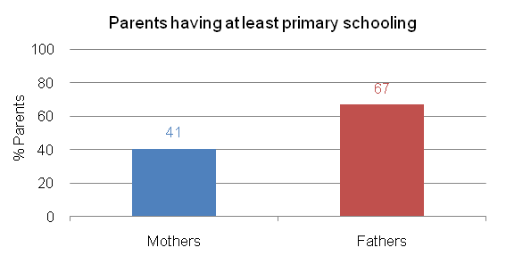
Parental Education
An important factor that influences learning levels
Only 41% Mothers have completed primary education in Mandi Bahauddin

Slide 29
How can ASER 2012 inform the planning, drafting, resourcing and implementation of 25-A?
ASER can help assess education with respect to :
Quality
Availability/Access
Equity
Planning according to district based assessment – generating District Report Cards (DRCs) linked to the Roadmap to Reforms and/or Sector Plans of the Provincial Governments.
Holding ASER Baithaks in ASER survey villages, parents, communities with parliamentarians and political holding ALL to account for ACTION! Continued Dialogues with Parliamentarians and Politicians in 2013 for elections, manifestoes and actionable steps that can be tracked
Linking the ASER information to national data and GMR /UN Human Development Reports /others in the run up to 2015 & post 2015 debates
Milestone achievement:“The Right to Free and Compulsory Education Act 2012”

Slide 30
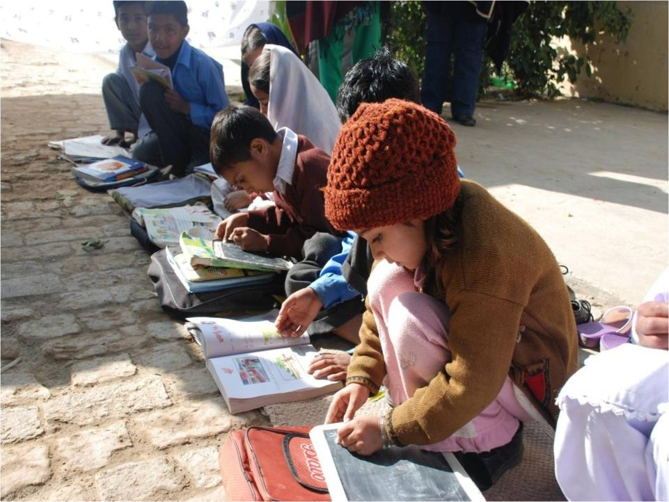
Discussion

Slide 31
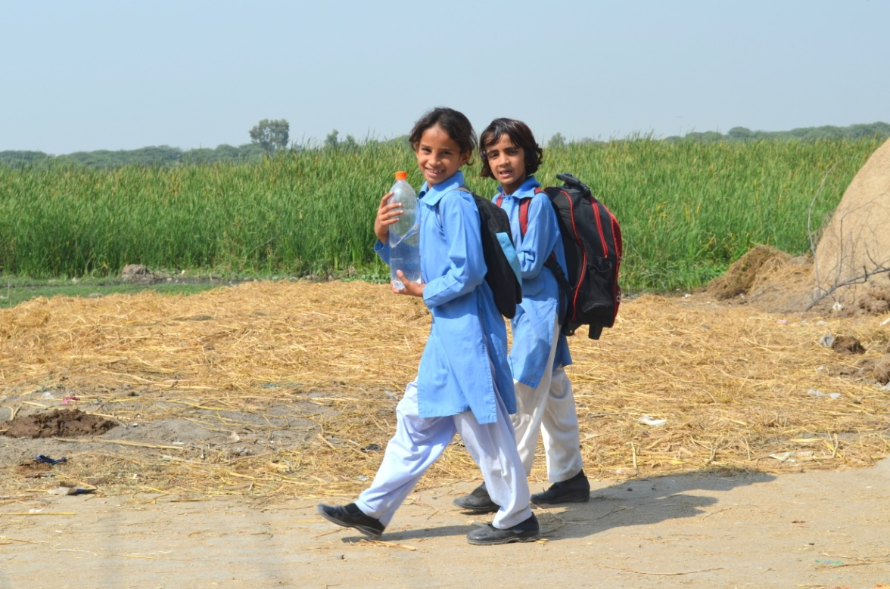
Thank You
You can follow us on
www.aserpakistan.org
ASER-Pakistan
ASERPAKISTAN

