Slide 1

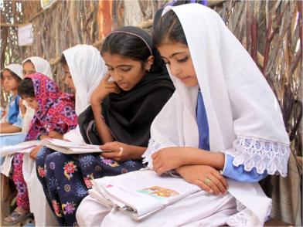
ANNUAL STATUS OF EDUCATION REPORT
ASER-PAKISTAN - 2011
ANNUAL STATUS OF EDUCATION REPORT
ASER-PAKISTAN - 2011
Date - - - - - - - -

Slide 2
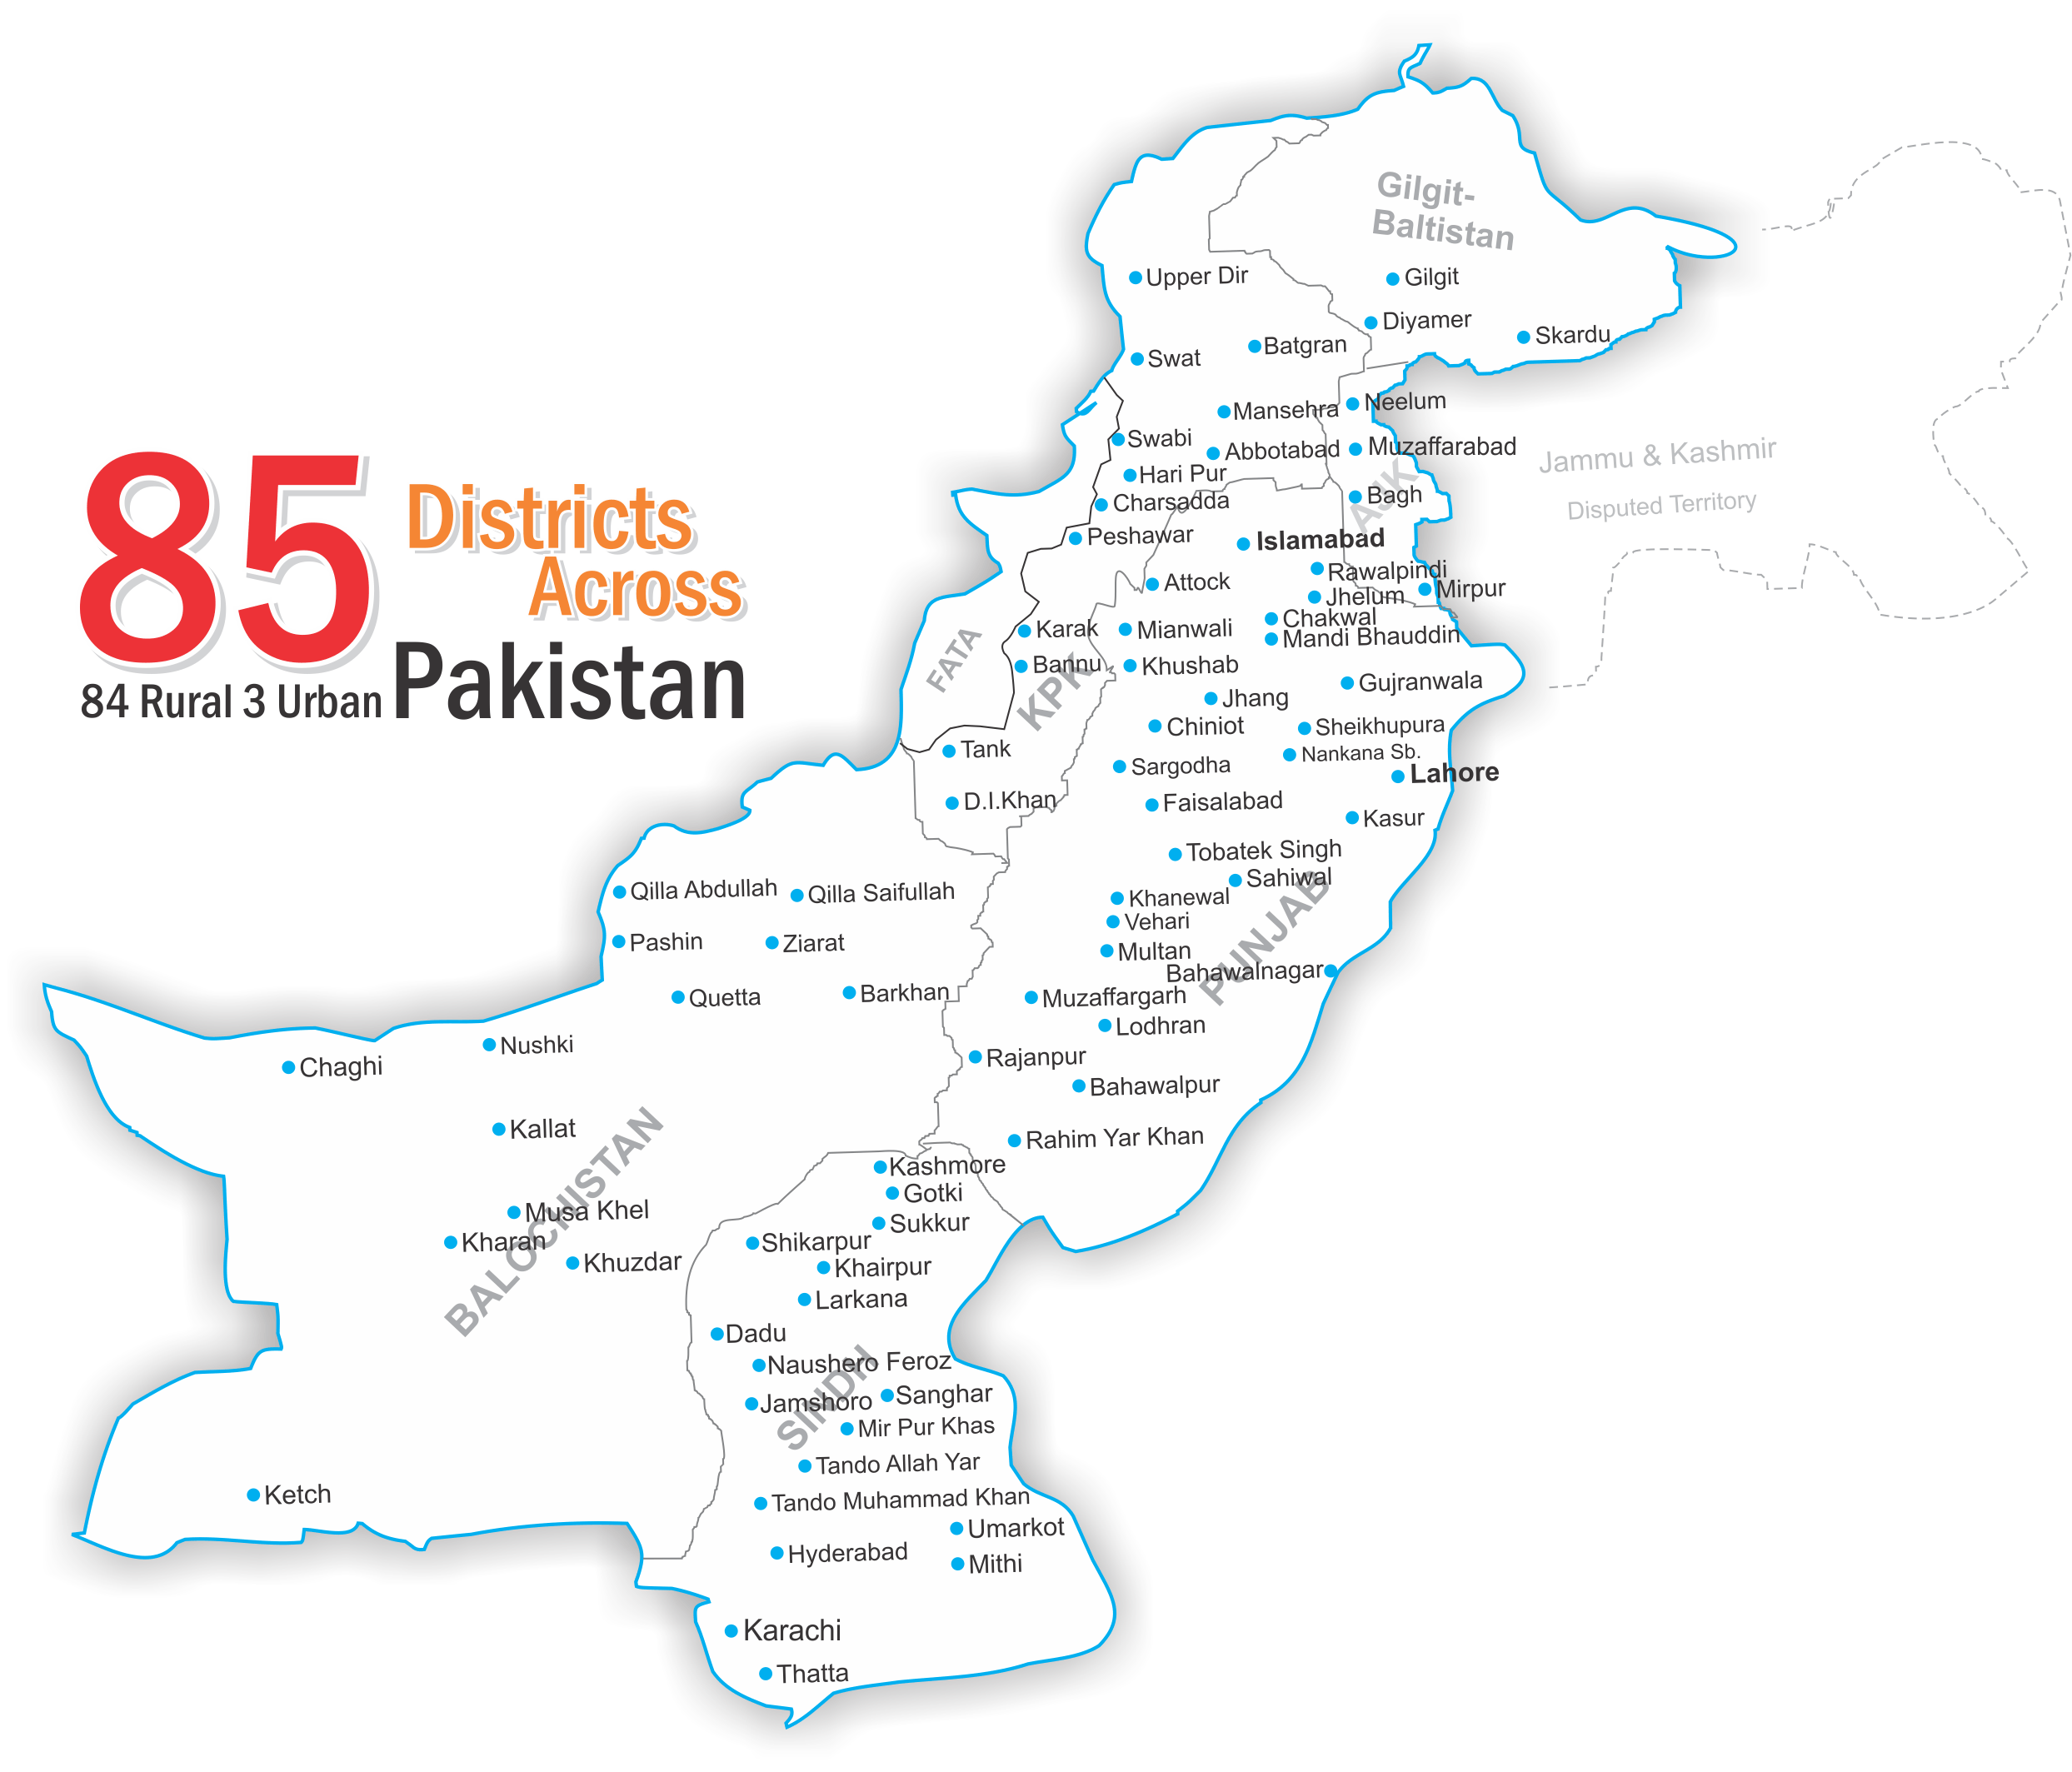

Slide 3
ASER PAKISTAN 2011
ASER- Annual Status of Education report is a survey of the quality of education.
ASER seeks to fill a gap in educational data by looking to provide a reliable set of data at the national level, that is comprehensive and at the same time, easy to understand.
ASER is a citizen led survey and it is conducted with the help of Govt., Civil Society Organizations and some other stakeholders working in education sector.

Slide 4
ASER PAKISTAN 2011
To get reliable estimates of the status of children’s schooling and basic learning (reading and arithmetic level) at the district level.
To measure the change in these basic learning and school statistics from last year.
To interpret these results and use them to affect policy decisions at various level.

Slide 5
FOCUS OF ASER
How well our children learn?
What are the competencies of our children in Urdu, English & Math?
The test conducted for the said assessment are up to class II & III level designed from their textbooks.

Slide 6
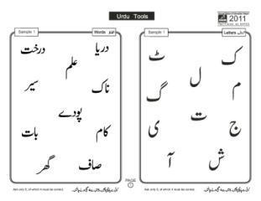
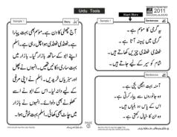
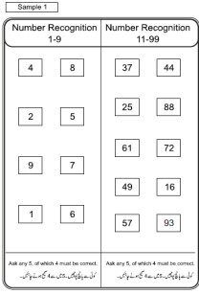
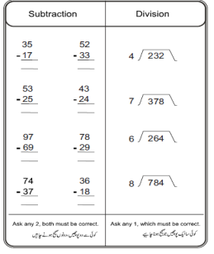
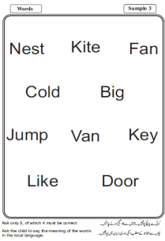
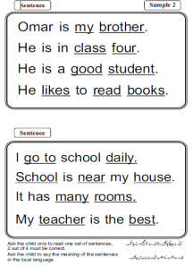
ASSESSMENT TOOLS

Slide 7

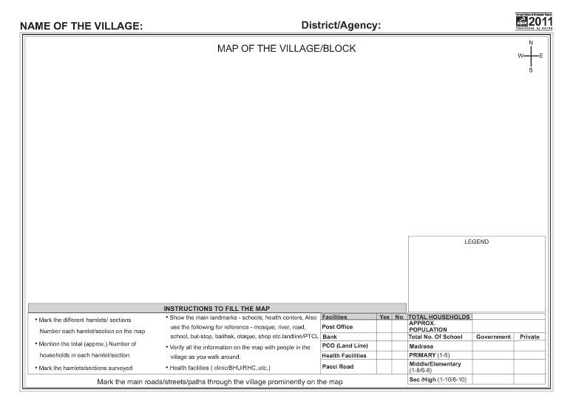
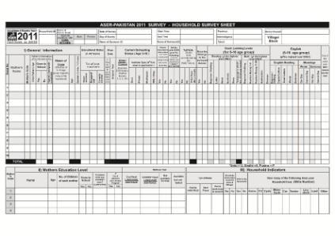

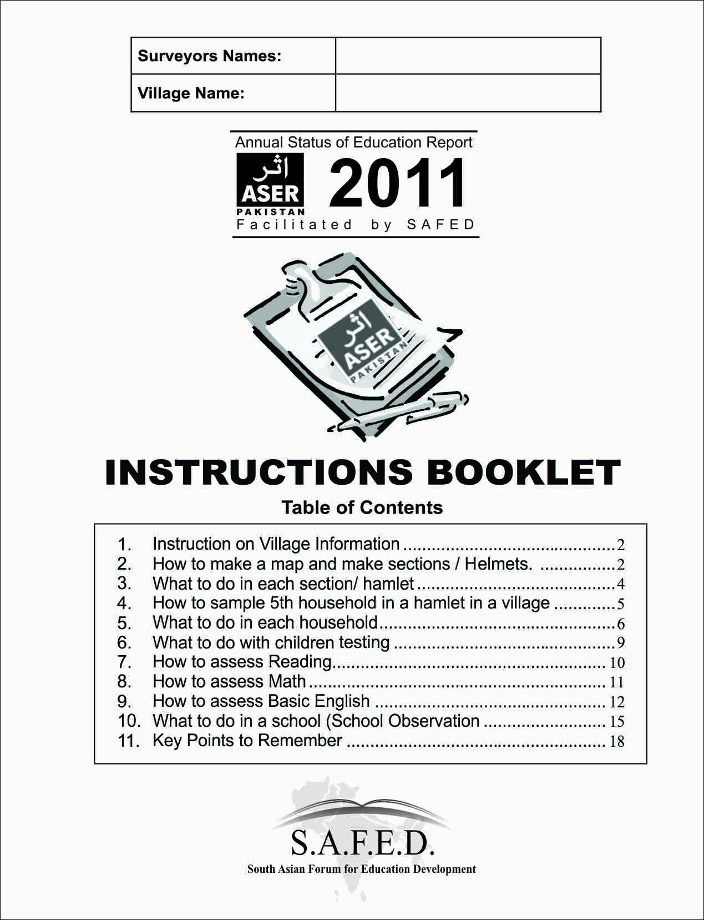
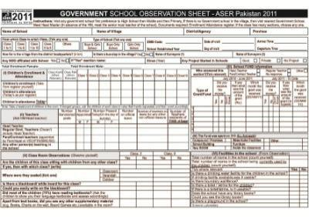
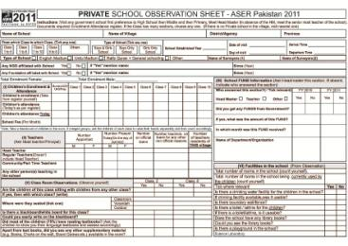
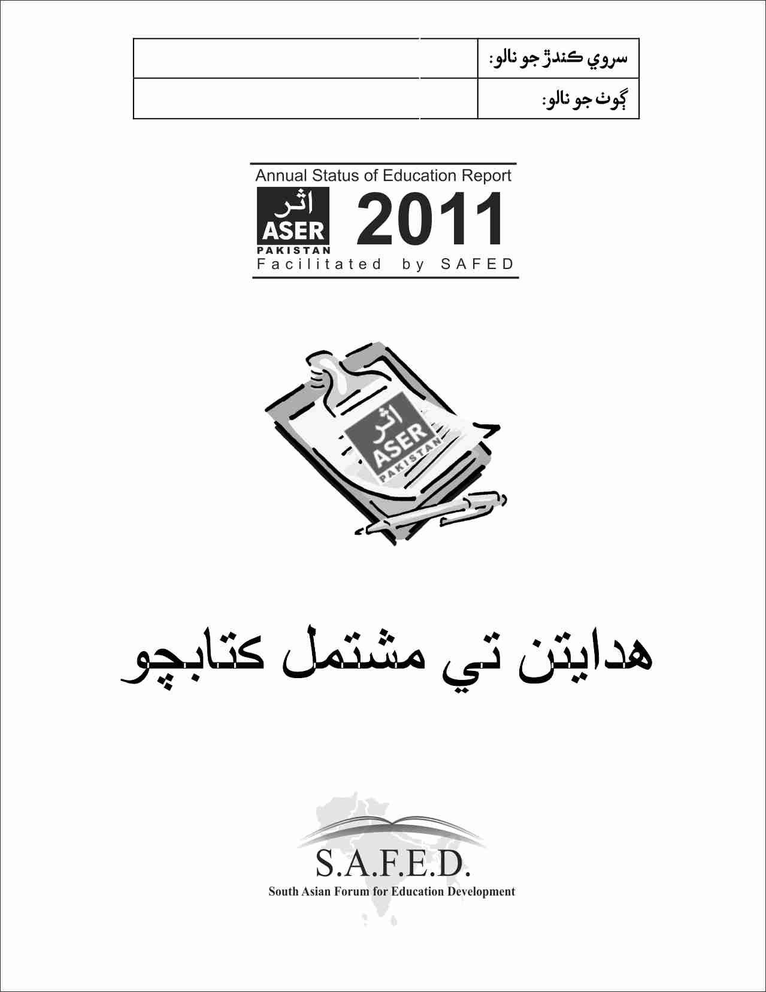


Slide 8

Scale of Survey
Coverage : Across Pakistan
Phase I : Year I 2010 – 32 districts across Pakistan
Phase II: Year II 2011 – 85 districts across Pakistan
(84 Rural + 3 Urban /2 overlap with rural districts)
Punjab : 28 districts in 2011 compared to 15 Districts in 2010
Sample: 600 households per district. Two-stage stratified sample;
30 Villages
20 Households per village
60 Schools per district
2 Schools per village (1 Govt. & 1 Private school)

Slide 9
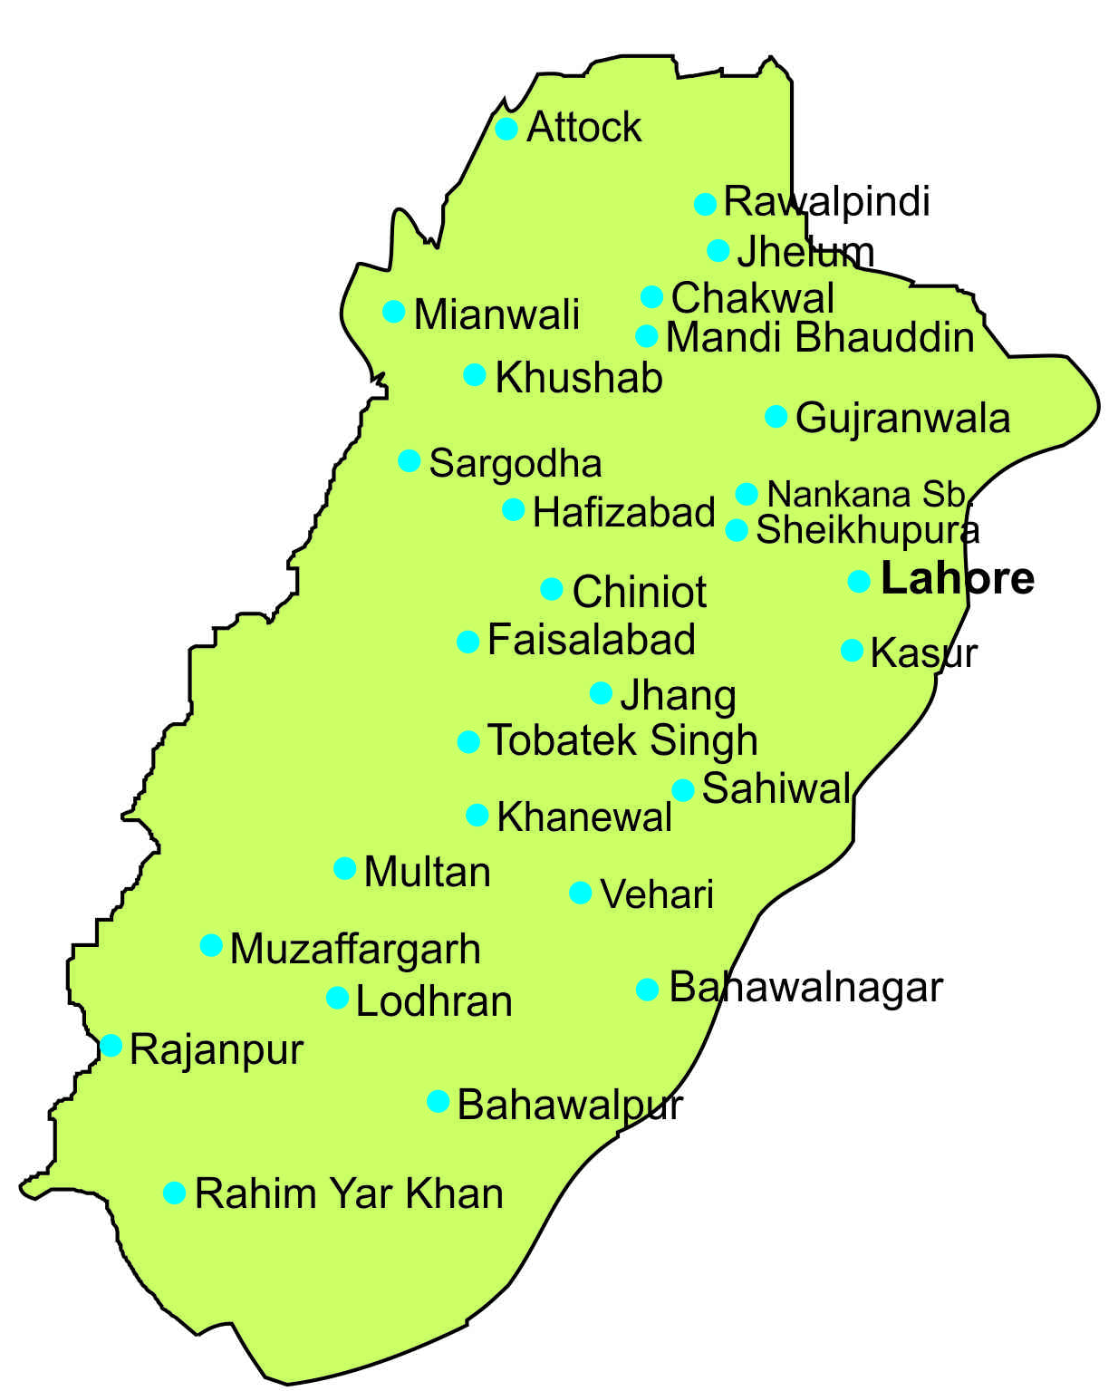
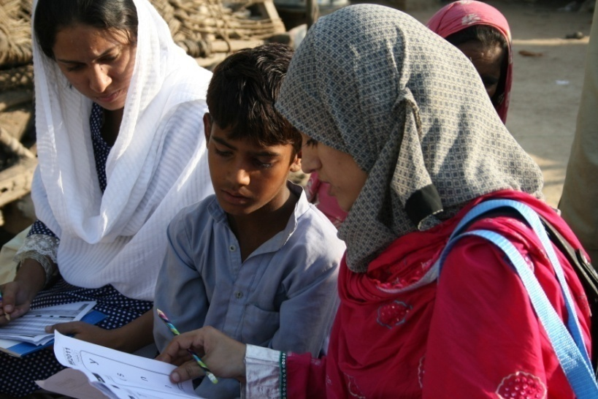
28 Districts Surveyed in Punjab

Slide 10

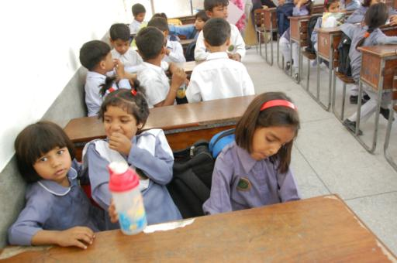
ASER Sahiwal

Slide 11

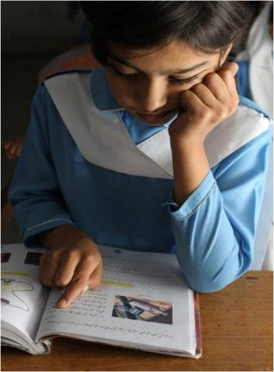
Access
What are our children doing?

Slide 12
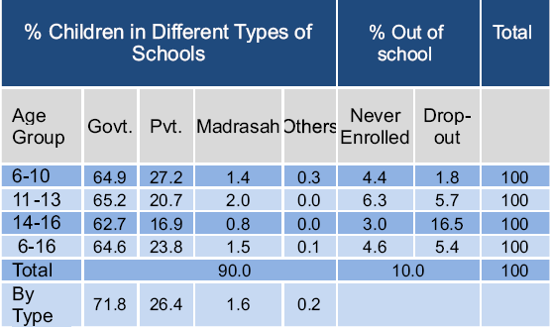
Enrollment in Sahiwal
Enrollment of Sahiwal as compared to some other districts in the Southern Punjab is better.

Slide 13
Enrollment
DISTRICT | % OF OUT OF SCHOOL CHILDREN | RANK
T.T. Singh | 7.9 | 4
Sahiwal | 10 | 9
Faisalabad | 12 | 11
Lahore | 15 | 15
Khanewal | 16 | 17
Jhang | 16 | 18
Every 9th child in Sahiwal is not in school!

Slide 14
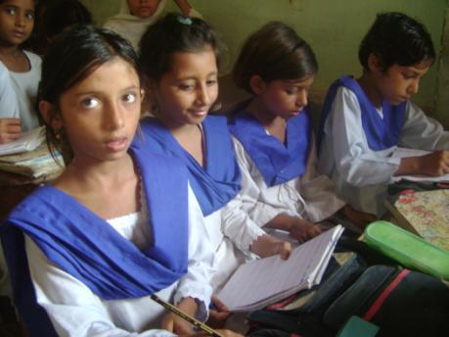
Quality Education ?
What are children learning in Sahiwal
schools?

Slide 15
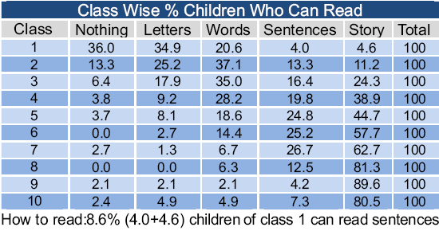
LEARNING LEVEL - URDU
55% Children in class 5 cannot read story (text of class 2) . In other words, 55% children are behind 3 classes with respect to their competency level

Slide 16
LEARNING LEVEL - URDU
55% children in Sahiwal
cannot read class 2 Urdu text (5-16 years)
DISTRICT | % Children who can read URDU Stories (5 Class) | RANK
Jhang | 72.40 | 4
Khanewal | 70.80 | 5
Faisalabad | 63.30 | 13
T.T.Singh | 57.80 | 21
Sahiwal | 44.70 | 26

Slide 17
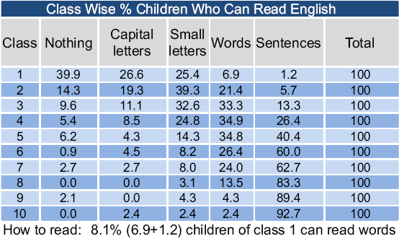
ENGLISH
60% Children in class 5 cannot read sentences (text of class 2) . In other words, 60 % children are behind 3 classes with respect to their competency level.

Slide 18
ENGLISH
60% children in Sahiwal cannot read class 2 English text
DISTRICT | % Children who can read English sentences (5 Class) | RANK
Khanewal | 61.10 | 1
Faisalabad | 58.50 | 3
T.T.Singh | 53.1 | 9
Sahiwal | 40.4 | 23
Jhang | 39.70 | 24

Slide 19
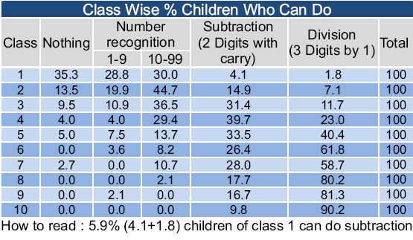
MATH
60% Children in class 5 cannot do division (3 digits by 1 digit) . In other words, 60% children are behind 2 classes with respect to their competency level in math

Slide 20
MATH
68% children in Sahiwal cannot do 3 digits division
DISTRICT | % Children who can do 3 Digits Division (5 Class) | RANK
Faisalabad | 39.2 | 3
Khanewal | 34.8 | 8
T.T. Singh | 34.6 | 9
Sahiwal | 31.7 | 13
Jhang | 24.6 | 23

Slide 21
LEARNING LEVELS - PUBLIC vs. PVT SCHOOLS
Comparing Learning Levels of
Private and Public Schools
41% of class 5 students in Public Schools 60% in Pvt. Schools can read story in Urdu.
38% of Class 5 students in Public Schools while 50% in Pvt. Schools can read sentences in English.
Totally 38% of Class 5 students in Public while 53% in Pvt. Schools ca do 3 digits division

Slide 22
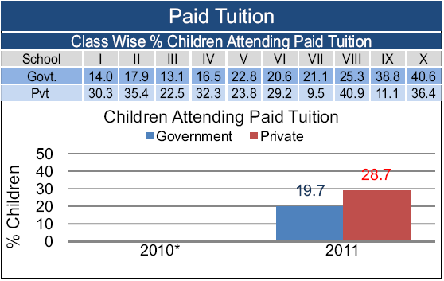
Private Supplementary Tuition?
29% Children from Pvt. And 20% Children from Public Schools are attending Paid Tuition.

Slide 23
RANKING OF DISTT. Sahiwal
amongst districts of Punjab
Sr. No. | Indicator | % | Rank
1 | Out of School Children | 10.0 | 9
2 | Urdu Readings | 44.70 | 26
3 | English Readings | 40.4 | 23
4 | Arithmetic | 31.7 | 13

Slide 24
What are children learning in
Sahiwal schools?
Sahiwal when compared to all the districts of Punjab the learning levels are really bad.
Sahiwal comes in the middle in learning levels in these subjects

Slide 25
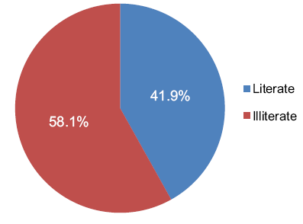
Mother’s Literacy
An important factor that influences learning levels
Only 42% Mothers are literate in Sahiwal
- out - Mothers are illiterate in Sahiwal

Slide 26
Attendance in Schools
 | Children Attendance on the day of visit
 | Government Schools
 | Primary | Elementary | High | Other | Total
% of Attendance (as per register) | 80 | 79 | 85 | - | 81
 | Teacher Attendance on the day of visit
 | Government Schools
 | Primary | Elementary | High | Other | Total
Teacher attendance (%) | 84 | 80 | 91 | - | 85

Slide 27
Available Facilities in Schools

Slide 28
Available Facilities in Schools

Slide 29
How far have we come on RTE compliance?
Article 25 - A
“The state shall provide free and compulsory education to all children of the age of five to sixteen years in such a manner as may be determined by Law”

Slide 30
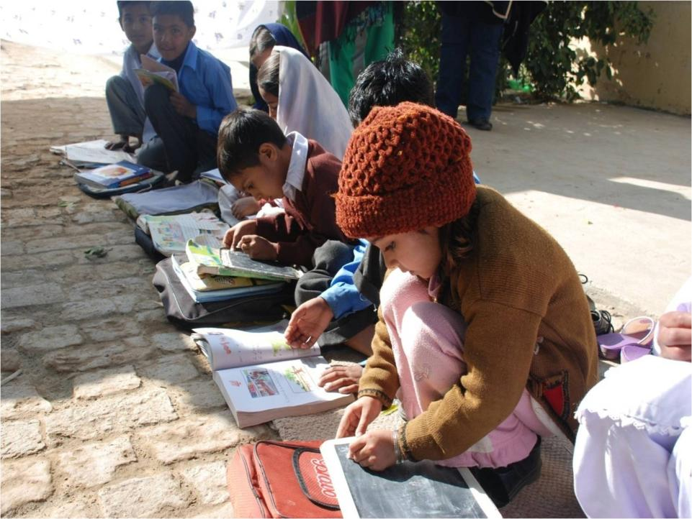
Discussion

Slide 31
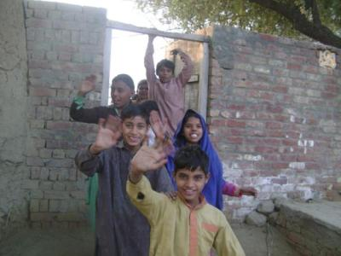
For more information visit: www.aserpakistan.org
Email: safedafed@gmail.com

