Slide 1
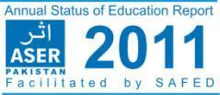
t
Balochistan Launch – 29 March 2012

Slide 2
ASER PAKISTAN 2010-2015
ASER - The Annual Status of Education Report (ASER) is a citizen led large scale national household survey about the quality of education in rural and some urban areas of Pakistan. Inspired by the ASER India & East Africa UWEZO methodology it seeks to fill in a gap on learning outcomes by providing a reliable set of data at the national level on an annual basis, that is comprehensive and easy to understand. The survey’s objectives are three fold:
To get reliable estimates of the status of children’s schooling and basic learning (reading and arithmetic skills)
To measure the change in these basic learning and school statistics from last year
To interpret these results and use them to affect policy decisions at various levels.

Slide 3
Scale & Scope of Survey
Coverage : In all five provinces i.e. Sindh, Balochistan, Punjab,
Khyber Pakhtoonkhwa, Gilgit Baltistan, and FATA & AJK.- Rural
Phase I : Year I 2010 – 32 districts across Pakistan
Phase II: Year II 2011 – 85 districts across Pakistan (84 Rural + 3 Urban /2 overlap with rural districts)
Phase III : Years III, IV , V all districts across Pakistan (138 districts)
Sample: 600 households per district. Two-stage stratified sample;
30 Villages will be selected randomly using the village directory of the latest Census. The Probability Proportional to Size Sampling (PPS) technique will be adopted as an appropriate one when the sampling units are of different sizes.
20 households per village and in each village 1 govt. and 1 private school are surveyed

Slide 4
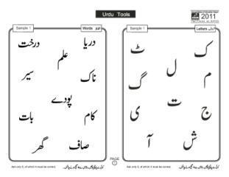
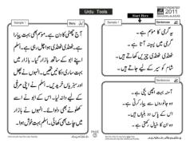
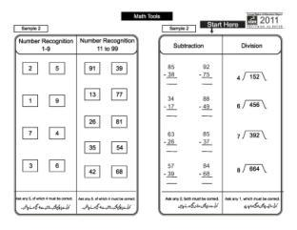
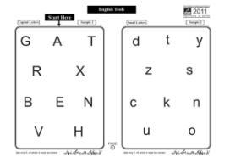
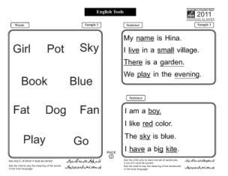
ASER Pakistan Assessment Tools Grade II
ASER Assessment tools are prepared in following Categories
Reading
Urdu
Sindhi Language
Arithmetic abilities
English

Slide 5
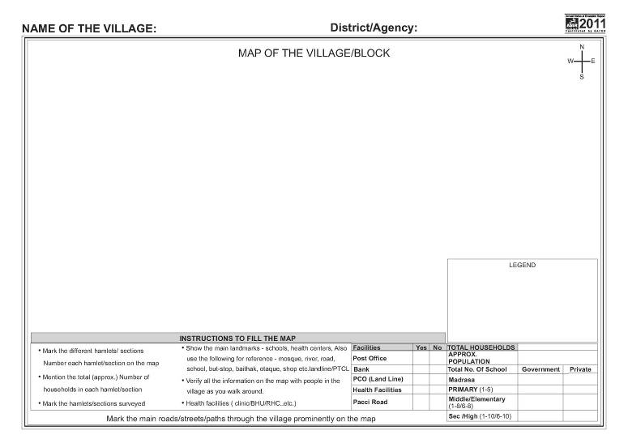
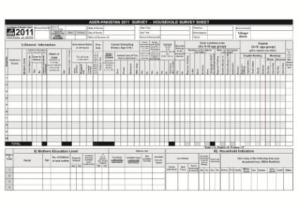
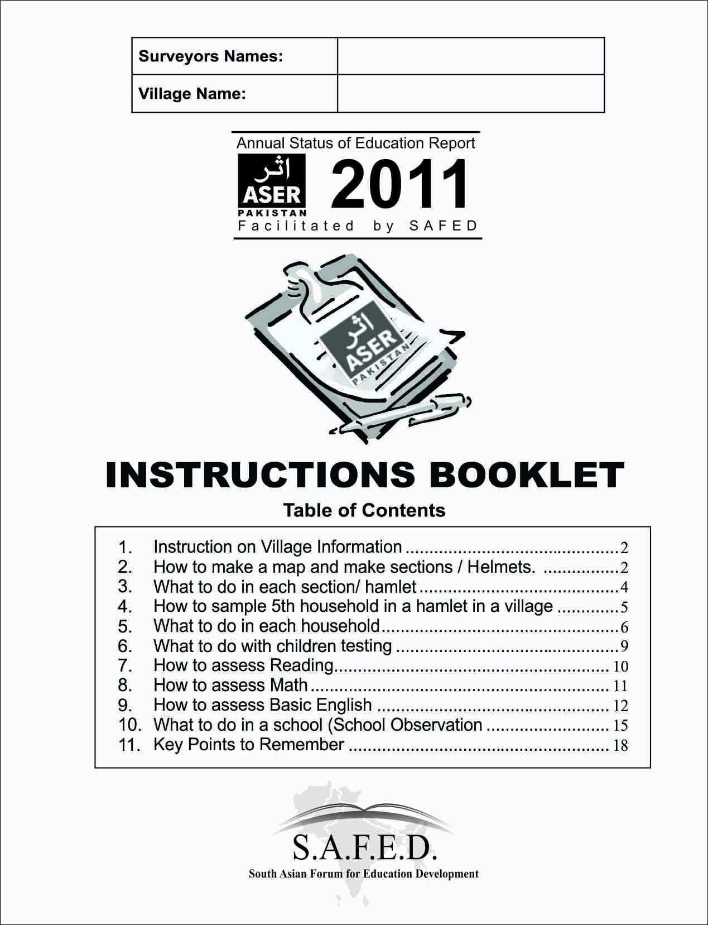
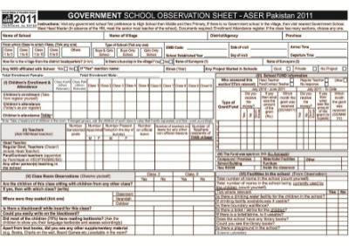
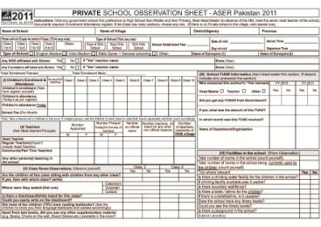
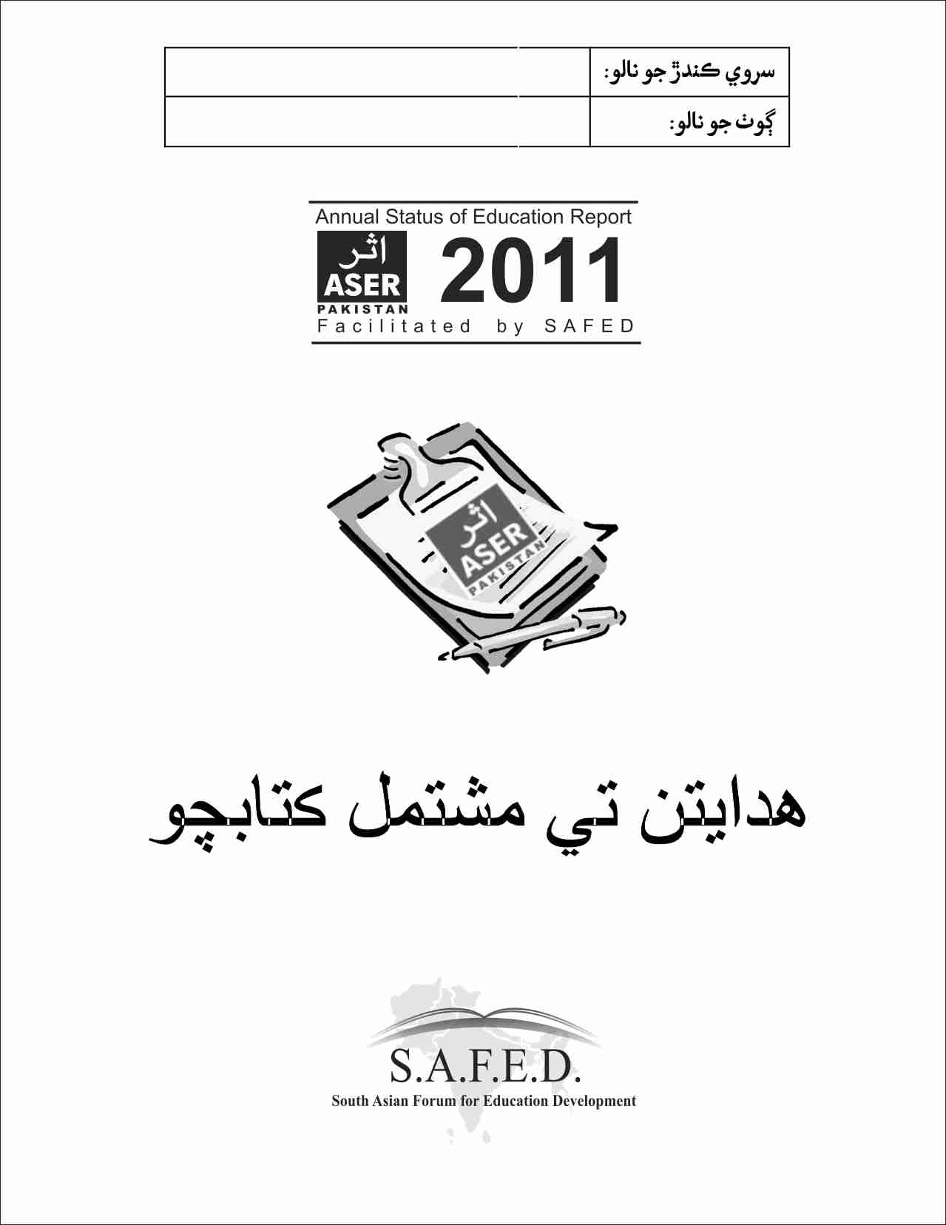
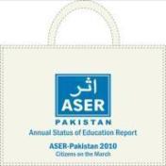

Slide 6
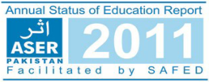
Section I: Scale of Survey

Slide 7
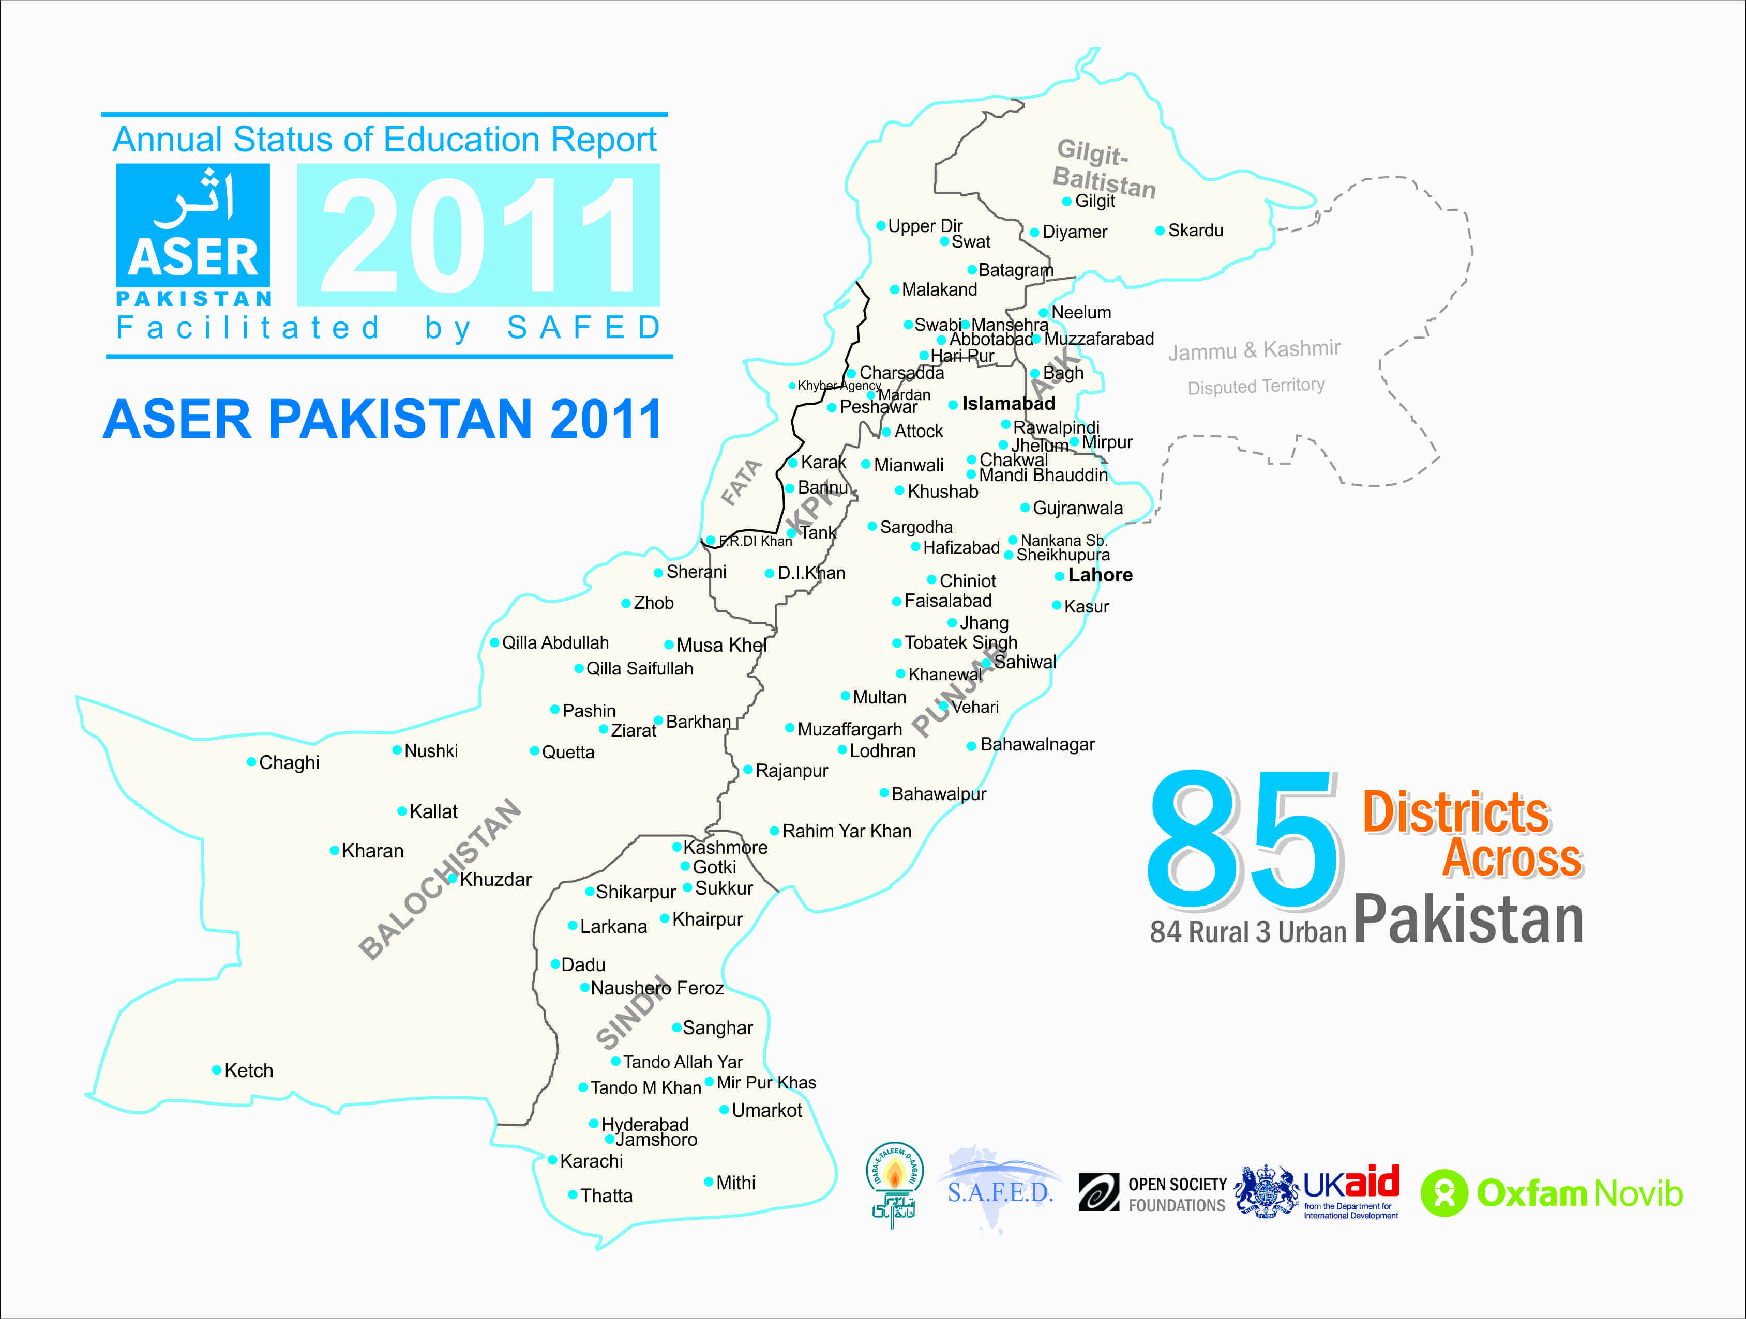
ASER 2011

Slide 8
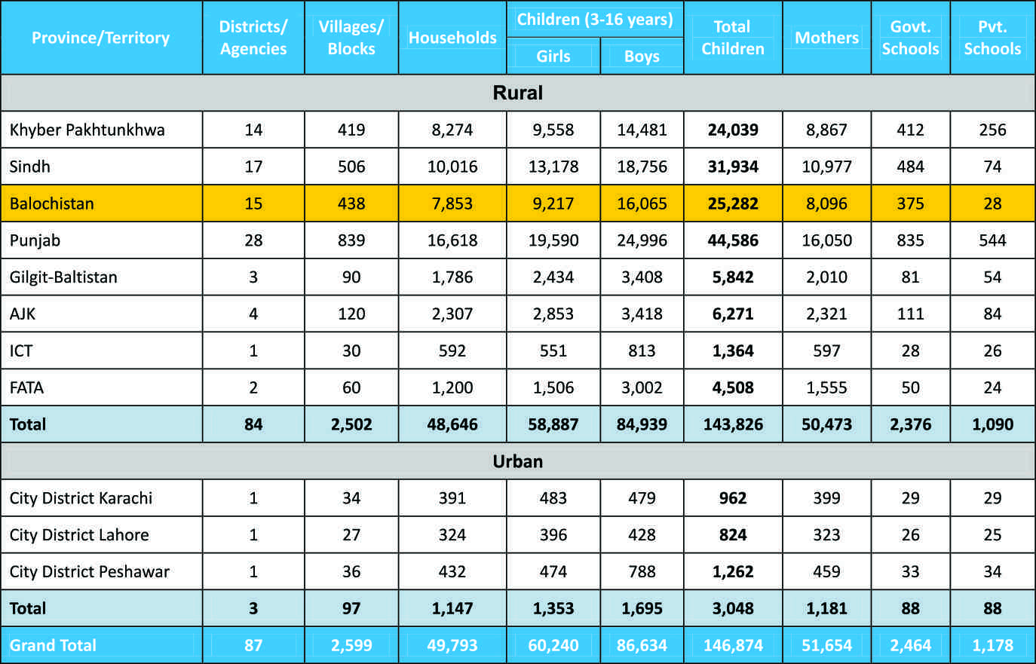
ASER 2011
Balochistan: 438 Villages, 7,853 Households, 25,282 Children, 8,096 Mothers and 375 Govt Schools & 28 Pvt Schools Surveyed

Slide 9
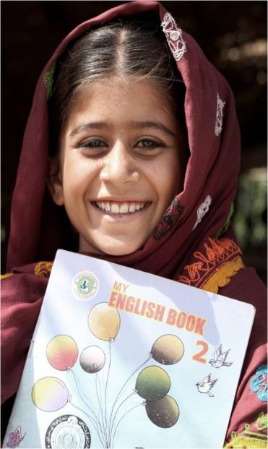
Scale:
Pilot Year in 2008 – 11 districts
2010 – 32 districts
2011 – 85 districts,
84 rural and 3 urban.
Balochistan
5 districts in 2010
15 districts in 2011

Slide 10
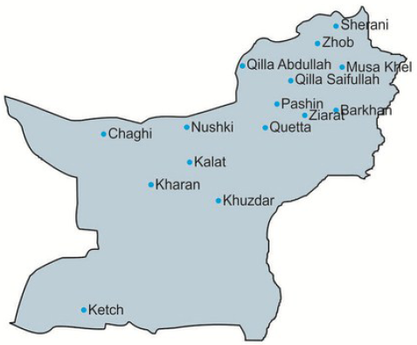
Source: PSLM Pakistan 2010-2011
15 Districts Surveyed in Balochistan
ASER 2011 Districts (15/30) | Literacy Rank **
Quetta * | 1
Kalat * | 6
Khuzdar | 7
Ziarat | 8
Pashin | 9
Qilla Abdullah | 11
Kharan | 12
Nushki | 13
Ketch | 16
Chaghi * | 18
Qilla Saifullah | 20
Zhob | 21
Sherani | 26
Musa Khel | 28
Barkhan * | 30
* Districts surveyed in 2010 and 2011
** Source: PSLM Pakistan 2010-2011

Slide 11
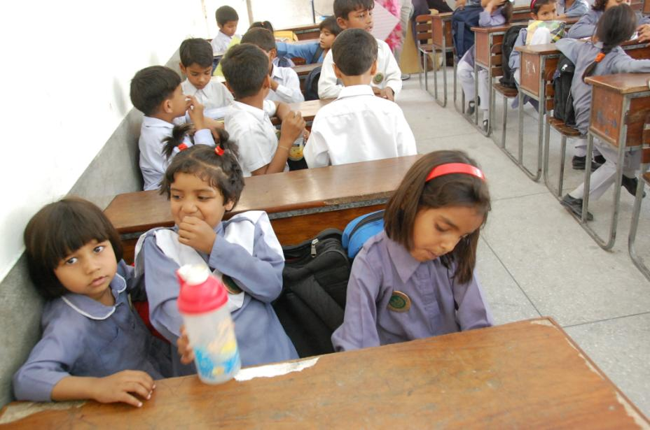
Section II : Access?

Slide 12
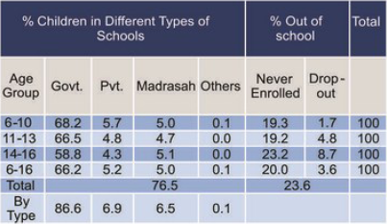
Enrollment (6-16 years)
76% of 6-16 year olds in rural Balochistan are enrolled in schools
Almost 24% of children are out of school
13% Rural children enrolled in private/non-state sector

Slide 13
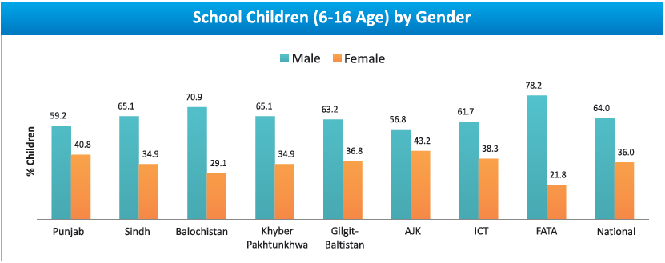
Inter-province Comparison
Enrollment
Enrollment for boys higher as compared to girls in all provinces

Slide 14
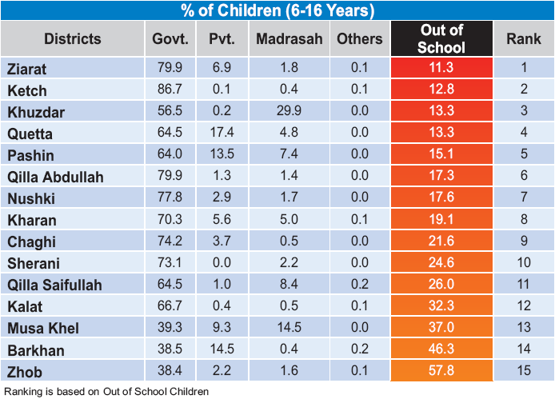
District Wise Enrollment
Among the 15 districts surveyed, Zhob has the highest number of out-of-school children (58%), followed by Barkhan (46%)
Ziarat has the lowest number of out-of-school children (11%)

Slide 15
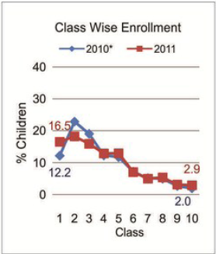
Class Wise Enrollment
Enrollment decreases sharply as class level increases

Slide 16
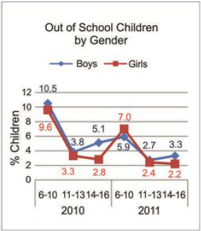
Out of school Children
significant gender gap for out of school children found for the age 6-10 and 14-16 years

Slide 17
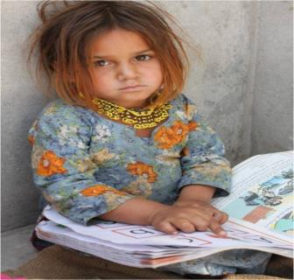
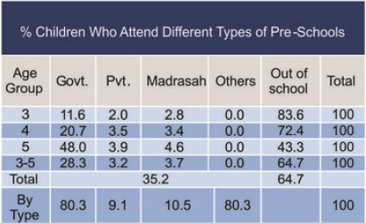
Pre-School Enrollment (3-5 Years)
Enrollment of children of 3 - 5 years was 35% in 2011
More than 80% of enrolled children are in government schools
Action : Early years need the best investment – the foundation years for future learning. Special attention and resources needed to increase enrollment with trained teachers and safe learning environment .

Slide 18
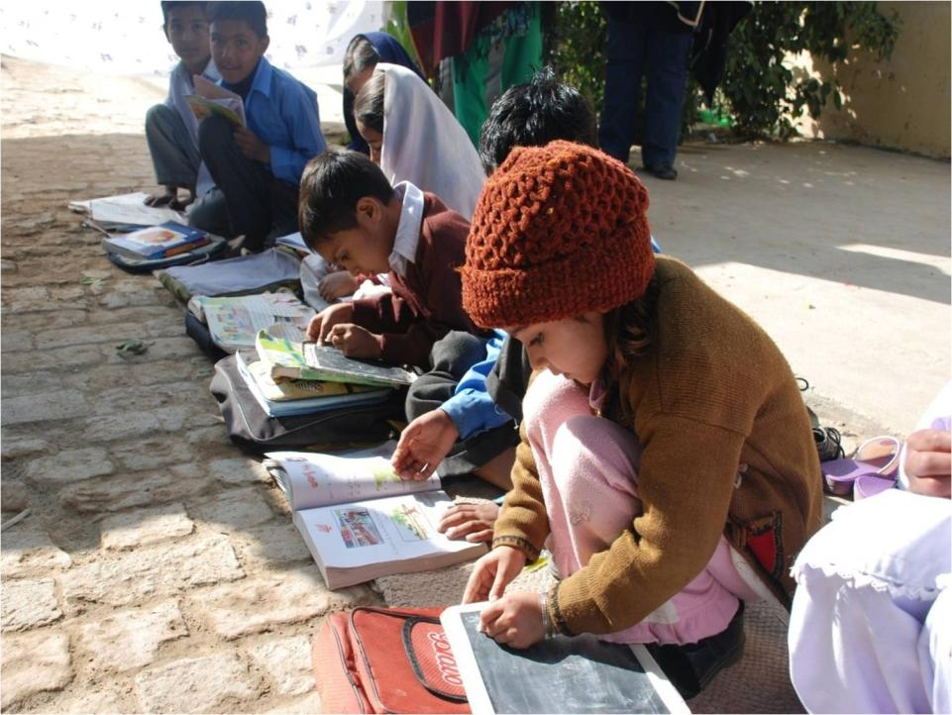
Section III:Quality?

Slide 19
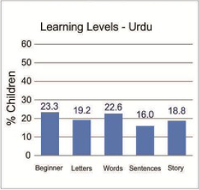
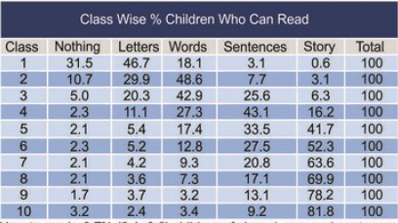
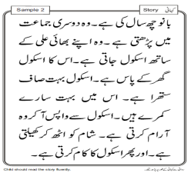
Learning levels – Urdu
58% of the children may complete primary level without learning how to read fluently in Urdu at grade II competencies
In Balochistan, Children enrolled in Class 3 have the worst performance in reading Urdu compared to other provinces
Std 2 level text

Slide 20
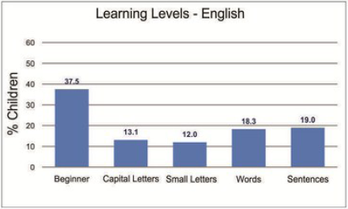
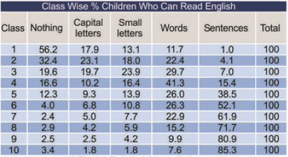
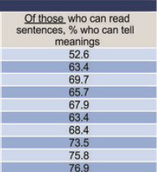
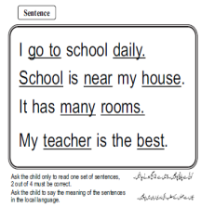
Leaning levels – English
More than 61% of the children may complete primary without learning how to read fluently in English at grade II competencies
in class 5, Only 68% of those who can read English understand the meaning
Std 2 level text

Slide 21
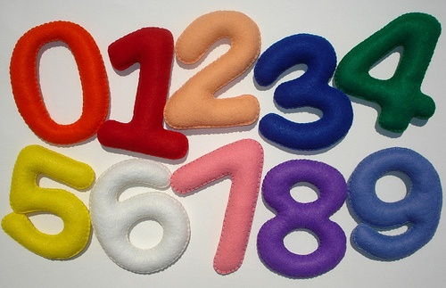
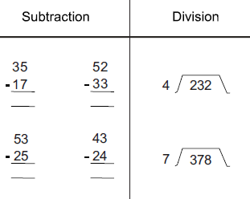
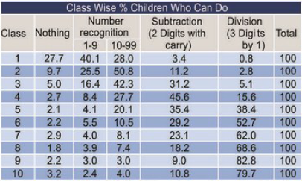
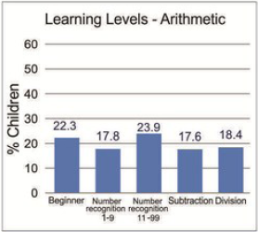
Basic Arithmetic levels
62% of the children may complete primary without learning how to do division at grade II competencies
Balochistan children of Class 3 have the poorest scores in Arithmetic, only 5%
Std 2 level

Slide 22
Learning levels
The consistently better districts in ALL three subjects include
Nushki
Quetta
Nushki ranks highest in Learning levels in ENGLISH and
ARITHMETICS
The consistently worse districts in ALL three subjects include
Chaghi
Khuzdar
Musa Khel

Slide 23
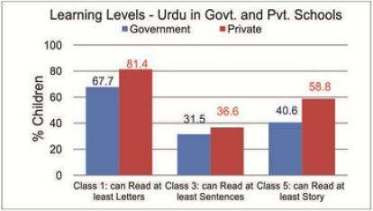
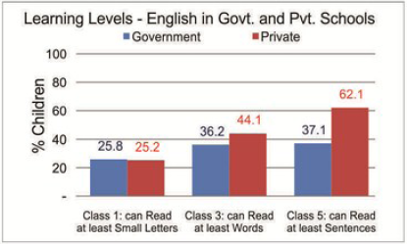
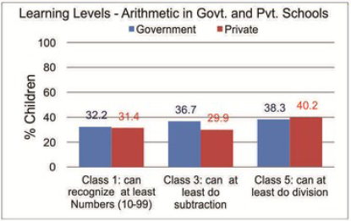
Learning levels – Public vs. Private
59% children in government and 41% children in private schools in class 5 are still unable to read a class 2 level Urdu text
63% of the children in Government schools and 38% of children in private schools may complete primary without learning how to read fluently in English at grade II competencies
62% of the children in Government schools and 60% of children in private schools in class 5 are still unable to do division
Reading levels better in Private schools for both English and Urdu

Slide 24
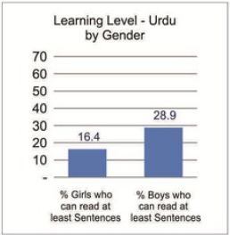
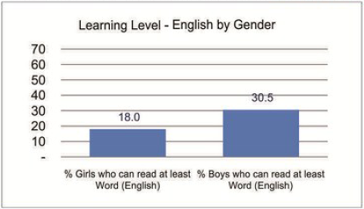
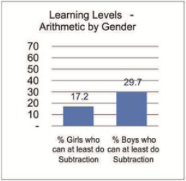
Learning levels – Boys vs. Girls
Learning levels better for boys in Urdu , English and Arithmetic

Slide 25
Learning Levels for Out of School Children in Punjab
33% of out-of-school children can read Letters in Urdu.

Slide 26
Section IV : Private Supplementary Tuition?

Slide 27
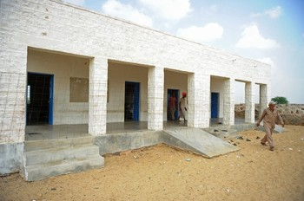
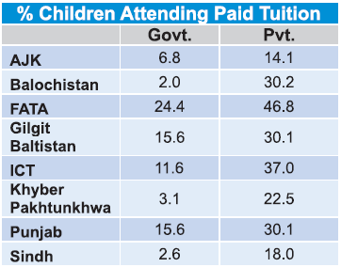
Additional learning support
In Balochistan 2% Government and 30% Private enrolled children take tuition
Rural

Slide 28
Section V : Attendance?

Slide 29
Attendance
Students “attendance as per register” higher compared to “attendance as per headcount” for both Govt. and Private schools
Teachers attendance lower in Government Primary schools (79%) than in Private primary schools (87%)
Overall better attendance in Private sector

Slide 30
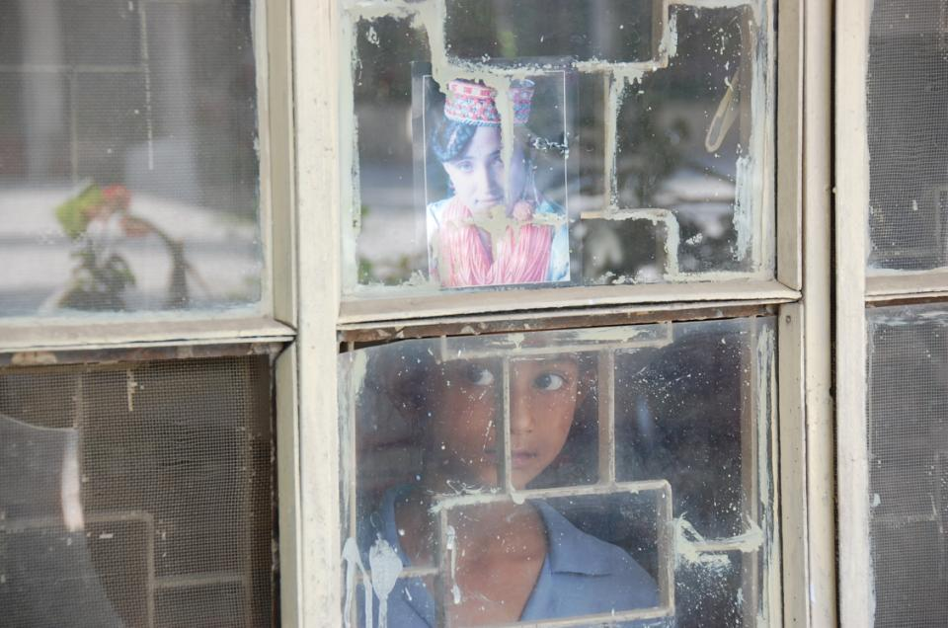
Section VI : Other dimensions that influence teaching and learning?

Slide 31
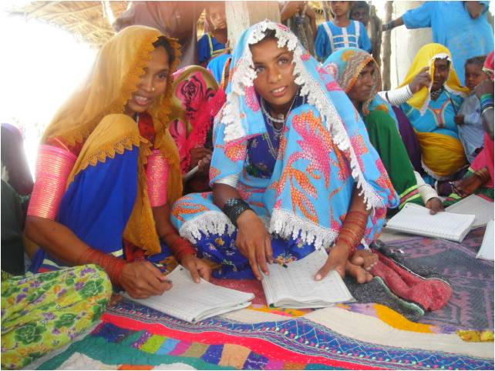
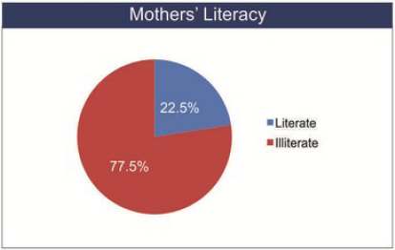
Mother’s Literacy
Percentage of Illiterate mothers
is 22% in Rural Balochistan
Balochistan has the 2nd lowest number of literate mothers when compared to other provinces

Slide 32
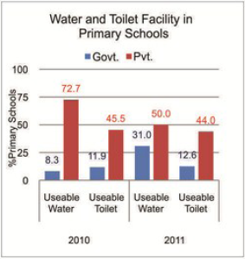
Basic Facilities – Toilet and Water
Missing Facilities
improved in
Govt. Schools
Since 2010
69% primary government schools still do not have useable water
87% primary government schools still no not have toilet facilities

Slide 33
Basic Facilities – Playground and Boundary Wall
More Boundary Walls in Govt. Schools since 2010
77% primary government school have a boundary wall

Slide 34
Multi-grade Classes
49% primary government schools children of class 2 sit with some other class and share teachers
What could cause this:
Missing Teachers or
lack of classrooms?

Slide 35
Section VIII: How far have we come on RTE compliance?
Article 25 A : “The state shall provide free and compulsory education to all children of the age of five to sixteen years in such a manner as may be determined by Law”

Slide 36
How can ASER 2011 inform the planning, drafting, resourcing and implementation of 25 A?
ASER can help assess education with respect to info. on:
Access
Quality
Equity
Planning according to district based assessment – generating District Report Cards (DRCs) linked to the Roadmap to Reforms initiative of the Govt. of Punjab.
Use of ASER data and teams for advocacy on Right to Education – focusing on gender & the excluded groups
Forming District RTE Vigilante Committees mobilizing coalitions, teachers, youth, media and bar associations.

Slide 37
For more information visit: www.aserpakistan.org
Email: safedafed@gmail.com

